Slide 1
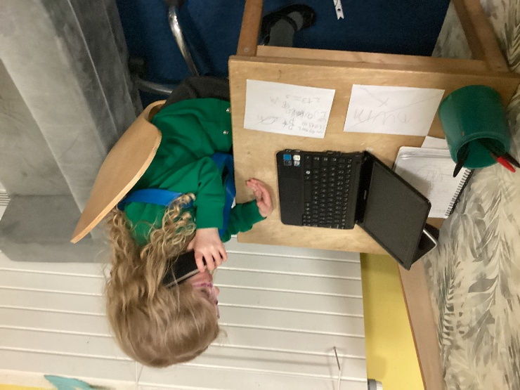
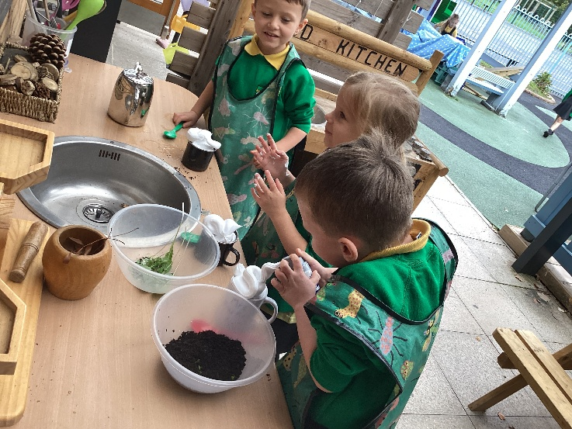
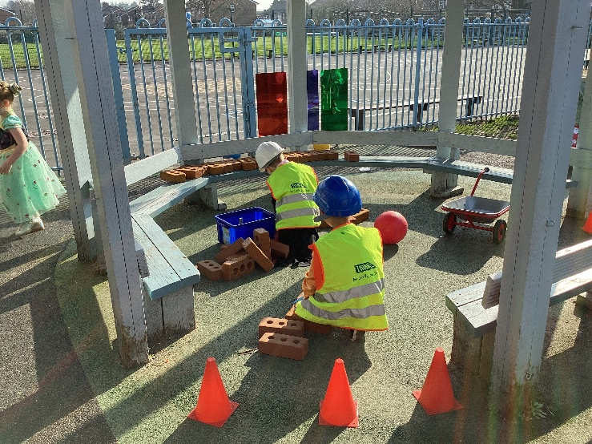
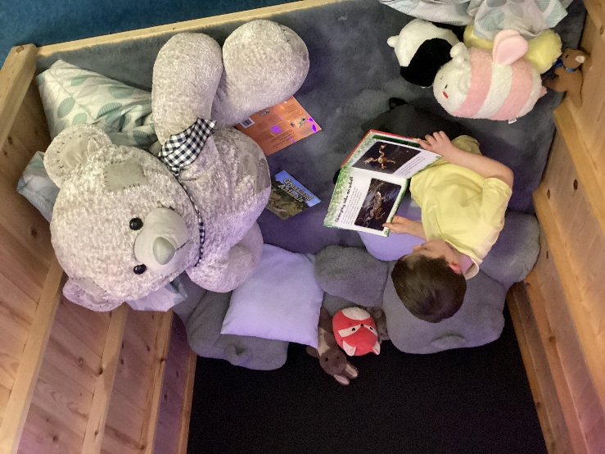
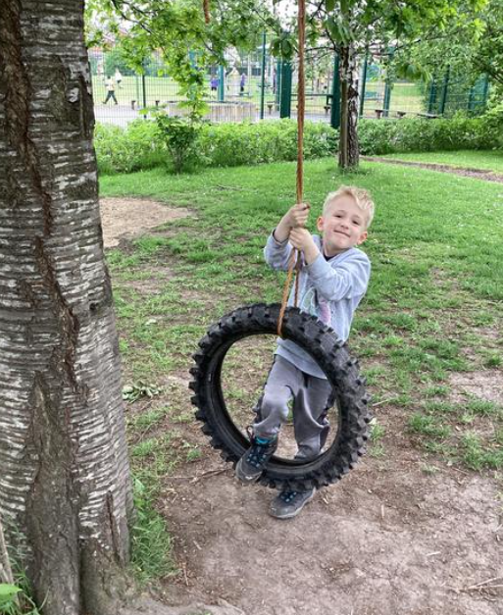
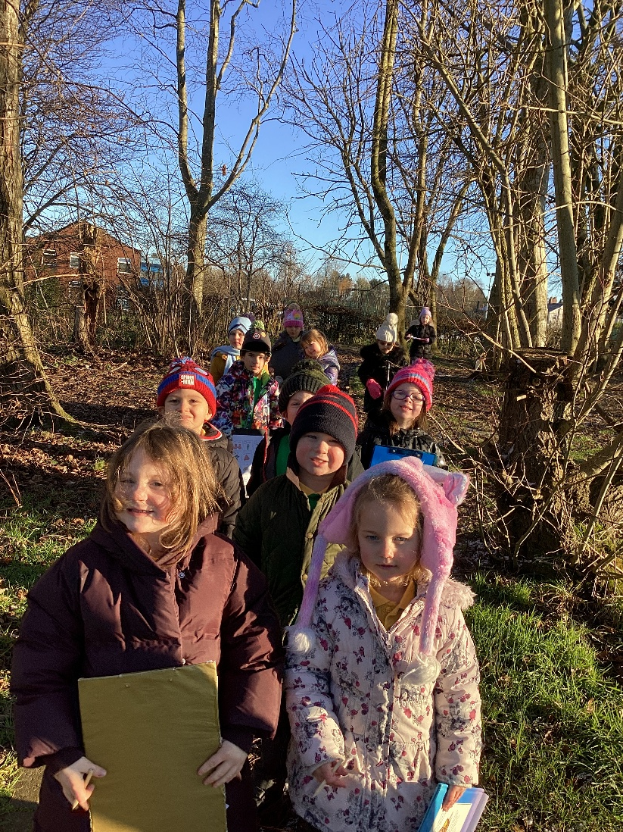
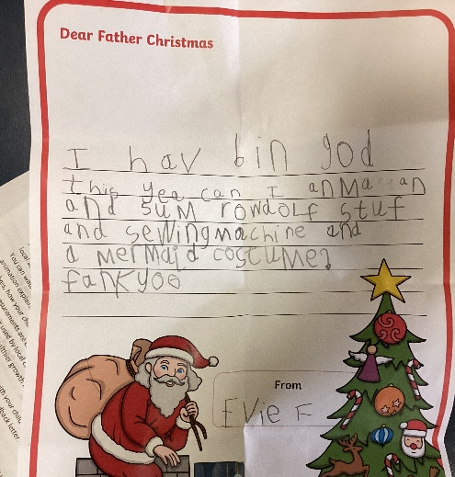

Welcome to Reception
Lostock Hall Community Primary School

Slide 2
The Reception Team
Mrs Webb: Headteacher
Mrs Alty: Acting EYFS Team Leader/DHT
Miss Berry: EYFS Team Leader/DHT
Miss Jones: SENDCo/Family Support Worker
Mrs Parker: Class teacher RP
Mrs Bell: Class teacher RB
Mrs Hesmondhalgh: Nursery Nurse RP
Miss Goldsmith: Nursery Nurse RB
Mrs Jamieson: Class RB & RP

Slide 3

Induction Timetable
Each child is allocated an Induction Group (A, B or C).
Non pre-school children start first, in age order, followed by our pre-school children.

Slide 4
Induction Diary Dates
Reception open day- Thursday 2nd July (see induction pack for times)
Home visits (non pre-school children) – Tuesday 1st & Wednesday 2nd September
Thursday 3rd September - induction process begins (Group A first - session until 1:30pm)
Tuesday 8th September – All children begin full-time sessions (doors open from 8:45 – 8.55am until 3.20pm)
Your child's induction group is in your induction pack.

Slide 5
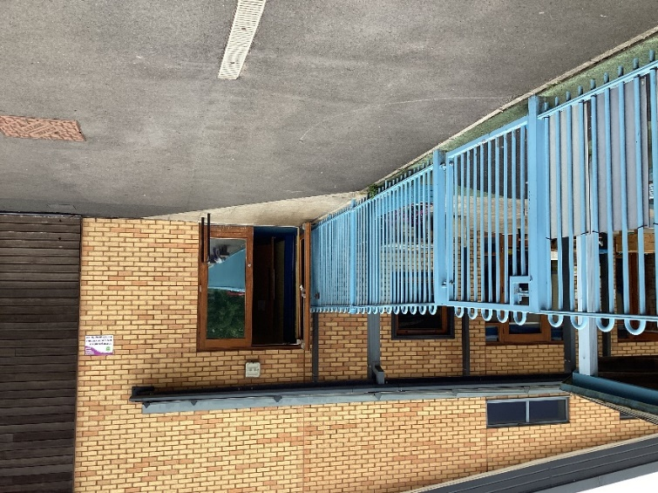
The start and the end of the day
First day arrangements – Reception playground door/gate will open at 9.10am
Please say your goodbyes on the playground and encourage children into school
End of day – The children exit through the Reception door/gate.
We only hand children over to a named/known adult. If someone different is collecting the child we need permission, unless in an emergency the password can be used
Waving hands!
Please be on time

Slide 6
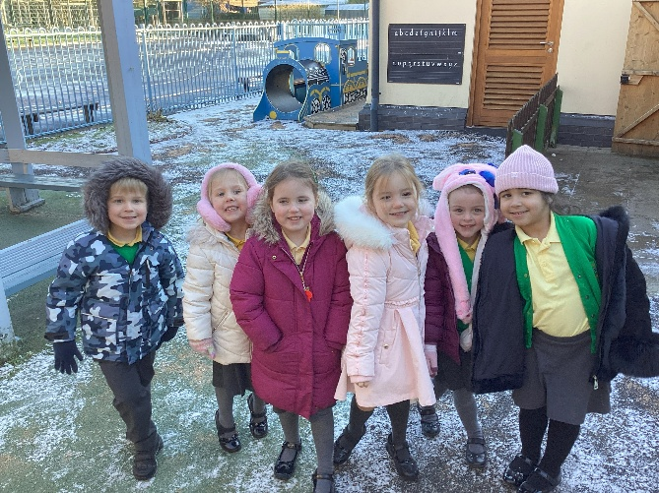
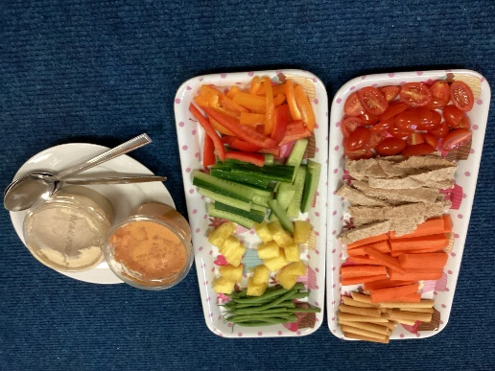
What your child will need to bring to school
A named coat WITH A HOOD that they can put on and off themselves
A fruit/veg snack– in a named/ labelled bag/tub
A bottle of still, unflavoured water - named with an anti-spill cap.
Reading pack (no backpacks/bags, no keyrings)
A named lunchbox (if not having a school dinner)

Slide 7
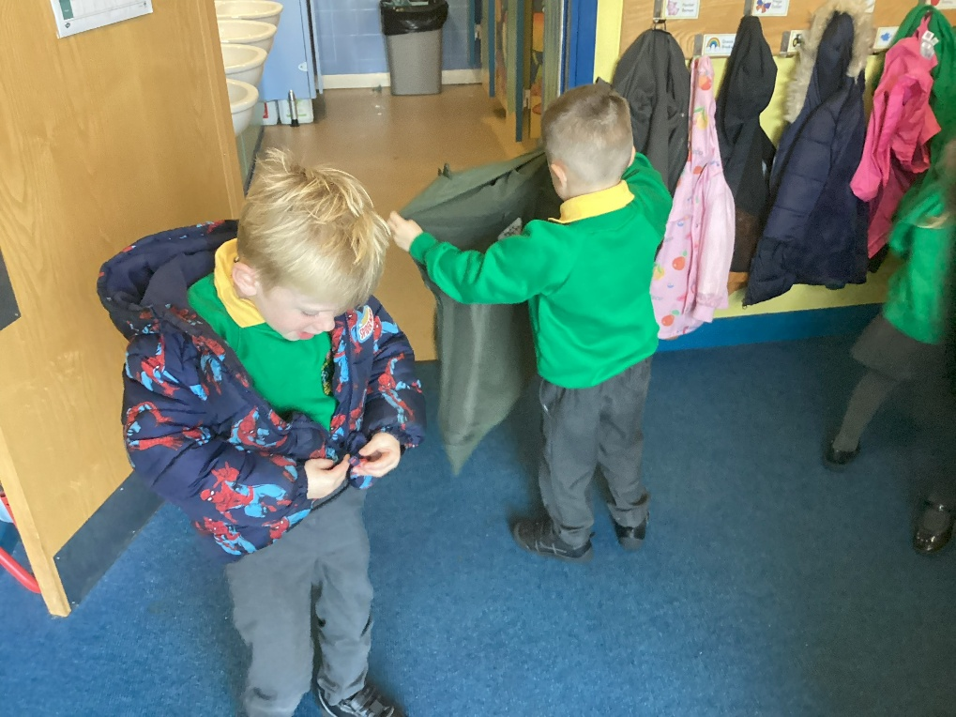
Be ‘School Ready’!
Putting on and taking off their own coat (including fastening)
Using the toilet independently – including wiping & washing hands
Sharing and tidying up
Using a hand dryer
Writing their own name
Dressing and undressing themselves – including shoes (velcro please & named)
Summer holiday school head start tasks

Slide 8
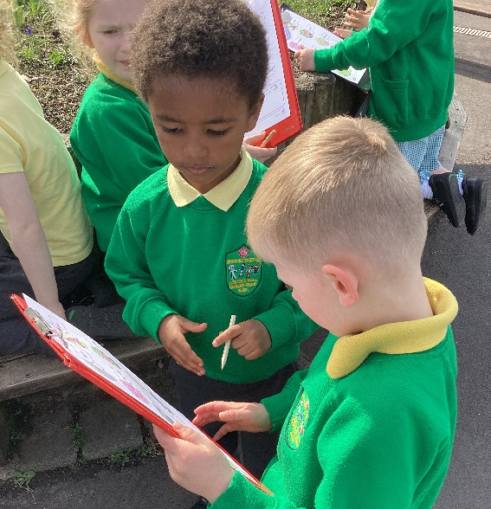
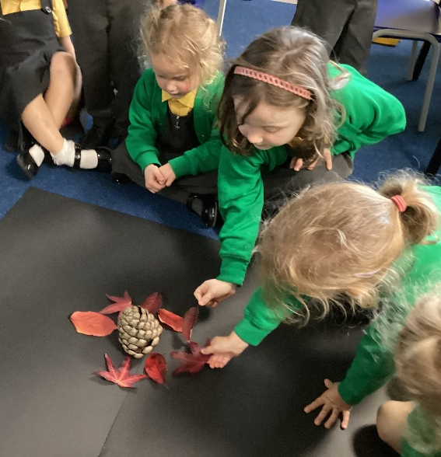
Preparing your child for school – Communication & Language
Communication and language underpins everything – behaviour, social skills, progress in school
Clarity of speech & pronunciation
Listening and attention – and waiting for attention
Understanding of language & vocabulary - books
Talk regularly, discuss everything!
Learn rhymes and songs
School will be in touch if any concerns - Tara

Slide 9


Slide 10
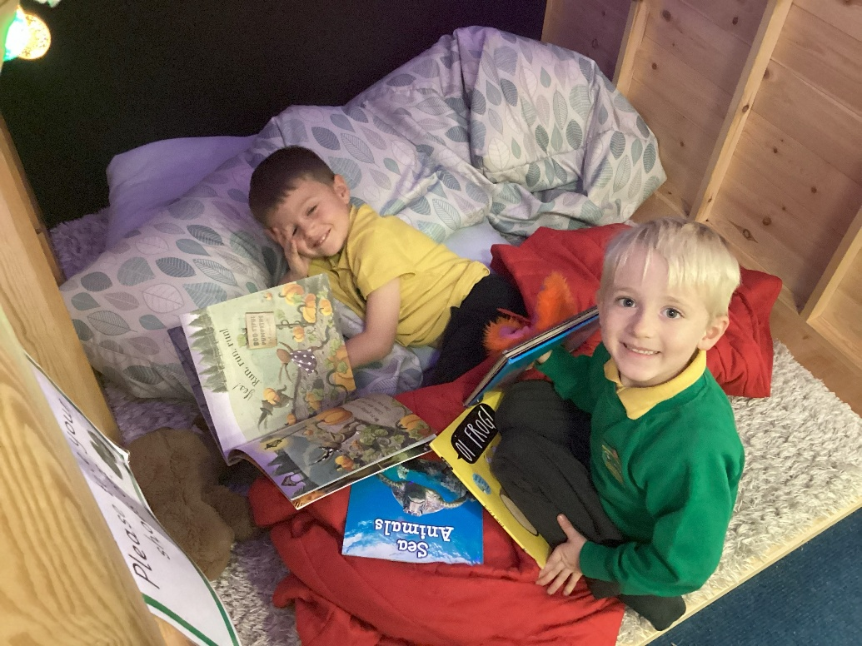
Reading
Reading with your child is vital & impacts everything
When children start school, we request that children read to an adult at home for at least 15 minutes EVERY DAY:
  May be short bursts at first (5-10 minutes)
  Build up to being able to sit and read for 15-20 minutes
Reading diaries checked weekly – letter home

Slide 11
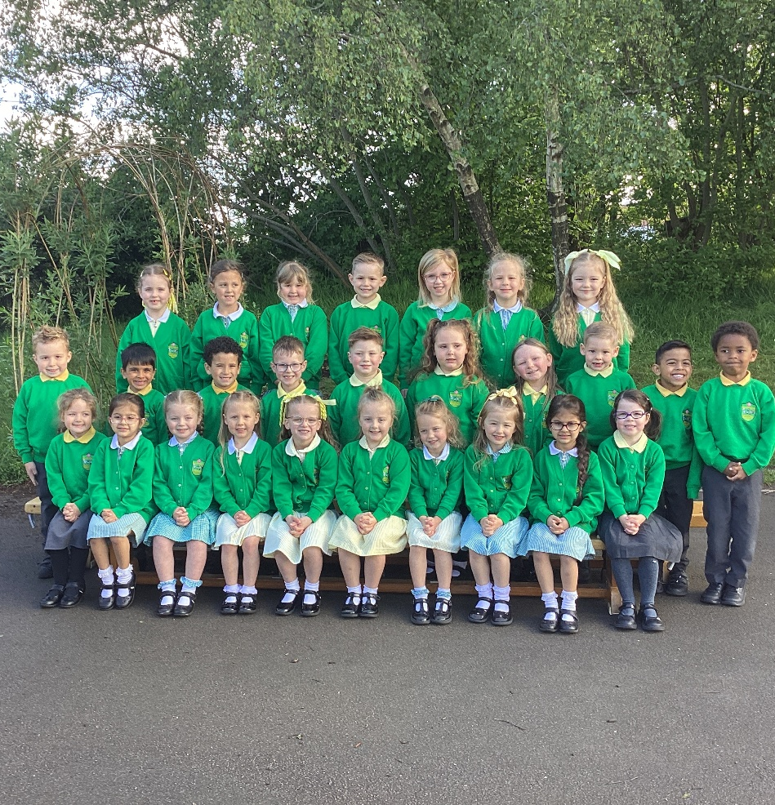
Uniform
All orders should now have been submitted for uniform – ready for home visit day.
Pre-loved uniform – cash only.
Name ALL uniform and make sure your child knows it belongs to them. Please place name labels in the neck area on jumpers, cardigans, tops and coats. Written in names wash out easily – iron in labels are best.
PE Kit – children will come to school in their PE kit on their PE day (Friday). You will be informed when the PE sessions commence.
Reading packs will be provided - please check every night. No key rings.

Slide 12
Payments
All payments must be paid online using your online account (uniform, trips etc.)
FREE - We provide healthy snacks each day and provide ingredients for practical, exciting activities, such as baking or special party events.
School dinners are free whilst in EYFS and KS1.

Slide 13
Free School Meals (FSM) eligibility
Your child may be able to get free school meals if you get any of the following:
Universal Credit with a household income of less than £7,400 a year (after tax and not including any benefits you get)
Income-Based Jobseekers' Allowance
Income-Related Employment and Support Allowance
Child Tax Credit, not entitled to Working Tax Credit and household income less than £16,190
Support under part VI of the Immigration and Asylum Act 1999
Guarantee element of State Pension Credit
Income Support
Working Tax Credit 'run on' – the payment you receive for a further four weeks after you finish work

Slide 14
Medical Information
Please ring and leave a message if your child is absent from school.
Sickness and illness: please keep your child off school for 48 hours.
Feeling unwell at school:
- We will air on the side of caution and phone you
- Contact numbers: ensure they are always up to date.
Inhalers:
- Please complete an asthma form (available on the open day)
- Children need to use their inhaler independently.
Headlice: please inform school. An app message will be sent out to the year group.

Slide 15
School Nursing Service
Role:
They support children and young people aged 0-19, carrying out the National Child Measurement Programme and School Health Needs Assessments
Provide advice on health promotion, wellbeing and health issues for children and teenagers.
For further information, please visit the school website – Parents – School Nursing Service
Contact details:
Telephone number: 0300 247 0040
Text a school nurse - 07312263554
Website for further info: http://www.lancsyoungpeoplefamilyservice.co.uk/

Slide 16
Family Support Worker (FSW) & Learning Mentor (LM)
Our FSW/ LM: Miss Jones
Role:-
Works alongside children and their families to provide support if/ when needed.
Oversees attendance and punctuality across the school.
Website: Please visit our website (parents> supporting our children & families) for more information: https://www.lostockhallcps.co.uk/supporting-our-children-and-families/

Slide 17

Linden Stay and Play
Times:
Breakfast Club – 7.45am until school begins.
After School Club – end of school day until 5.30pm.
Cost:
Breakfast Club - £4.00
After School Club - £7.50 (£7 for other siblings)
Holiday Club:
Times - 8am until 5pm
Full Day - £18
Holiday Club is not open during Christmas Half Term
Request a place:
Fill out the relevant expression of interest form on the school website:
Parents > Linden Stay & Play > BC/ASC > Expression of Interest Form
Bookings:
Places are on a permanent basis
Charges apply irrespective of non-attendance
Further Information
This is available on the school website
All queries to be sent directly to Linden Stay & Play, not school.

Slide 18
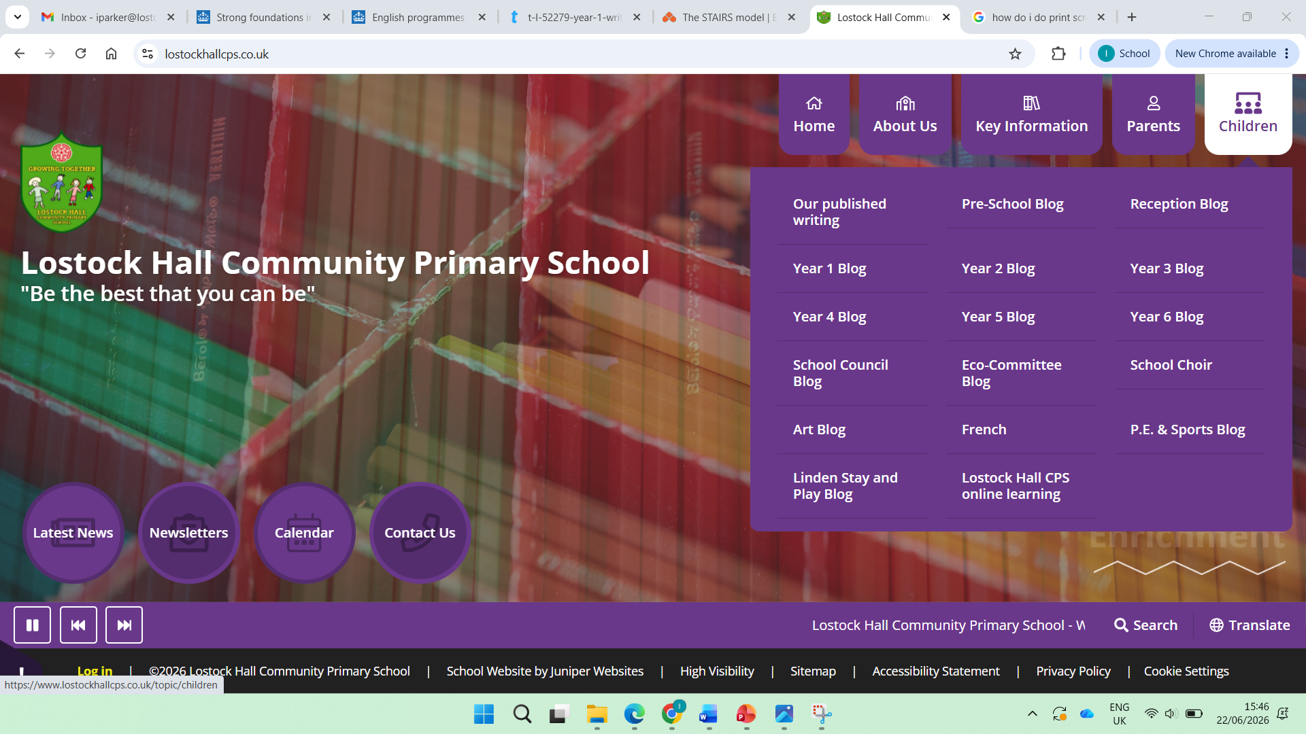
Keeping Informed
A lot happens in school – important to keep informed
Paperless where possible – download the app
Notifications need to be turned ON (own phone settings)
Please check the Reception blog every week
  School website – Children – Reception blog

Slide 19
Attendance
Attendance at school from Reception onwards is key
Please be on time – back doors close at 8.55am
Monitoring of attendance

Slide 20
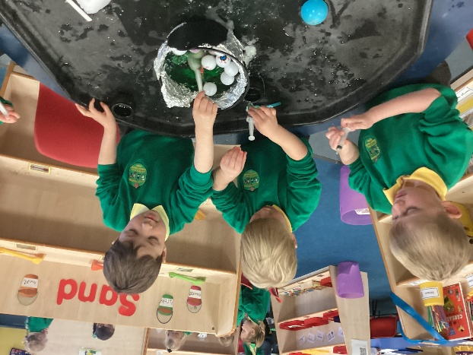
Finally…
We look forward to seeing you and your child at our open day on Thursday 2nd July at your given appointment time
We will be holding our ‘EYFS Curriculum meeting’ on Wednesday 9th September @ 5pm – it is vitally important that parents & carers attend
Please ensure you download our school app - ‘Juniper Ed’ in preparation for September.
Please check the website for relevant information/ photographs and a copy of this PowerPoint: Parents> Reception intake information (in September this will change to the Reception Blog – please check weekly)

