Slide 2


light
Start Timer
Start Timer
Use Timer
Show Answer
Next

Slide 3
quigh
Start Timer
Show Answer
Start Timer
Use Timer
Next

Slide 4
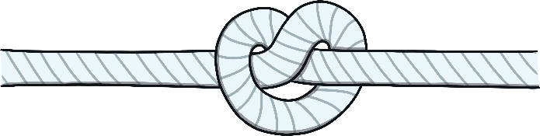
tight
Start Timer
Start Timer
Use Timer
Show Answer
Next

Slide 5
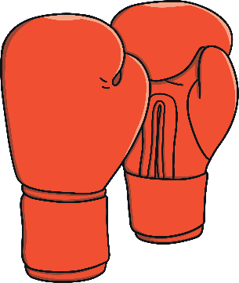
fight
Start Timer
Start Timer
Use Timer
Show Answer
Next

Slide 6
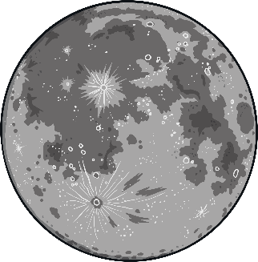
night
Start Timer
Start Timer
Use Timer
Show Answer
Next

Slide 7
thight
Start Timer
Show Answer
Start Timer
Use Timer
Next

Slide 8

right
Start Timer
Start Timer
Use Timer
Show Answer
Next

Slide 9
zight
Start Timer
Show Answer
Start Timer
Use Timer
Next

Slide 10

high
Start Timer
Start Timer
Use Timer
Show Answer
Next

Slide 11
chight
Start Timer
Show Answer
Start Timer
Use Timer
Next

