Slide 1
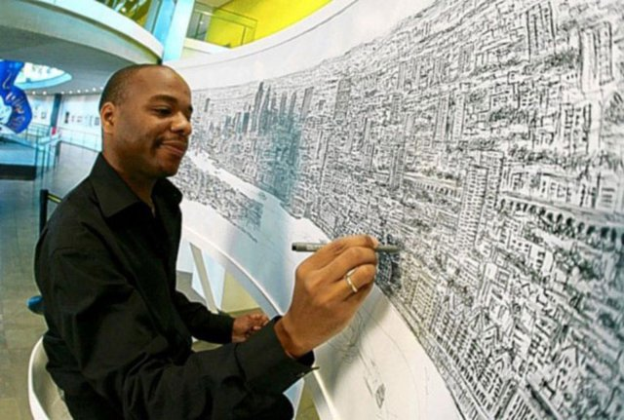
Artist of the Month-Stephen Wiltshire
Stephen Wiltshire, is a British architectural artist. He is known for his ability to draw a landscape from memory after seeing it just once! His work has gained worldwide popularity.

Slide 2
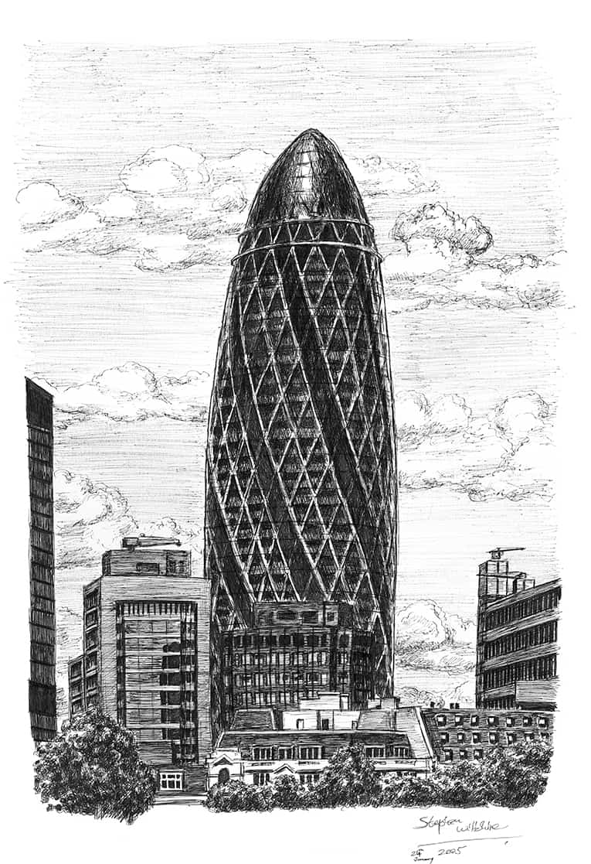
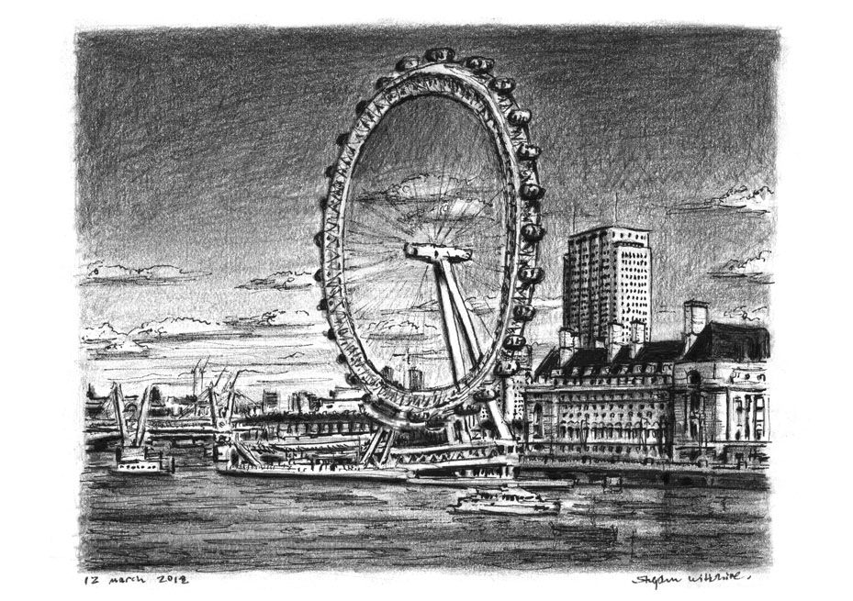

Slide 3
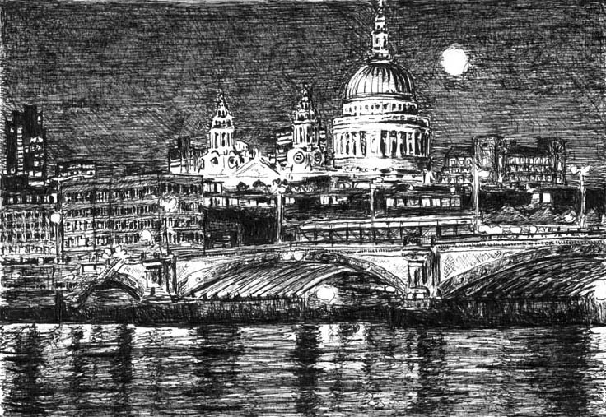

Competition Time!
Research Stephen Wiltshire’s work and create your own piece of work inspired by his style!
When is it due? Friday 24th May
Who should I hand my work to? The Arts Ambassadors or Mrs Allen

