Slide 1
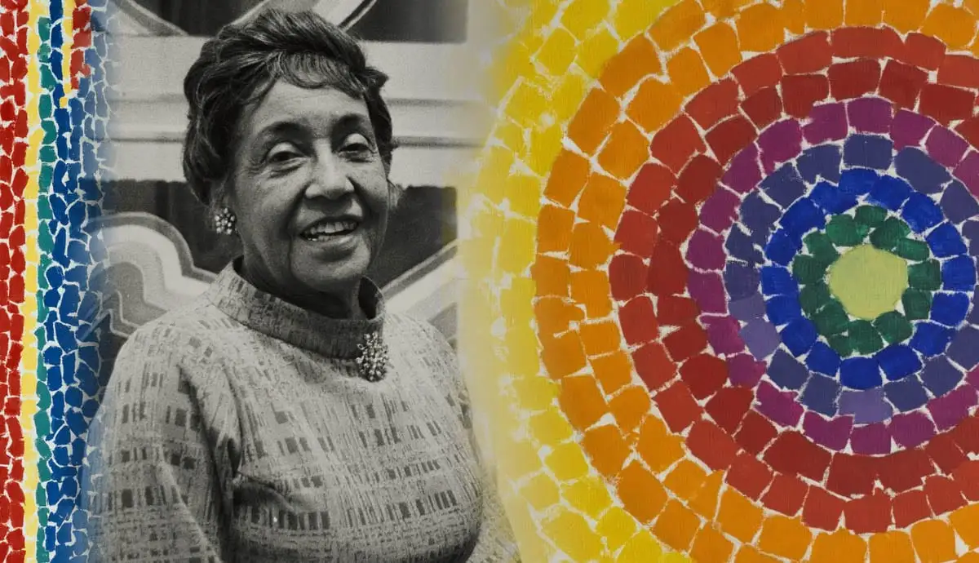
Artist of the Month- Alma Thomas
Alma Thomas was born in the USA over 100 years ago in a place called Georgia. Alma loved art and music but wasn’t allowed to visit art galleries because of her skin colour. People used to be treated unfairly because of their skin colour. Alma’s family moved to Washington where more people accepted her. Alma had art lessons, went to university and became an art teacher. She retired at 68 and became a full time artist. When Barack Obama became the president he displayed some of Alma’s art work in the White House.

Slide 2
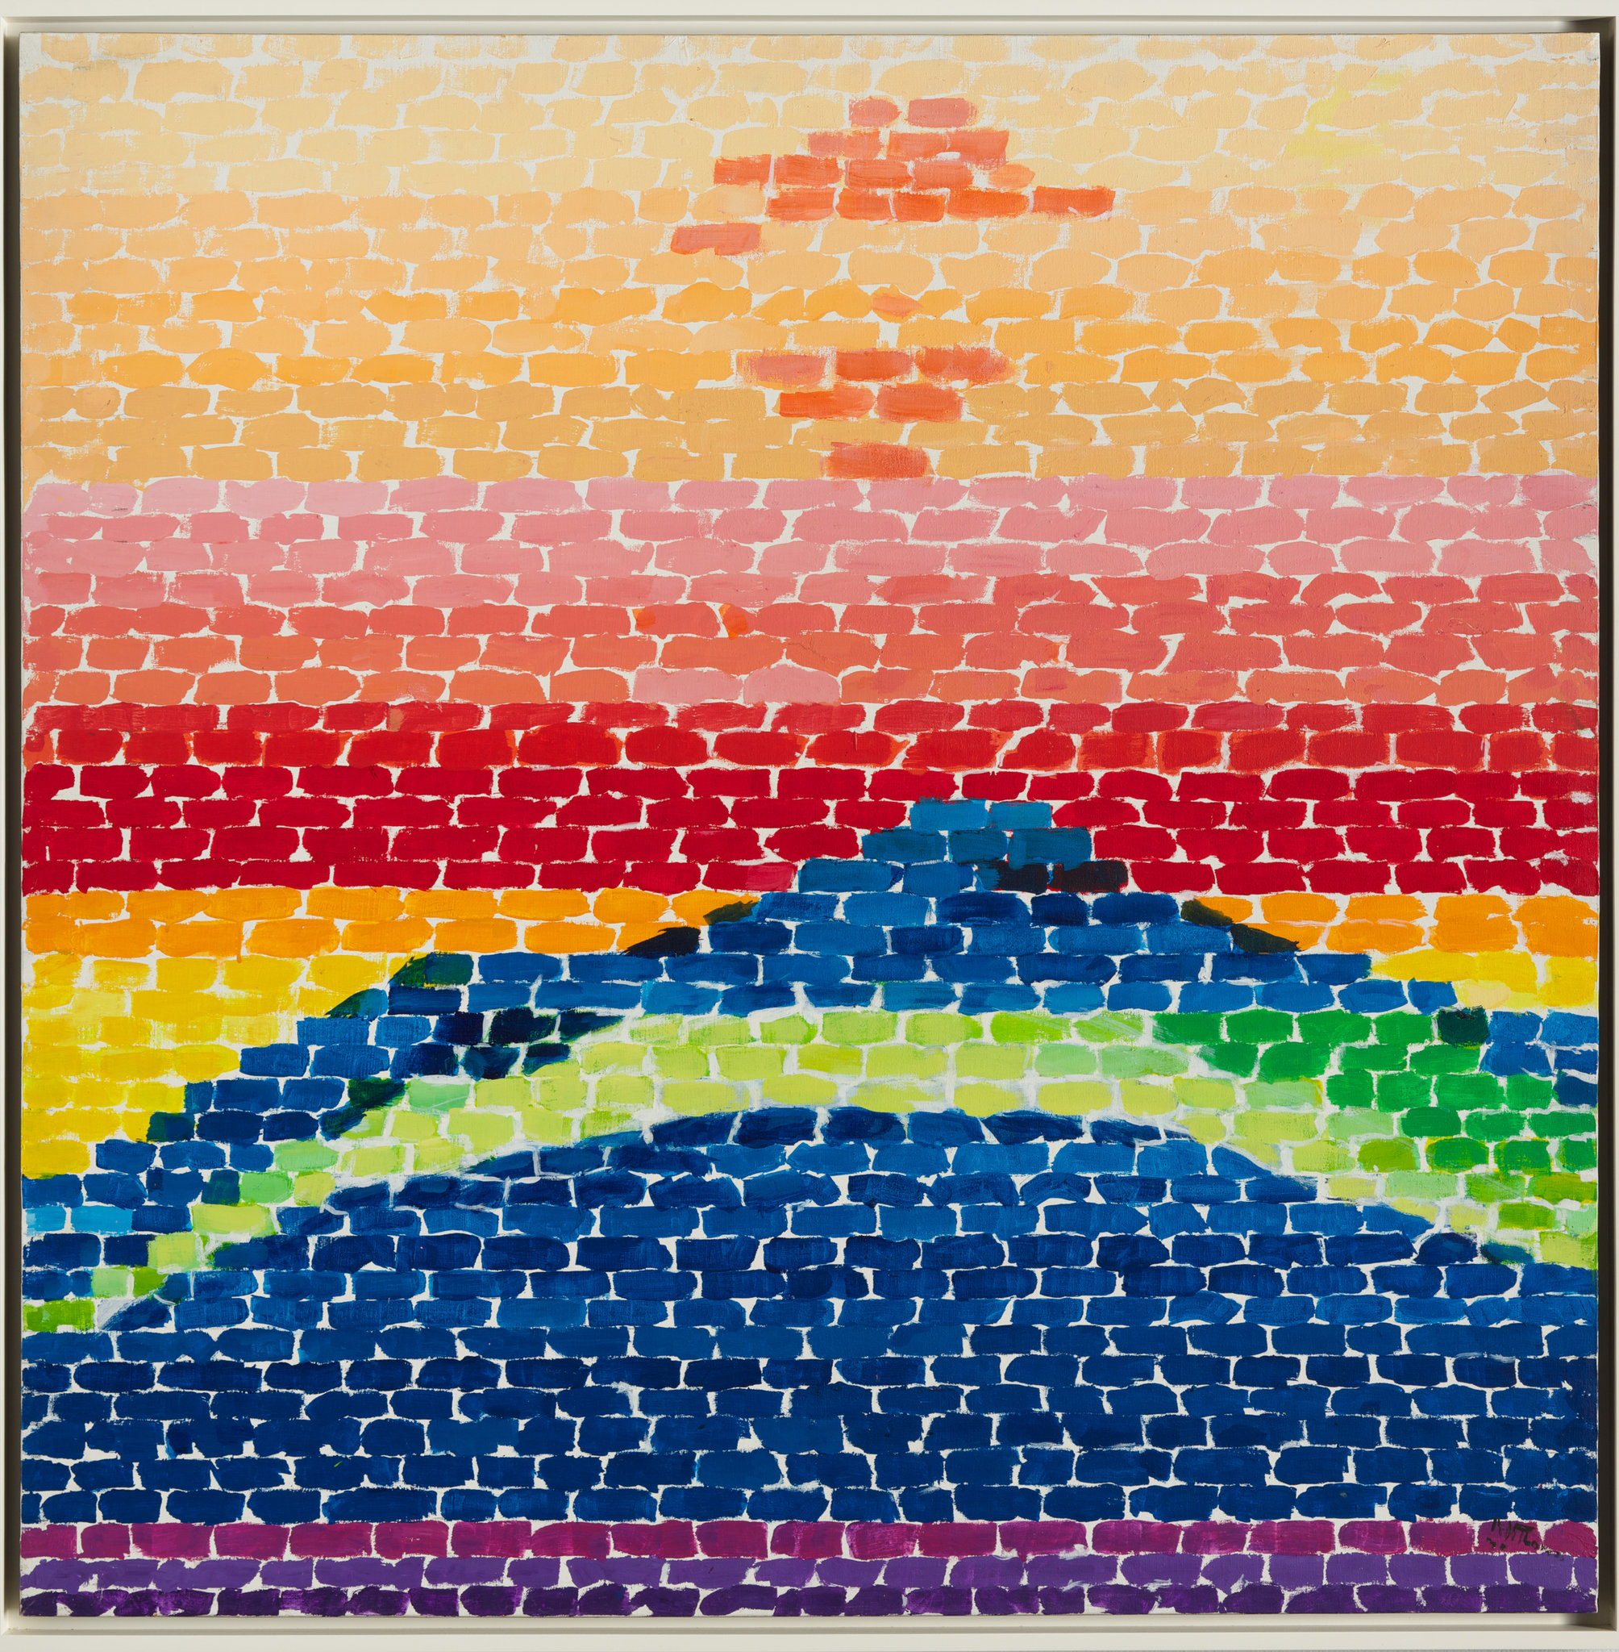
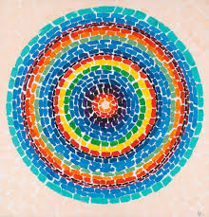

Slide 3
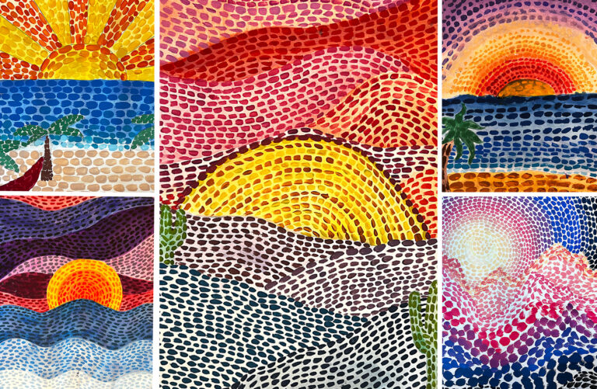

Competition Time!
Research Alma Thomas’ work and create your own piece of work inspired by her style!
When is it due? Friday 28th June
Who should I hand my work to? The Arts Ambassadors or Mrs Allen

