Slide 1
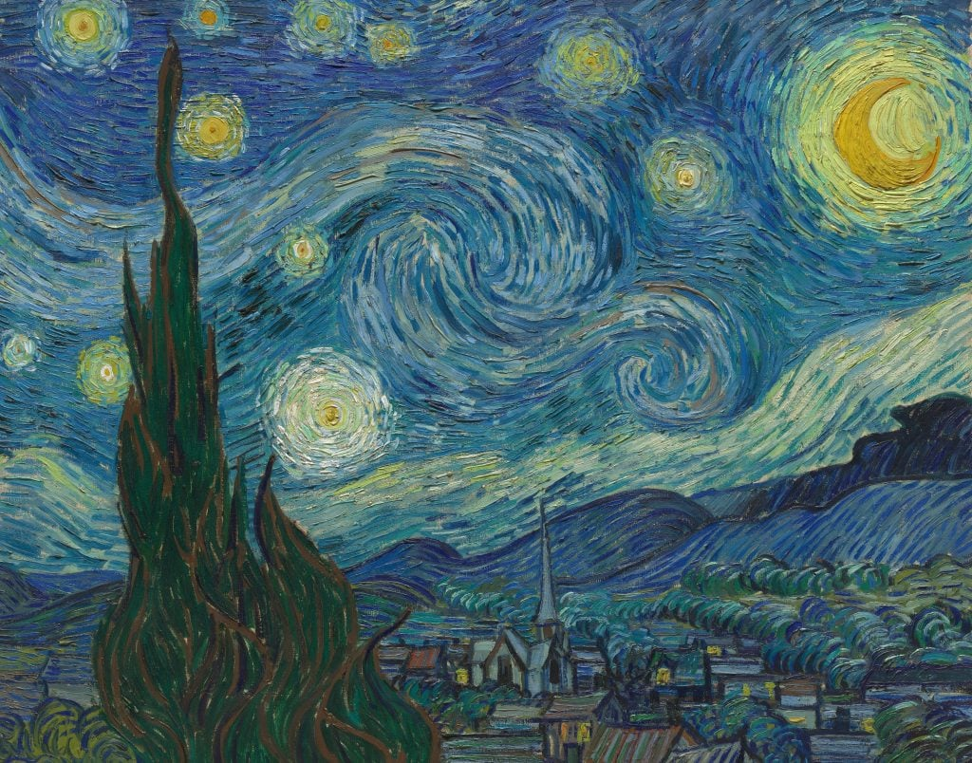
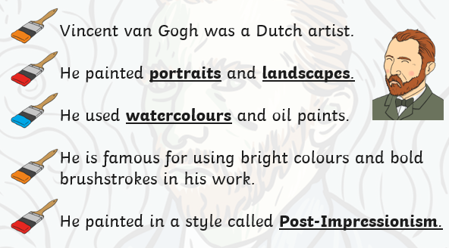
Artist of the Month- Vincent Van Gogh

Slide 2
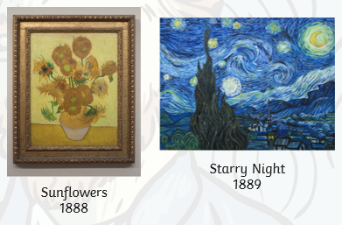

Slide 3
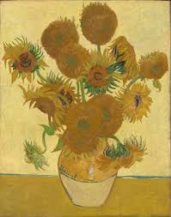

Competition Time!
Research Vincent Van Gogh’s artwork and create your own piece of work inspired by his style!
When is it due? Tuesday 29th October
Who should I hand my work to? Mrs Allen

