Slide 1
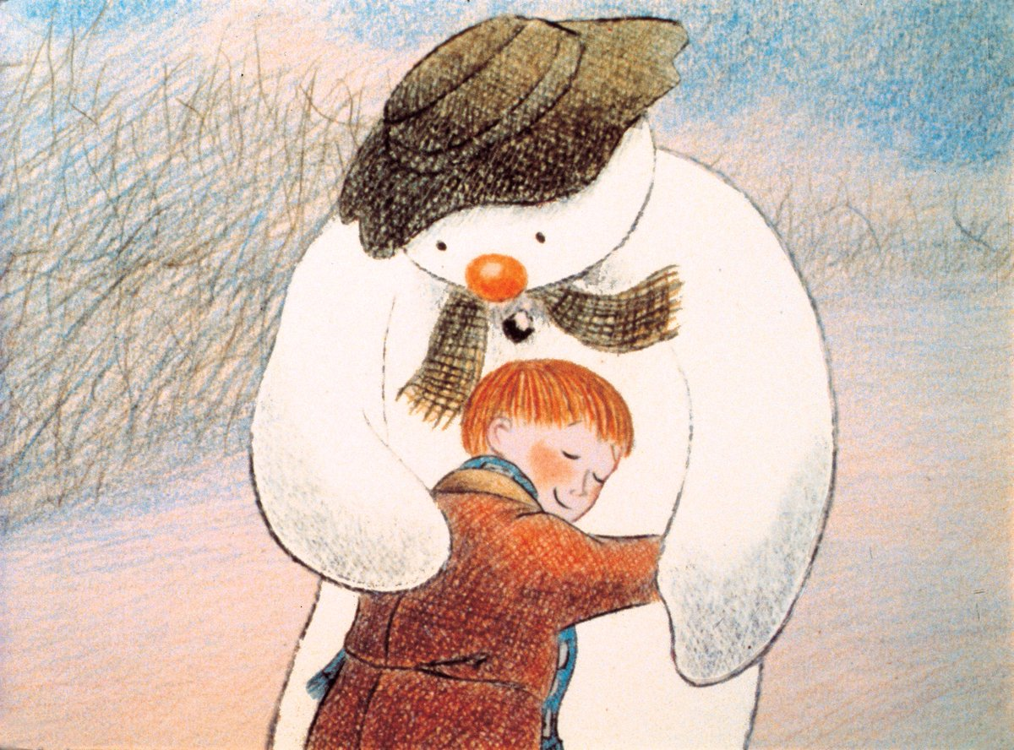
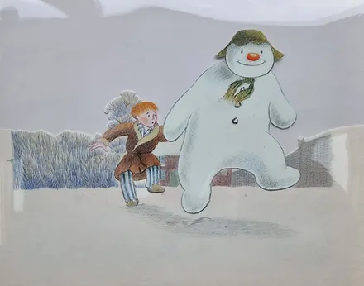
Artist of the Month- Raymond Briggs
Raymond Briggs was an English illustrator, cartoonist and author. He is best known in Britain for his story The Snowman, which is televised every Christmas.

Slide 2
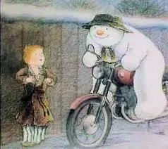
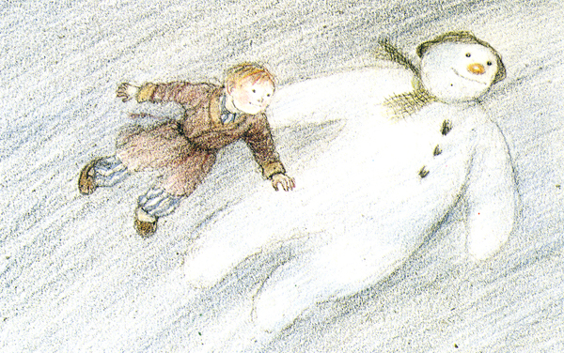

Slide 3
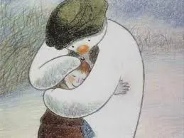
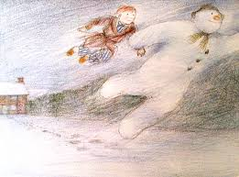

Competition Time!
Research Raymond Briggs’ work and create your own piece of work inspired by his style!
When is it due? Friday 13th December.
Who should I hand my work to? The Arts Ambassadors or Mrs Allen

