Slide 1
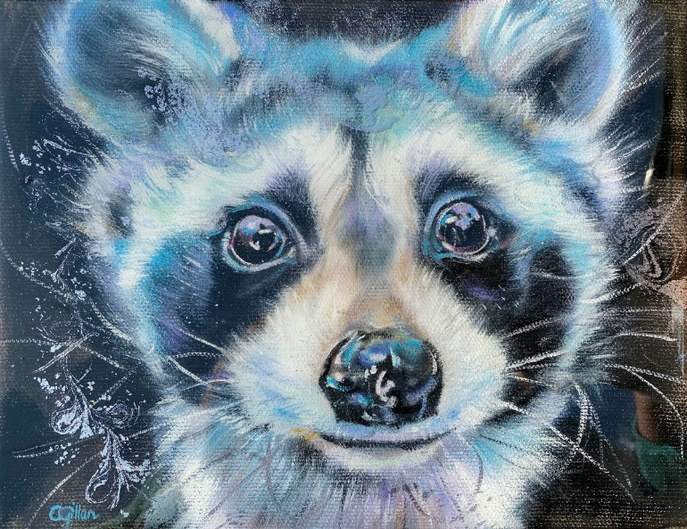
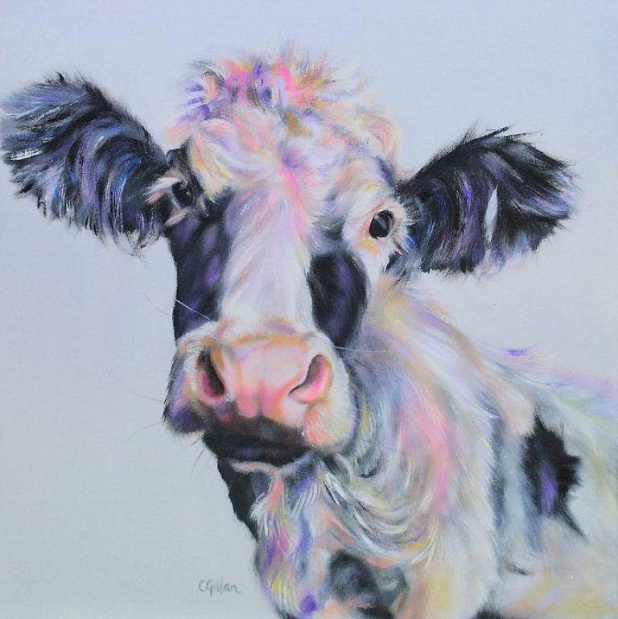
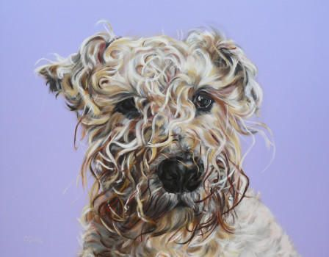
Artist of the Month- Carol Gillan
Carol Gillan specialises in oil paintings of British wildlife, farm animals and pets. She celebrates their unique characteristics through her funny animal portraits.

Slide 2
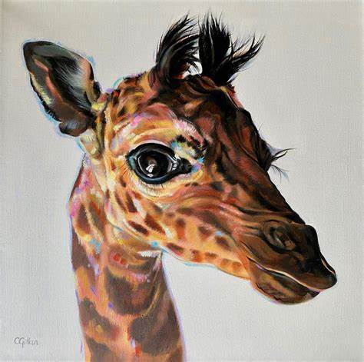
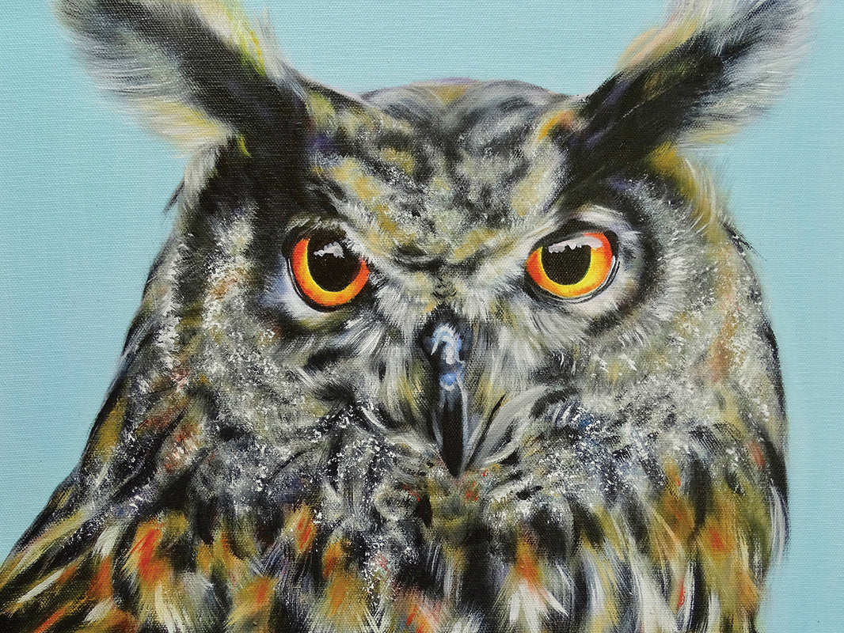

Slide 3
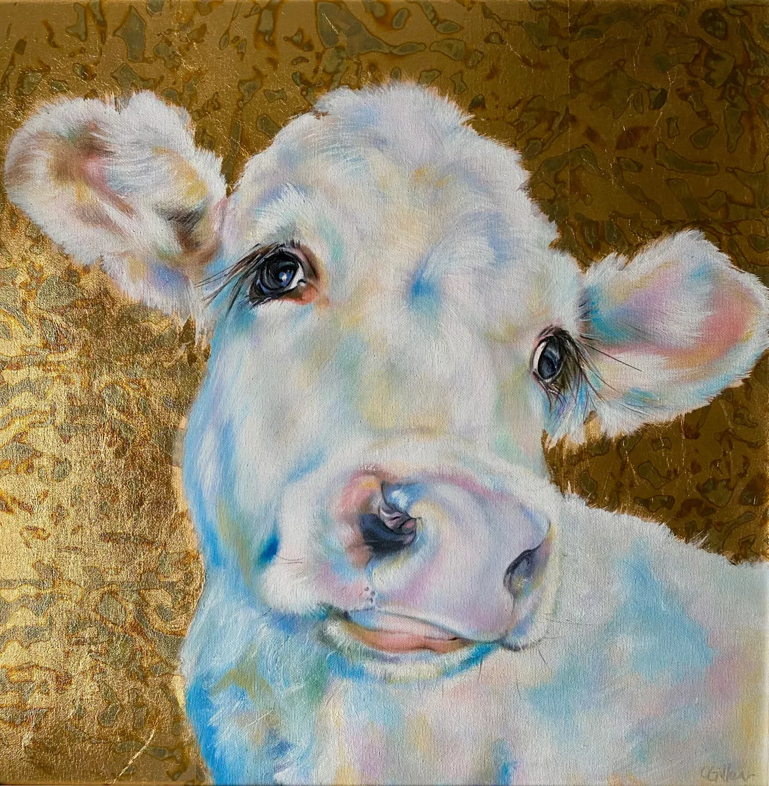
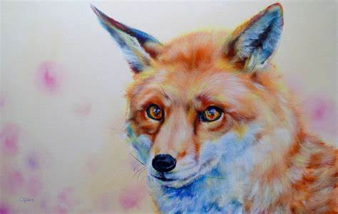

Competition Time!
Research Carol Gillan’s work and create your own piece of work inspired by her style!
When is it due? Friday 28th February.
Who should I hand my work to? Mrs Allen

