Slide 1

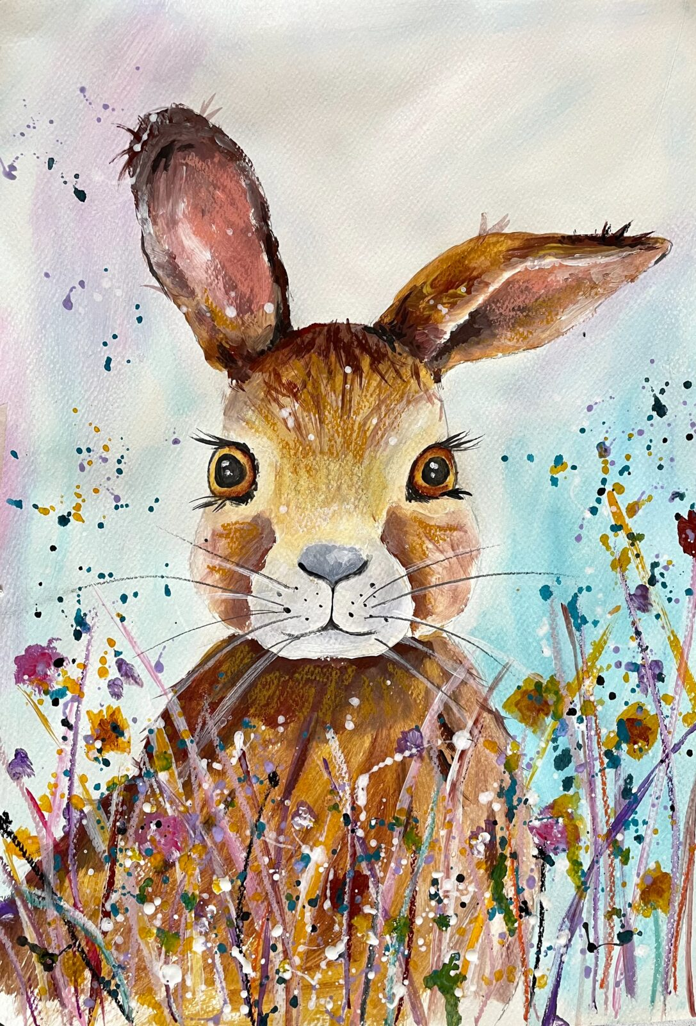
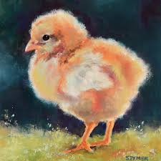
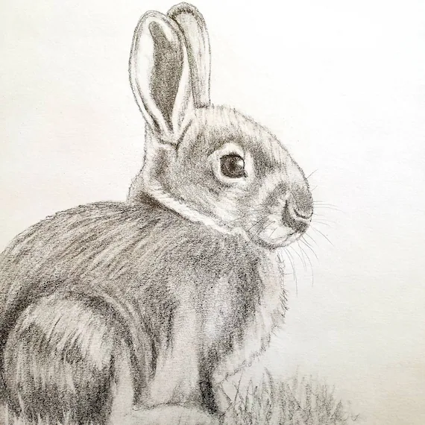
Easter Art Competition
Create an Easter or Spring inspired picture using any materials you like!
When is it due? Friday 2nd May
Who should I hand my work to? Mrs Allen

