Slide 1
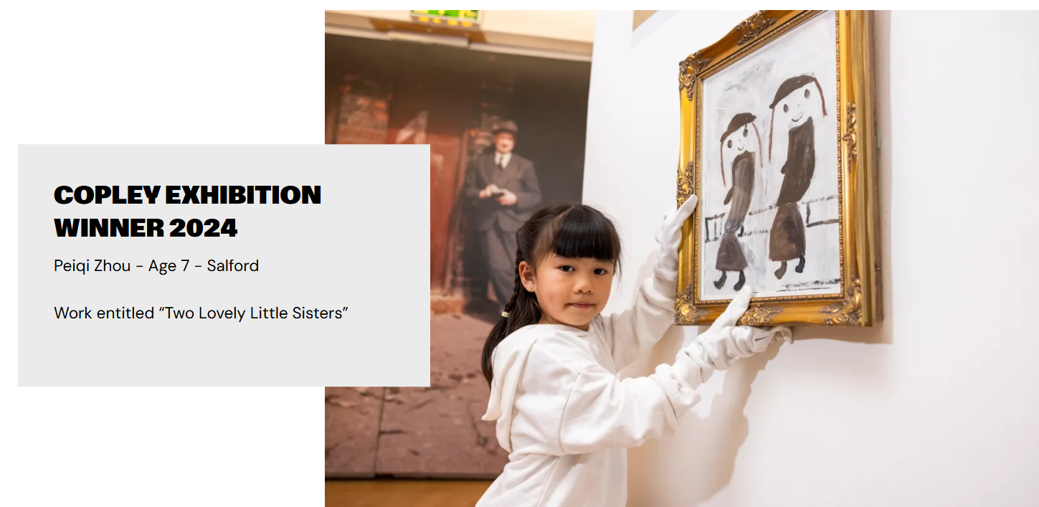
LS Lowry Art Competition
Create a piece of artwork inspired by LS Lowry.

Slide 2
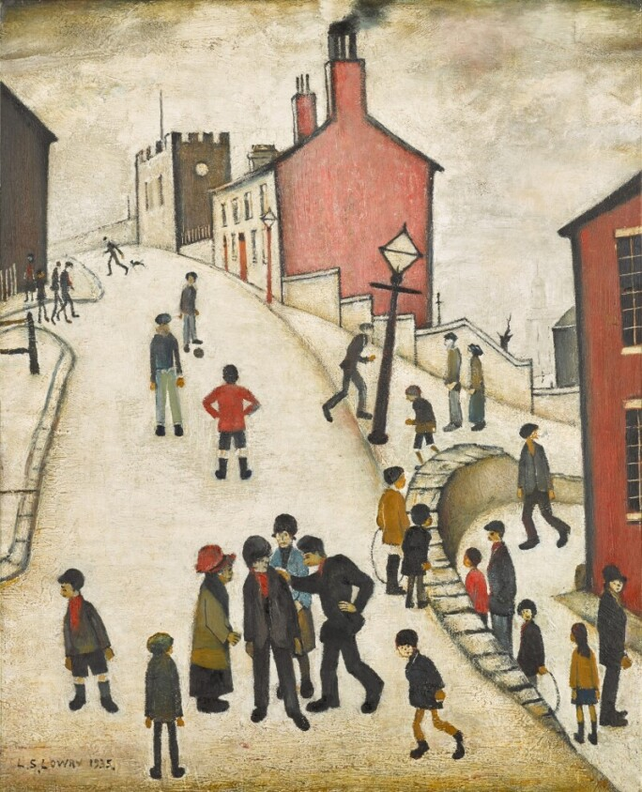
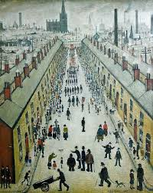

Slide 3
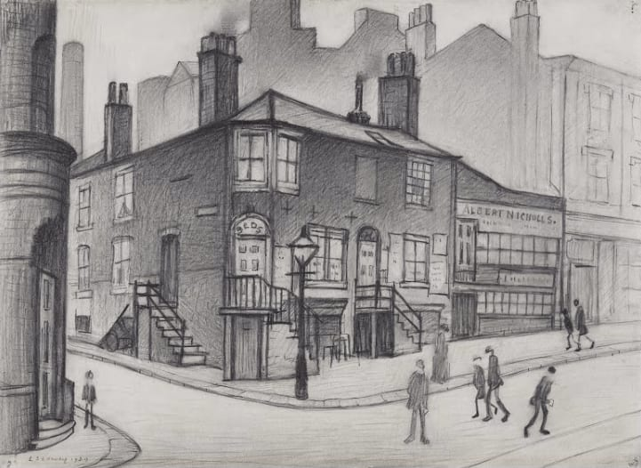
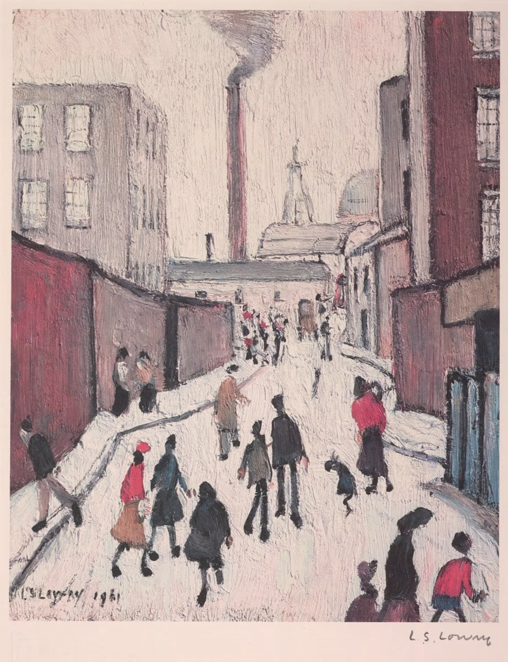

Competition Time!
Research LS Lowry’s work and create your own piece of work inspired by his style!
When is it due? Friday 4th July
Who should I hand my work to? Mrs Allen
The two winners from our school will be given a £10 Amazon voucher and have their work submitted to the Copley Art Competition. If they are also chosen as a winner by the Copley Art Compeition, their art work will be framed professionally and hung in The Lowry Galleries.

