Slide 1
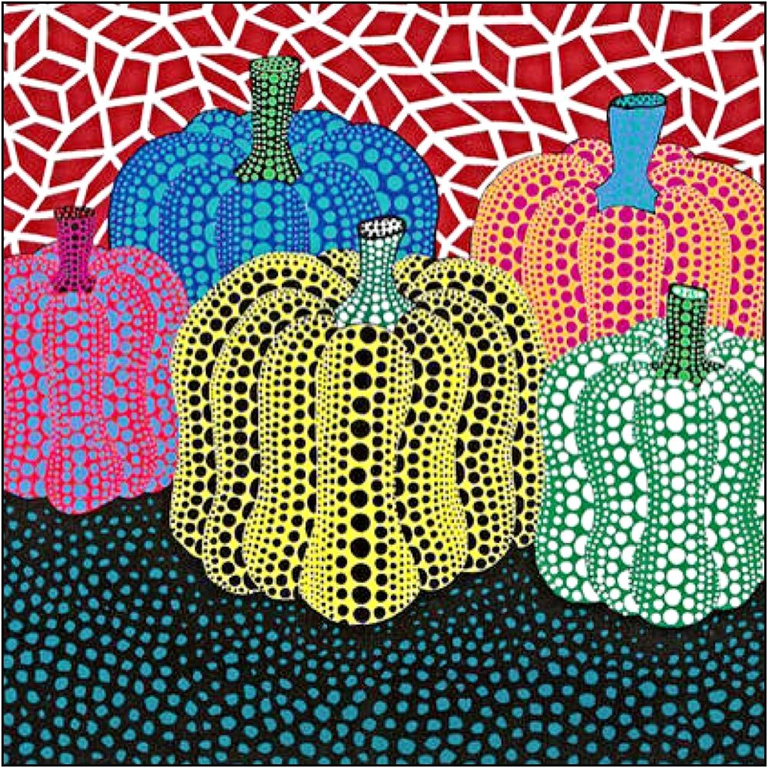
Art Competition- Yayoi Kusama
Yayoi Kusama is a Japanese artist who is sometimes called ‘the princess of polka dots'. Although she makes lots of different types of art – paintings, sculptures, performances and installations – she has become known for the one thing they have in common, DOTS!

Slide 2
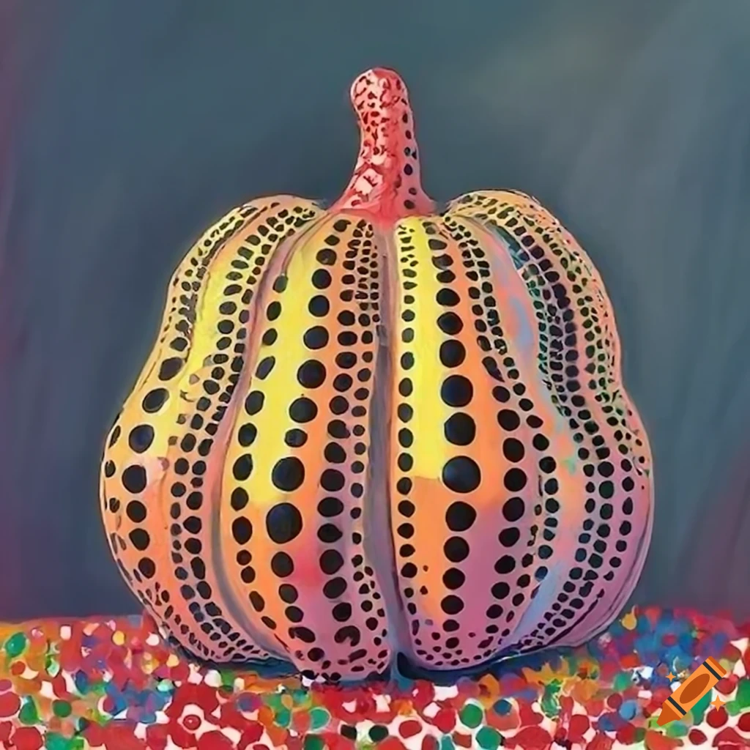
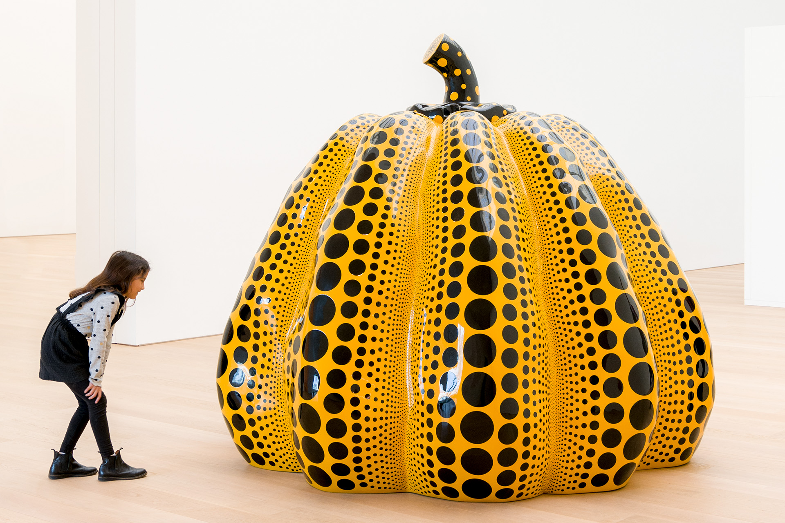

Slide 3
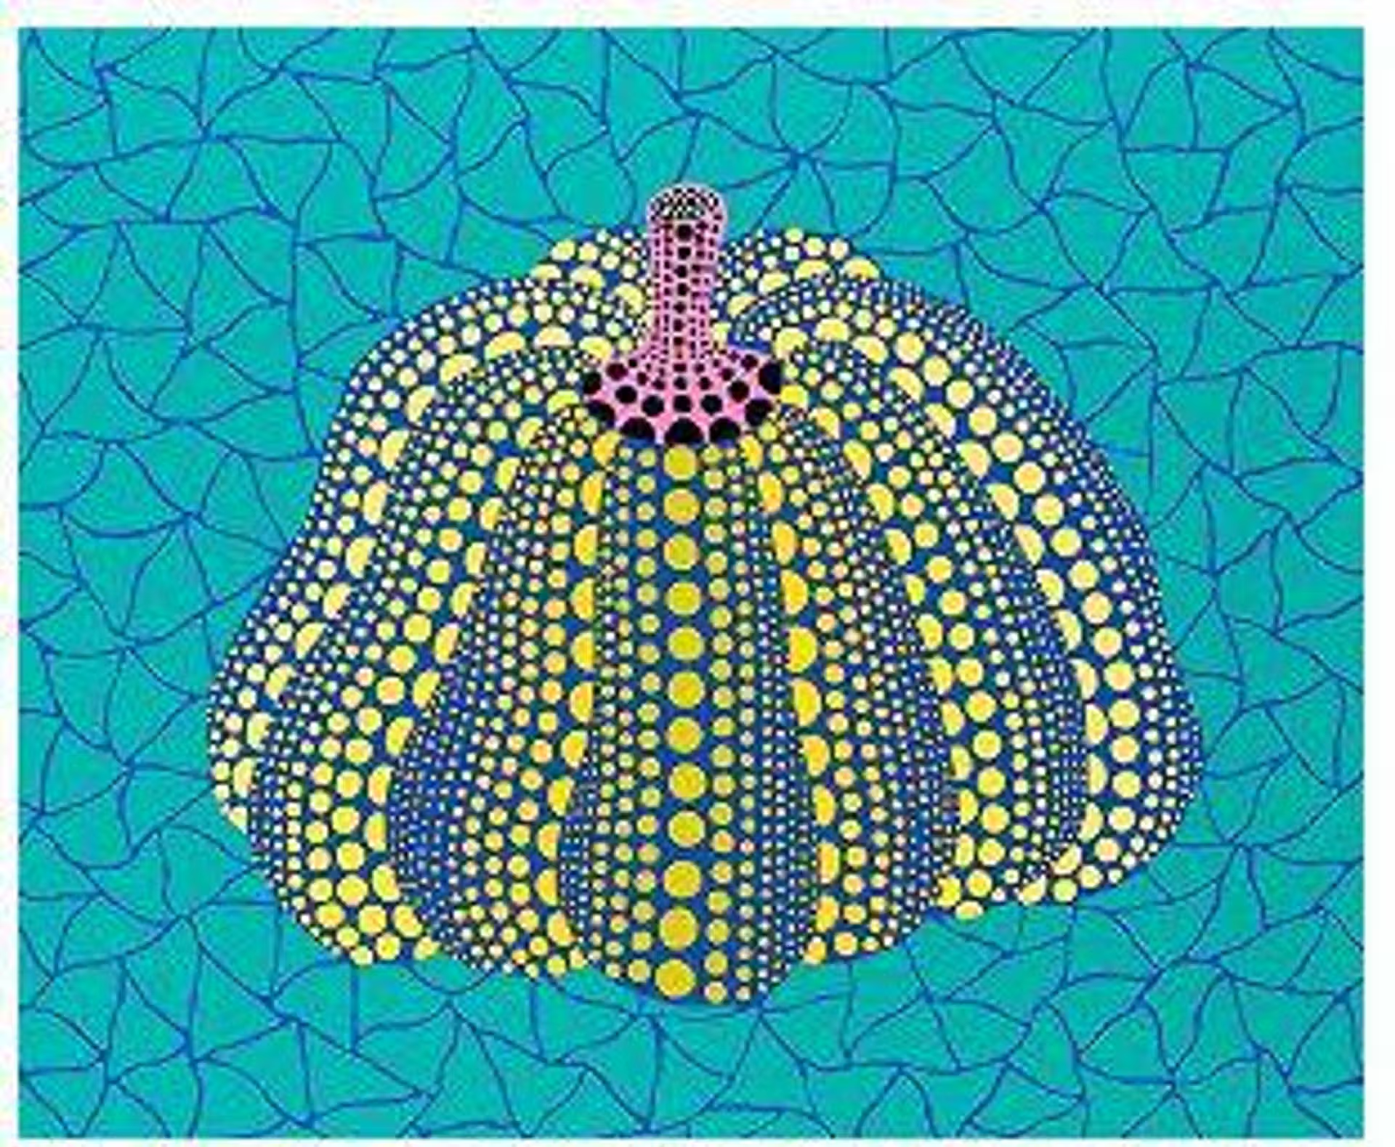

Competition Time!
Research Yayoi Kusama’s work and create your own piece of work inspired by her style!
When is it due? Friday 24th October
Who should I hand my work to? Mrs Allen

