Slide 1

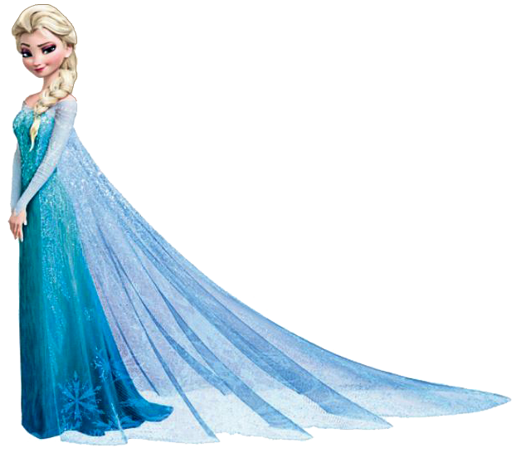

The Question Queen
Sid’s Statements
The Commander

Slide 2



Sid’s Statements
A statement is an information sentence. It tells the reader something.
An example of a statement:
The ship sailed across the ocean.
A statement starts with a capital letter and ends with a full stop.

Slide 3
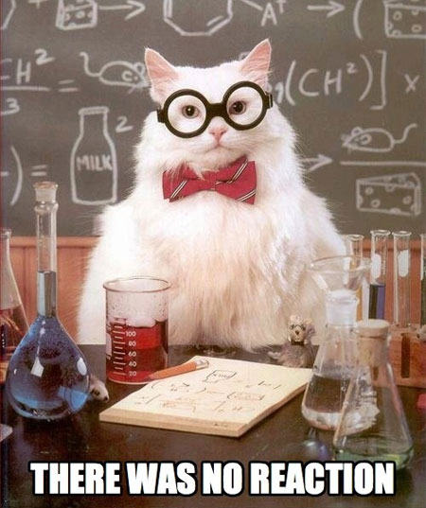
Sid’s Statements
Science Kitty is doing an experiment.
The moldy bread is in the bin.
Mr ______ is our headteacher.
This pen doesn’t work!
There isn’t anyone called Roger in year six.

Slide 4

Question Queen
A question asks the reader something. It begins with a question word.
An example of a question:
What color is the dog?
A question starts with a capital letter and ends with a question mark.

Slide 5
Question Queen
A question can be answered.
What color is the dog?
The dog is brown.
It starts with a question word.
It asks something.

Slide 6


What are question words?
Here are a few:
Were?
Do?
Could?
Who?
Can?
What?
When?
Are?
May?
Where?
Why?
Should?
How?
Did?
Is?
Would?
Which?
Was?
Does?

Slide 7
Would you like a jam tart?
Why is the sky blue?
Is it Monday today?
Who is sitting next to you?
Do pigs fly?
Can I have a biscuit?
Where is Mrs _________?
Are you having a nice day?
Would?

Slide 8

Command
A command is an order.
A command usually starts with an imperative verb, which is a bossy verb, telling you what to do.
It can end with a full stop or an exclamation mark.
Do your homework!

Slide 9
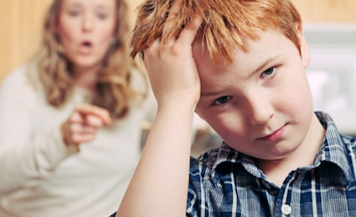
Walk quietly!
Close the door.
Tidy your room.

Slide 10
Question, Command or Statement?
What time is it?
We did gymnastics in PE.
Stir the mixture well.
If these statements are the answers, what were the questions?
I am ten years old.
It is raining today.
We are at ________Primary School.
Tip: There is more than one right answer to these ones.

