Slide 1
Lesson 3: Improving a game
Year 6 – Programming A – Variables in games
Notes:
Last updated: 07-02-22
Resources are updated regularly — the latest version is available at: ncce.io/tcc.
This resource is licensed under the Open Government Licence, version 3. For more information on this licence, see ncce.io/ogl.

Slide 2
Lesson 3: Improving a game
Objectives
To choose how to improve a game by using variables
I can decide where in a program to change a variable
I can make use of an event in a program to set a variable
I can recognise that the value of a variable can be used by a program

Slide 3
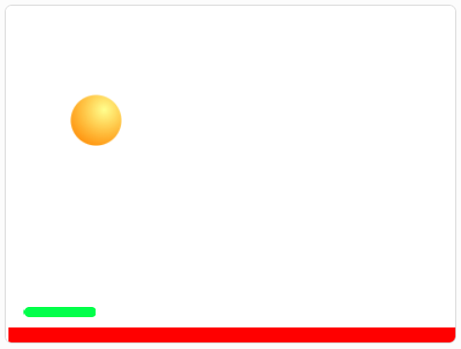
What could be set and changed in this game?
Introduction
ncce.io/pongstarter
Possible variables:
Score
Timer
Lives

Slide 4

Keeping score
Activity 1
Go to this project: ncce.io/pong.
Create a variable for ‘score’.

Slide 5
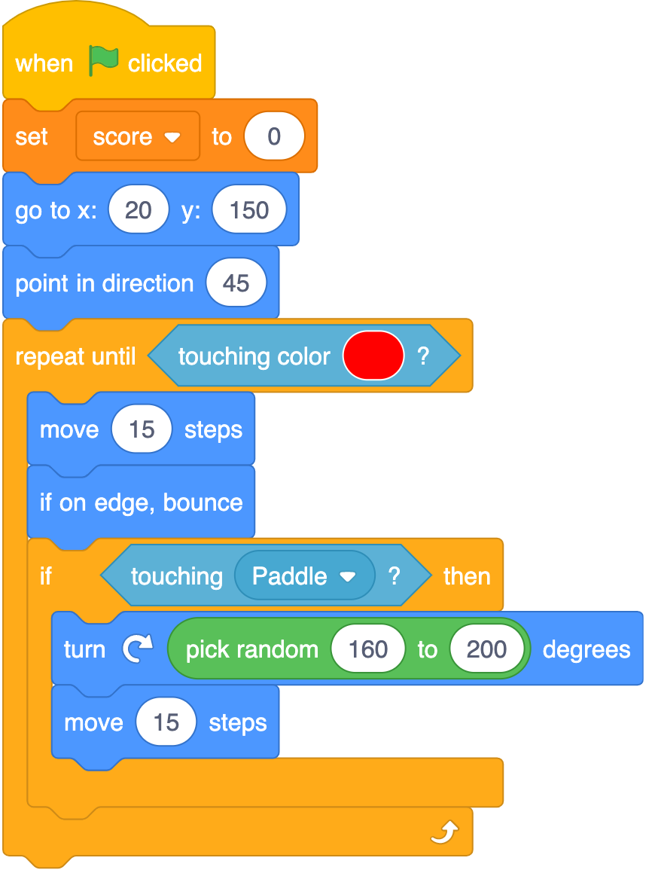
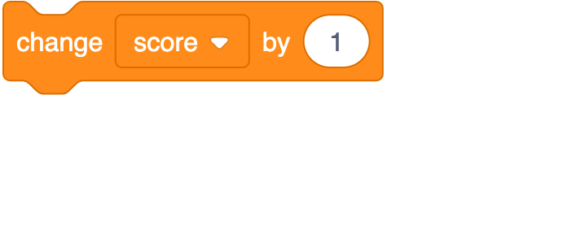
Experiment with the ‘score’ variable
Activity 1
What happens when you add to this code snippet in positions A, B, or C?
Test your predictions by adding the block.
A
B
C

Slide 6
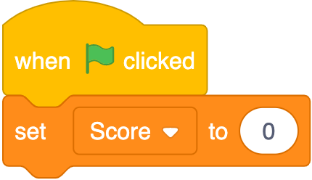
Setting variables
Activity 2
What would happen if the score is never reset in a game?
When do you need to set the score in a game?

Slide 7
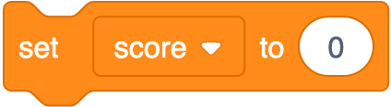
Experiment with the value of the variable
Activity 2
Experiment with changing the value of the variable.
Try changing by two, five, or ten.
What happens if you use a negative number?
Do you always have to set the variable to zero?

Slide 8
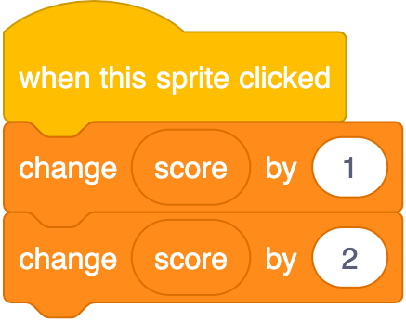

Change a variable more than once
Activity 2
What would happen if this code snippet was run?
Could you use one change block instead?
What about this snippet?

Slide 9

Change a variable more than once
Activity 2
Try adding two change score variables to your code in different places.
What happens?
You might need to change the values.

Slide 10



Variables in programs
Activity 3
A program can use the value of a variable to perform different tasks.
Operator blocks are just some of the ways you can do this.

Slide 11
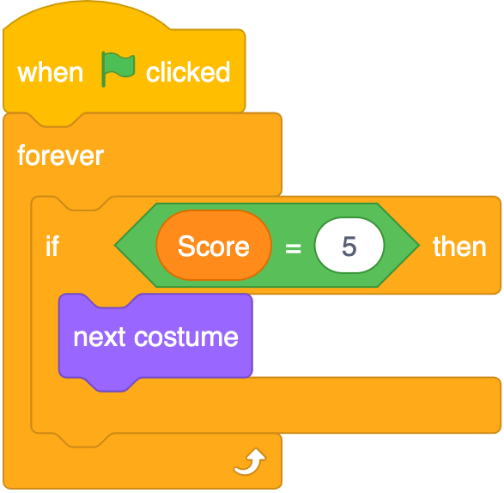
Variables in programs
Activity 3
What do you think will happen when the score gets to five?
The program is using the value of the variable to determine whether to change the sprite’s costume.

Slide 12
Variables in programs
Activity 3
Return to your Scratch project. Add the operator block to your Paddle sprite’s code.
Choose an action to take place when the score reaches a certain value.

Slide 13

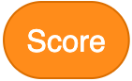
Display the score
Plenary
The variable does not have to be displayed throughout the running of your program, for example:
Click on the Variables category and untick .
What happens?

Slide 14

Assessment
How confident are you? (1–3)
I can decide where in a program to change a variable
I can make use of an event in a program to set a variable
I can recognise that the value of a variable can be used by a program
3 – Very confident
2 – Unsure
1 – Not confident
Notes:
Image source: https://pixabay.com/vectors/thumb-up-hand-like-confirm-go-top-307176

Slide 15
Next lesson
Summary
In this lesson, you…
Set variables and experimented with how they can be displayed
Next lesson, you will…
Design your own project that uses variables

