Slide 1
Lesson 4: Designing a game
Year 6 – Programming A – Variables in games
Notes:
Last updated: 07-02-22
Resources are updated regularly — the latest version is available at: ncce.io/tcc.
This resource is licensed under the Open Government Licence, version 3. For more information on this licence, see ncce.io/ogl.

Slide 2
Lesson 4: Designing a game
Objectives
To design a project that builds on a given example
I can choose the artwork for my project
I can create algorithms for my project
I can explain my design choices

Slide 3
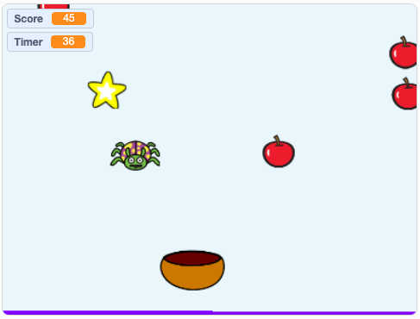
Analyse a game
Introduction
Explore this game: ncce.io/introfruit
How do you play the game?
How many sprites are there?
What do the sprites do?
Do the sprites all fall at the same speed?
How do you know how well you have done?
Think, pair, share

Slide 4

Activity 1
Your task
Over the next few lessons, you will create your project.
Task: Create a ‘catching’ game that includes a score and at least three falling objects. The objects should fall at different speeds.
Notes:
Image source: https://pixabay.com/illustrations/building-blocks-insert-2065238/

Slide 5
Game template
Activity 1
In this version, the apples and the spider have been removed.
ncce.io/fruitcatcher
This will be the basis for your game.

Slide 6

Choose your artwork
Activity 1
Choose two more sprites to fall
Choose one background
Sprite 1 Name: Falling star | Sprite 2 Name: | Sprite 3: Name:
Background:
Only complete the first section of the worksheet. You will complete the rest of the worksheet in the next activity.

Slide 7
Design your algorithms
Activity 2
An algorithm is a precise sequence of instructions, or set of rules, for performing a task.

Slide 8
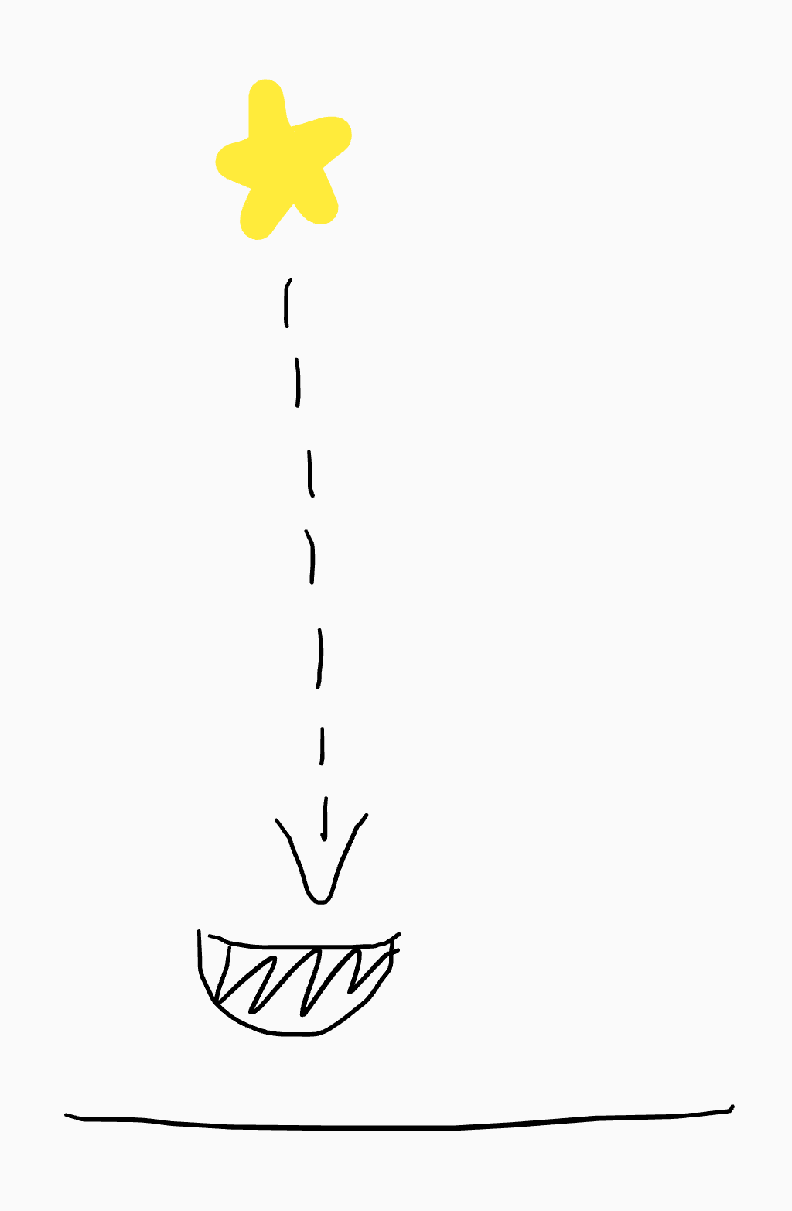
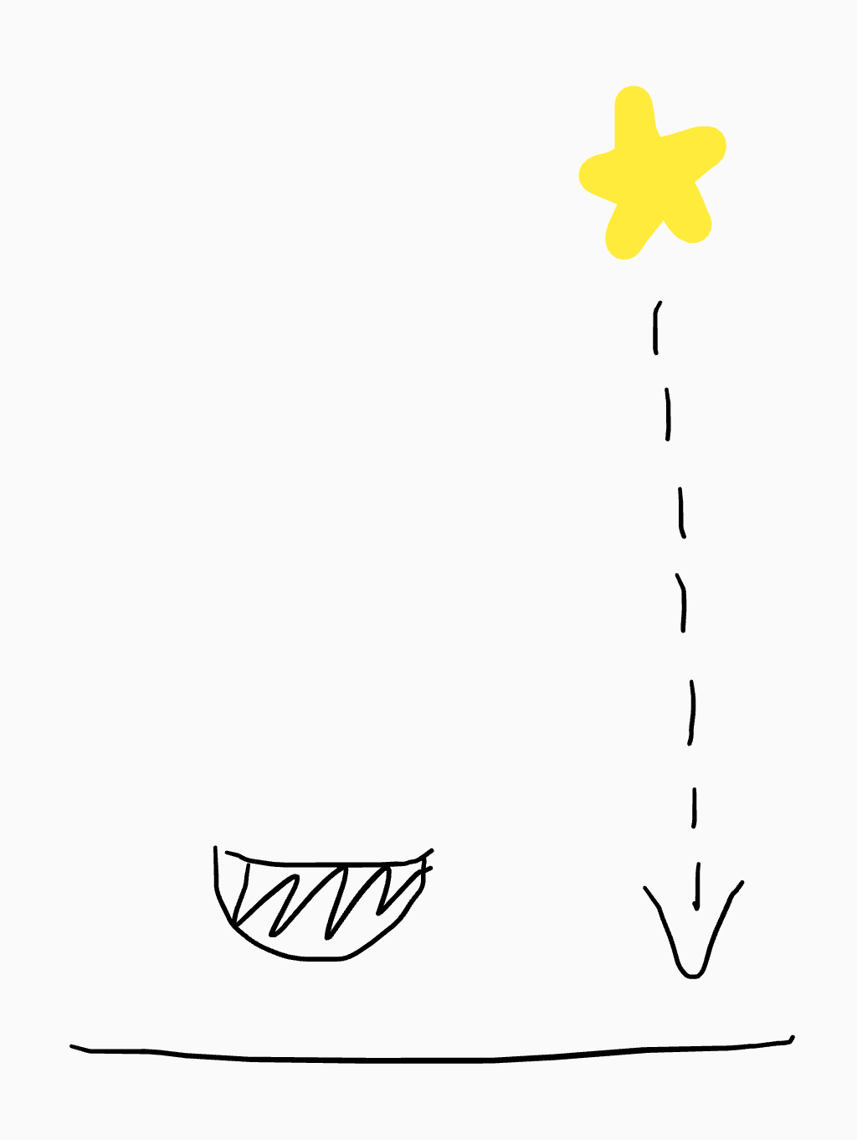
Algorithm for the falling star
Activity 2
The falling star moves down by eight from a random x position at the top of the screen.
If the sprite falls onto the bowl, change the score by three. It falls again from a random x position at the top of the screen.
If the falling star touches the screen bottom, it falls again from a random x position at the top of the screen.
Falling star
+3 points
Bowl

Slide 9
Design your algorithms
Activity 2
Add algorithms for the two new sprites to the design template. Each algorithm should include a drawing and a description.
Design suggestions:
Each sprite should change the score by a different amount (you could use a negative number)
Each sprite can move at a different speed
Sprites can be different sizes
Make sure that any design choices are included in your algorithms.

Slide 10

Explain your design
Activity 3
Explain your design to a partner.
What artwork have you chosen?
What speed does each sprite fall down the screen?
How does the bowl move?
What happens when a sprite is caught by the bowl?
What happens when a sprite reaches the bottom of the stage?
Notes:
Image source: https://pixabay.com/illustrations/balloon-to-speak-language-german-2557031/

Slide 11

Think, pair, share
Plenary
Are there other algorithms already represented as code in your project?
What are they?
Notes:
Image source: https://pixabay.com/photos/question-question-mark-help-2309040/

Slide 12

Assessment
How confident are you? (1–3)
I can choose the artwork for my project
I can create algorithms for my project
I can explain my design choices
3 – Very confident
2 – Unsure
1 – Not confident
Notes:
Image source: https://pixabay.com/vectors/thumb-up-hand-like-confirm-go-top-307176

Slide 13
Next lesson
Summary
In this lesson, you…
Designed your own project, including variables
Next lesson, you will…
Create a project, based on your design

