Slide 1
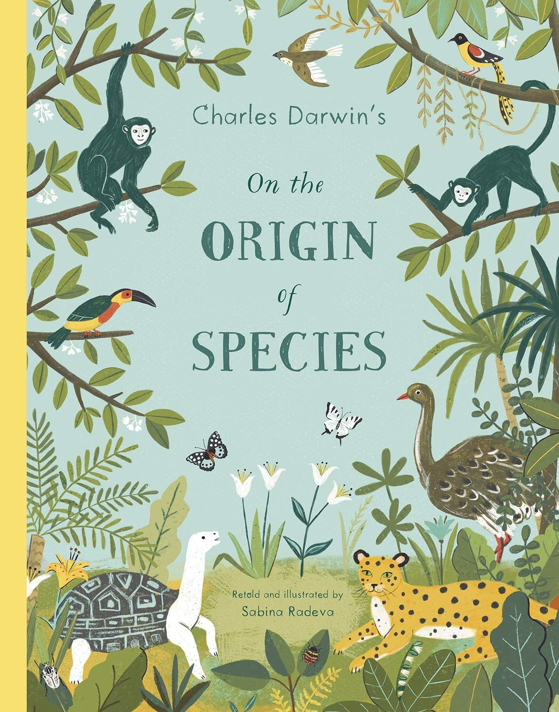
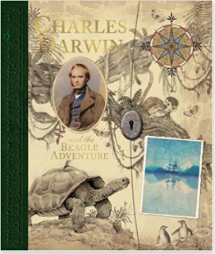
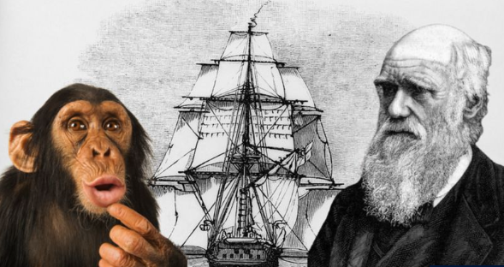

Monday
Retrieve: What can you tell me that you can prove is definitely correct?
Predict: What do you think these books are going to be about?
Explain: Do you think you will like any of these extracts? Why?
Links: How are the three images above linked?
Notes:
This page should include images related to the three extracts (book covers, etc) with 4 questions based on these images.

Slide 2

Tuesday - Vocabulary Corner
SOAR WITH SEVEN
Although not entirely new, it was a radical idea at the time…
Both his grandfathers had a really big influence on Charles.
This book discussed a very controversial idea – transmutation…
After inheriting those traits, the cubs would be even better…
There, and on other parts of his journey, he carefully observed…
…some had a knack for catching insects, but all of them descended…
…people were shocked by the idea that humans shared a common ancestor…
My Word: ______________________________
Word class: ______________________________
Dictionary Definition: __________________________________________________________________________________
Synonym: ______________________________
Antonym: ______________________________
Word in a Sentence: ___________________________________________________________________________________
Notes:
Vocabulary Corner in UKS2 should always include 7 pieces of new vocabulary, presented as they appear in the extract.

Slide 3

Read the Newsround Article 'Charles Darwin Day' -
https://www.bbc.co.uk/newsround/60303621
Rapid Retrieval
SOAR WITH SEVEN
What type of books did Charles Darwin write?
What was Darwin’s face on?
Who were big influences on Darwin?
What is evolution?
True or false - Darwin trained to be a doctor?
Find and copy a word which shows Darwin had more than an interest in Biology.
In what year did Darwin release his book?
EXT: Write your own retrieval question.
Notes:
Rapid Retrieval should always feature a mix of 7 retrieval questions of different types based on the extract for that day. The EXT question must always be included.

