Slide 1


Slide 3

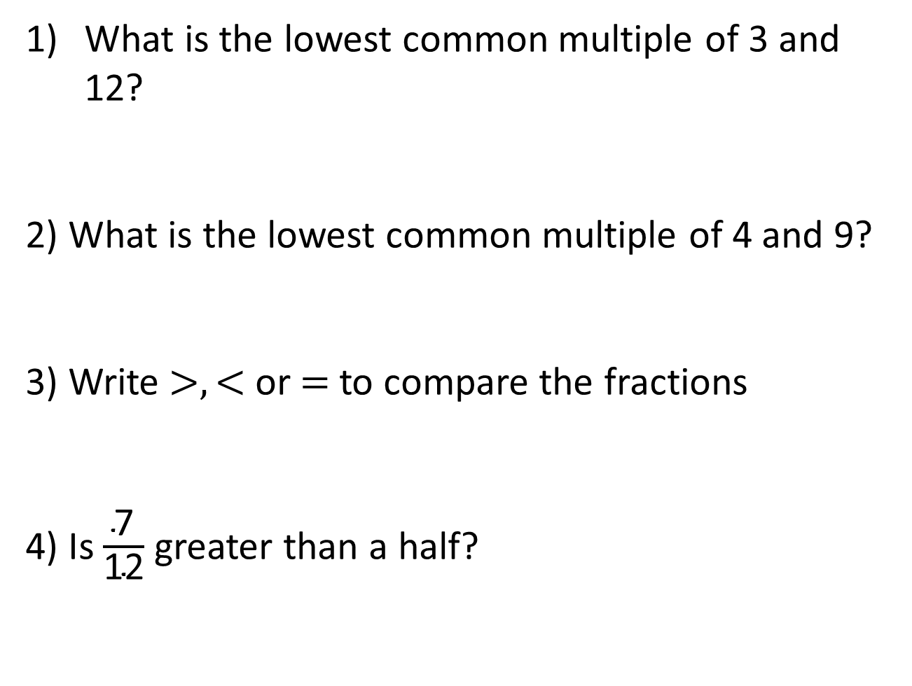
What is the lowest common multiple of 3 and 12?
2) What is the lowest common multiple of 4 and 9?
3) Write $>, <$ or $=$ to compare the fractions
4) Is $\frac{\text{7}}{\text{12}}$ greater than a half?
$\frac{\text{5}}{\text{6}}$ $\frac{\text{2}}{\text{3}}$

Slide 4

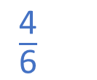

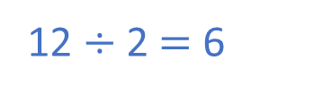
What is the lowest common multiple of 3 and 12?
2) What is the lowest common multiple of 4 and 9?
3) Write $>, <$ or $=$ to compare the fractions
4) Is $\frac{\text{7}}{\text{12}}$ greater than a half?
12
Multiples of 3: 3, 6, 9, 12
Multiples of 9: 9, 18, 27, 36
36
$\frac{\text{5}}{\text{6}}$ $\frac{\text{2}}{\text{3}}$
$×$ 2
$\frac{\text{4}}{\text{6}}$
$$>$$
Yes
12 $÷$ 2 $=$ 6

Slide 6






Write $>, <$ or $=$ to compare the fractions
$\frac{\text{4}}{\text{9}}$ $\frac{\text{4}}{\text{5}}$
$$<$$
$\frac{\text{2}}{\text{3}}$ $\frac{\text{2}}{\text{7}}$
$$>$$
What’s the same and what’s different?
What do you notice?
Have a think

Slide 7


Write $>, <$ or $=$ to compare the fractions
$\frac{\text{4}}{\text{9}}$ $\frac{\text{4}}{\text{5}}$
$$<$$
$\frac{\text{2}}{\text{3}}$ $\frac{\text{2}}{\text{7}}$
$$>$$
What’s the same and what’s different?
What do you notice?
greater
smaller
When the numerators are the same, the the denominator, the the fraction.
greater
smaller

Slide 8
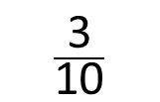
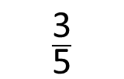
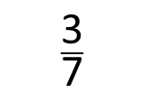
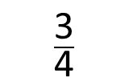
Put the following fractions in order from greatest to smallest.
When the numerators are the same, the smaller the denominator, the greater the fraction.
$\frac{\text{3}}{\text{4}}$
$\frac{\text{3}}{\text{7}}$
$\frac{\text{3}}{\text{5}}$
$\frac{\text{3}}{\text{10}}$
Have a think

Slide 9
Have a go at questions 1 – 4 on the worksheet

Slide 10


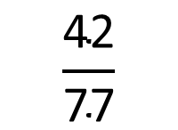



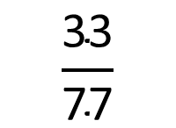

Write $>, <$ or $=$ to compare the fractions
$\frac{\text{3}}{\text{7}}$ $\frac{\text{6}}{\text{11}}$
$$<$$
Multiples of 7: 7, 14, 21, 28, 35, 42, 49, 56, 63, 70, 77, 84
Multiples of 11: 11, 22, 33, 44, 55, 66, 77, 88, 99, 110
$\frac{\text{3}}{\text{7}}$ $\frac{\text{6}}{\text{11}}$
$×$ 11
$×$ 7
$$\frac{\text{33}}{\text{77}}$$
$$\frac{\text{42}}{\text{77}}$$

Slide 11

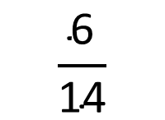

Write $>, <$ or $=$ to compare the fractions
$\frac{\text{3}}{\text{7}}$ $\frac{\text{6}}{\text{11}}$
$$<$$
When the numerators are the same, the greater the denominator, the smaller the fraction.
$\frac{\text{3}}{\text{7}}$ $\frac{\text{6}}{\text{11}}$
$\frac{\text{3}}{\text{7}}$ $\frac{\text{6}}{\text{11}}$
$×$ 11
$×$ 7
$×$ 2
$$\frac{\text{33}}{\text{77}}$$
$$\frac{\text{42}}{\text{77}}$$
$$\frac{\text{6}}{\text{14}}$$

Slide 12





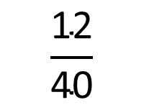



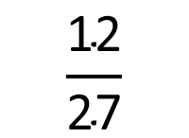
Write $>, <$ or $=$ to compare the fractions
$\frac{\text{3}}{\text{10}}$ $\frac{\text{12}}{\text{37}}$
$\frac{\text{4}}{\text{9}}$ $\frac{\text{10}}{\text{27}}$
$$<$$
$$>$$
$×$ 4
$×$ 3
$$\frac{\text{12}}{\text{40}}$$
$$\frac{\text{12}}{\text{27}}$$
2 $\frac{\text{3}}{\text{8}}$ 2 $\frac{\text{1}}{\text{5}}$
Have a think

Slide 13
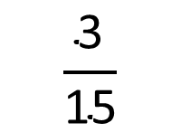



Write $>, <$ or $=$ to compare the fractions
2 $\frac{\text{3}}{\text{8}}$ 2 $\frac{\text{1}}{\text{5}}$
$$>$$
$\frac{\text{3}}{\text{8}}$ $\frac{\text{1}}{\text{5}}$
$×$ 3
$$\frac{\text{3}}{\text{15}}$$

Slide 14
Have a go at the rest of the questions on the worksheet

