Slide 1

Wednesday - Vocabulary Corner
SOAR WITH SEVEN
Darwin had arranged to send batches of carefully packed and labelled specimens…
… Darwin did not trust his precious specimens to the hazards of transfer…
Surveying was slow, tedious work…
…the Navy did not agree with this decision and refused to reimburse him.
The seas around the tip of South America are notorious for being…
… when many of his precious specimens were irretrievably damaged…
… a few dozen miles from the western foothills of the Andes mountains.
My Word: ______________________________
Word class: ______________________________
Dictionary Definition: __________________________________________________________________________________
Synonym: ______________________________
Antonym: ______________________________
Word in a Sentence: ___________________________________________________________________________________

Slide 2

Read the South America spread from Charles Darwin and the Beagle Adventure -
https://www.lovereading4kids.co.uk/extract/3909/Charles-Darwin-and-the-Beagle-Adventure-by-Amanda-Wood.html
Rapid Retrieval
SOAR WITH SEVEN
What was the Beagle?
Where was Darwin completing his coastal survey?
When did Darwin begin to feel like a real explorer?
Who made the the first detailed drawing of a dusky dolphin?
What was the name given to the light that danced around the ships masts?
Find and copy a word which shows that FitzRoy decided himself to get the two skippers.
For how long did Darwin & FitzRoy travel upriver?
EXT: Write your own retrieval question.

Slide 3

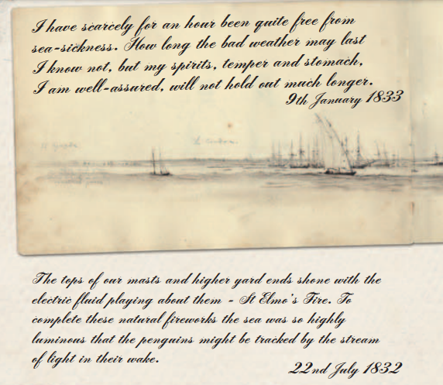
Time To Talk…
Throughout the extract, the style of writing changes – why do you think the author did this? Explain your answer.
EXT: What else has been done in this extract to engage the reader?

Slide 4

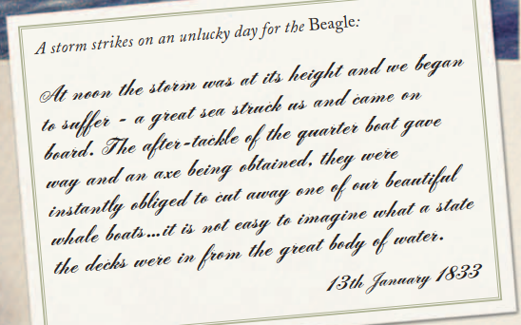
Think for yourself…
‘We began to suffer’ – what do you think is meant by this phrase?
EXT: Explain two consequences of the storm.

Slide 5
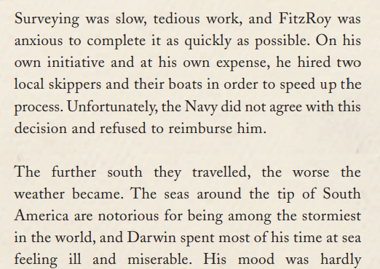
Time To Talk…
Why do you think the Navy didn’t agree with the decision – explain your answer.
EXT: What words have been used here to suggest that Darwin didn’t enjoy the trip?

Slide 6
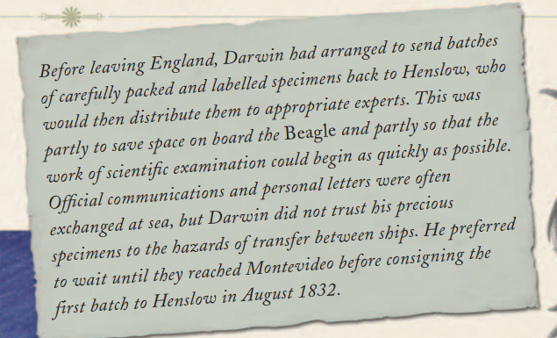
Think for yourself…
Why do you think Darwin didn’t trust the ships when sending batches of specimens to experts?
EXT: Can you think of any downsides to involving others in this work?

Slide 7
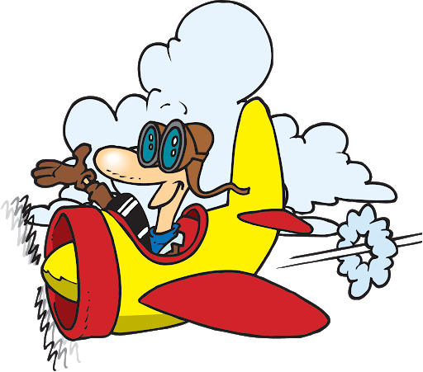
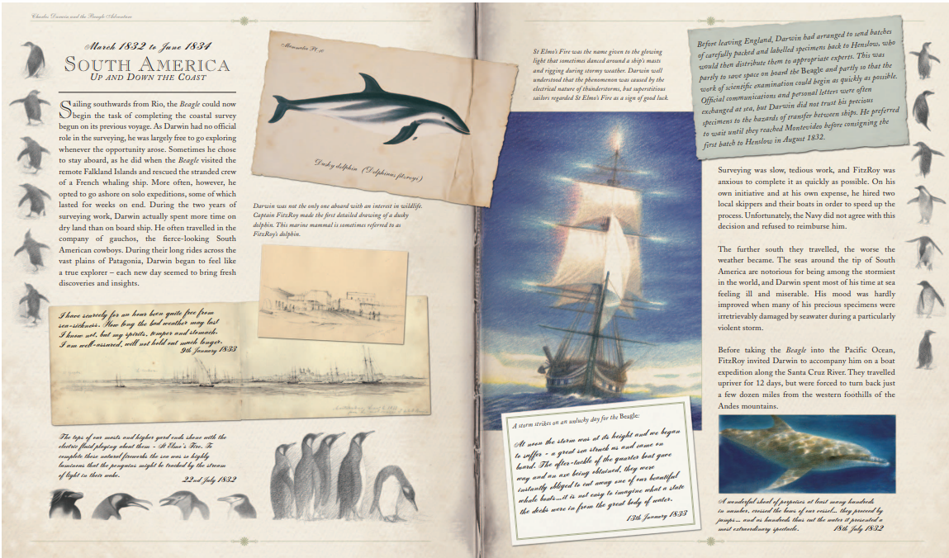
Flying Solo…
Why do you think surveying was slow and tedious work?
Choose one word to explain how Darwin might have felt when some of his specimens were damaged. Explain your choice of word.
Choose a different word to explain how Darwin might have felt he was forced to turn back. Explain your choice of word.
EXT: Summarise the South America expedition in three sentences.

Slide 8

CHALLENGE:
Write a tweet as if you are Darwin on one of the survey explorations. Try and explain to your followers how your journey has been so far.

