Slide 1


Slide 3

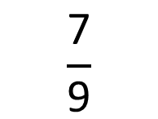
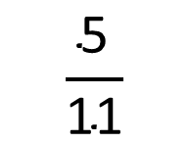

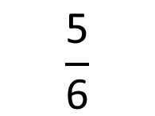


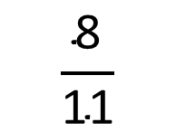
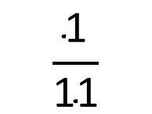

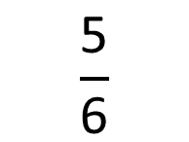
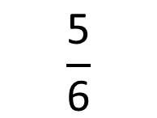
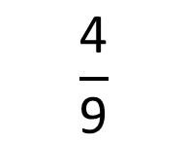


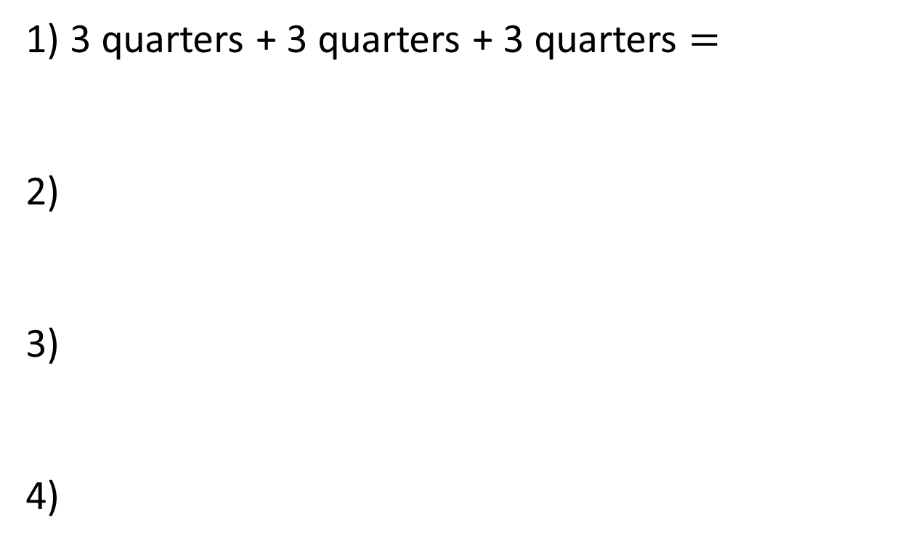
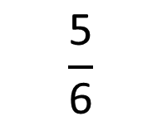


1) 3 quarters + 3 quarters + 3 quarters $=$
2)
3)
4)
$$\frac{\text{5}}{\text{6}}$$
$$\frac{\text{5}}{\text{6}}$$
$$\frac{\text{5}}{\text{6}}$$
$$\frac{\text{5}}{\text{6}}$$
$$+$$
$$+$$
$$+$$
$$=$$
$$\frac{\text{7}}{\text{9}}$$
$$\frac{\text{4}}{\text{9}}$$
$$−$$
$$=$$
$$\frac{\text{8}}{\text{11}}$$
$$\frac{\text{5}}{\text{11}}$$
$$\frac{\text{1}}{\text{11}}$$
$$−$$
$$−$$
$$=$$

Slide 4
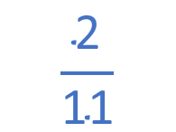
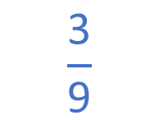
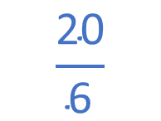
1) 3 quarters + 3 quarters + 3 quarters $=$
2)
3)
4)
9 quarters
$$\frac{\text{5}}{\text{6}}$$
$$\frac{\text{5}}{\text{6}}$$
$$\frac{\text{5}}{\text{6}}$$
$$\frac{\text{5}}{\text{6}}$$
$$\frac{\text{20}}{\text{6}}$$
$$+$$
$$+$$
$$+$$
$$=$$
$$\frac{\text{7}}{\text{9}}$$
$$\frac{\text{4}}{\text{9}}$$
$$\frac{\text{3}}{\text{9}}$$
$$−$$
$$=$$
$$\frac{\text{8}}{\text{11}}$$
$$\frac{\text{5}}{\text{11}}$$
$$\frac{\text{1}}{\text{11}}$$
$$\frac{\text{2}}{\text{11}}$$
$$−$$
$$−$$
$$=$$

Slide 6




They’ve eaten $\frac{\text{4}}{\text{15}}$ of the bar
Charlie eats $\frac{\text{1}}{\text{5}}$ of the chocolate bar.
Suzie eats $\frac{\text{3}}{\text{10}}$ of the chocolate bar.
How much have they eaten altogether?
Have a think

Slide 7


Charlie eats $\frac{\text{1}}{\text{5}}$ of the chocolate bar.
Suzie eats $\frac{\text{3}}{\text{10}}$ of the chocolate bar.
$\frac{\text{5}}{\text{10}}$ of the bar is eaten.

Slide 8
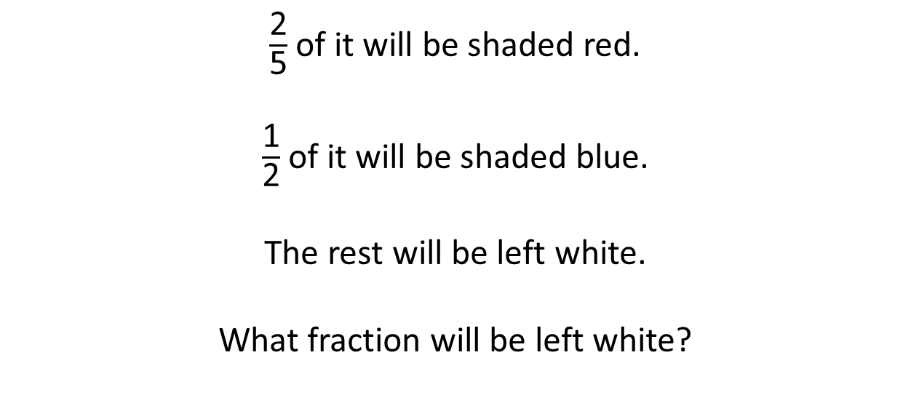
Have a think
Here is a strip of paper.
$\frac{\text{2}}{\text{5}}$ of it will be shaded red.
$\frac{\text{1}}{\text{2}}$ of it will be shaded blue.
The rest will be left white.
What fraction will be left white?

Slide 9
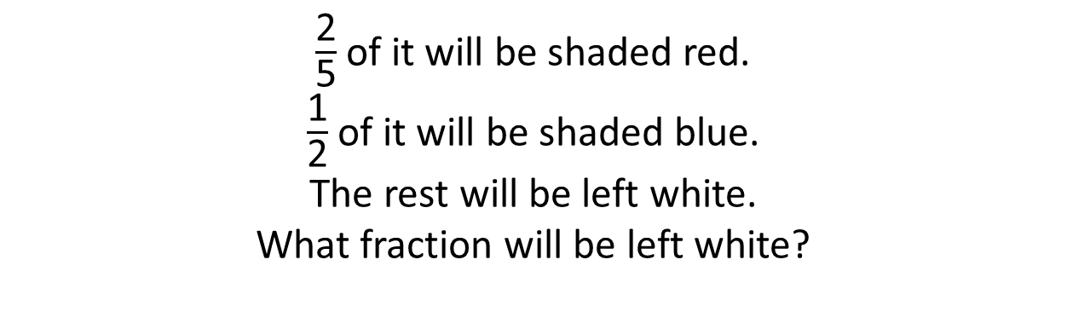
$\frac{\text{1}}{\text{10}}$ will be left white.
$\frac{\text{2}}{\text{5}}$ of it will be shaded red.
$\frac{\text{1}}{\text{2}}$ of it will be shaded blue.
The rest will be left white.
What fraction will be left white?

Slide 10


Use the bar models to solve:
Have a think
$$\frac{\text{7}}{\text{12}}−\frac{\text{1}}{\text{4}}=$$
$$\frac{\text{7}}{\text{12}}+\frac{\text{1}}{\text{4}}=$$

Slide 11
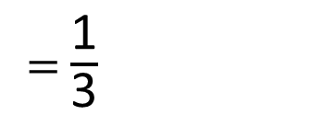
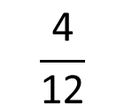


Use the bar models to solve:
$$\frac{\text{7}}{\text{12}}−\frac{\text{1}}{\text{4}}=$$
$$\frac{\text{4}}{\text{12}}$$
$=$ $\frac{\text{1}}{\text{3}}$
$$\frac{\text{7}}{\text{12}}+\frac{\text{1}}{\text{4}}=$$

Slide 12
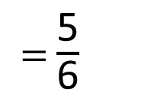
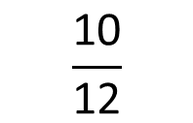


Use the bar models to solve:
$$\frac{\text{7}}{\text{12}}−\frac{\text{1}}{\text{4}}=$$
$$\frac{\text{10}}{\text{12}}$$
$$\frac{\text{7}}{\text{12}}+\frac{\text{1}}{\text{4}}=$$
$=$ $\frac{\text{5}}{\text{6}}$

Slide 13
Have a go at questions 1 – 5 on the worksheet

Slide 14
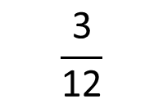

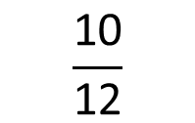
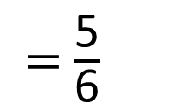


$$\frac{\text{7}}{\text{12}}+\frac{\text{1}}{\text{4}}$$
$×$ 3
$$\frac{\text{3}}{\text{12}}$$
$$\frac{\text{7}}{\text{12}}+\frac{\text{3}}{\text{12}}=$$
$$\frac{\text{10}}{\text{12}}$$
$=$ $\frac{\text{5}}{\text{6}}$

Slide 15
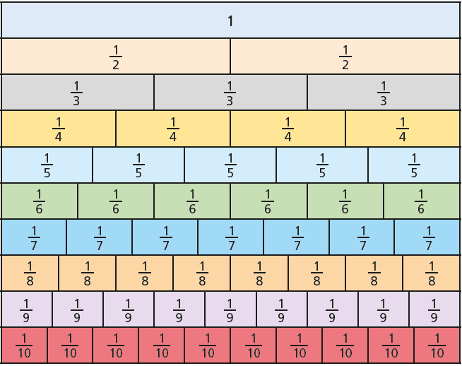
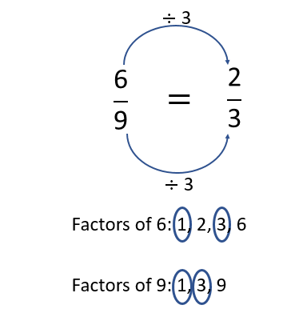
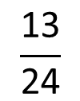
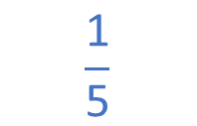

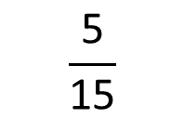



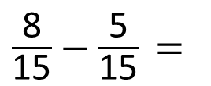
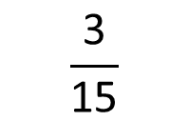
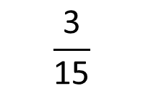

Have a think
$$\frac{\text{8}}{\text{15}}−\frac{\text{1}}{\text{3}}$$
$$\frac{\text{3}}{\text{8}}+ \frac{\text{1}}{\text{6}} =$$
$$\frac{\text{13}}{\text{24}}$$
$×$ 5
$$\frac{\text{5}}{\text{15}}$$
$\frac{\text{8}}{\text{15}}−\frac{\text{5}}{\text{15}}$ $=$
$$\frac{\text{3}}{\text{15}}$$
$÷$ 3
Factors of 3: 1, 3
$$\frac{\text{3}}{\text{15}}$$
$$\frac{\text{1}}{\text{5}}$$
Factors of 15: 1, 3, 5, 15
$÷$ 3

Slide 16
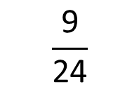



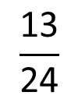
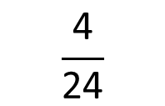

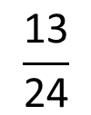

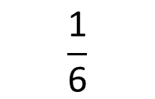
$$\frac{\text{3}}{\text{8}}+ \frac{\text{1}}{\text{6}} =$$
$$\frac{\text{13}}{\text{24}}$$
$×$ 3
$$\frac{\text{9}}{\text{24}}$$
$$\frac{\text{13}}{\text{24}}$$
$$\frac{\text{9}}{\text{24}} + \frac{\text{4}}{\text{24}} =$$
$÷$ 4
$$\frac{\text{4}}{\text{24}}$$
$$\frac{\text{1}}{\text{6}}$$
$÷$ 4

Slide 17


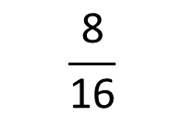

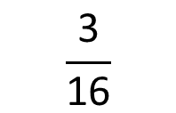
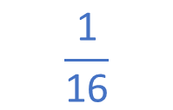
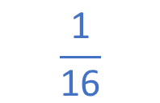

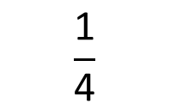
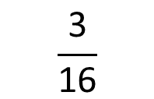
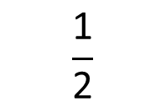
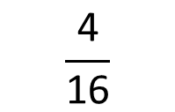
Dexter has $\frac{\text{1}}{\text{2}}$ a tin of paint.
He then uses $\frac{\text{3}}{\text{16}}$ of the tin to paint the bathroom
and $\frac{\text{1}}{\text{4}}$ of the tin to paint the kitchen.
$$\frac{\text{1}}{\text{16}}$$
How much paint does Dexter have left?
$$\frac{\text{1}}{\text{2}}$$
$$\frac{\text{8}}{\text{16}}$$
$$\frac{\text{3}}{\text{16}}$$
$$\frac{\text{1}}{\text{4}}$$
$$\frac{\text{3}}{\text{16}}$$
$$\frac{\text{4}}{\text{16}}$$
$$\frac{\text{1}}{\text{16}}$$
?

Slide 18
Have a go at the rest of the questions on the worksheet

