Slide 1

Vocabulary Corner
SOAR WITH SEVEN
… opened people's eyes to the incredible diversity of life on Earth.
In a shed in his back garden, he had a makeshift chemistry laboratory…
But medical procedures were carried out without anaesthetic…
Henslow soon became a mentor of Darwin̕s, and would eventually…
The revolutionary ideas about evolution and natural selection…
Darwin had seen on the mainland, but they had certain characteristics…
… more likely to survive and produce more offspring.
My Word: ______________________________
Word class: ______________________________
Dictionary Definition: __________________________________________________________________________________
Synonym: ______________________________
Antonym: ______________________________
Word in a Sentence: ___________________________________________________________________________________

Slide 2

Read the first four spreads (Who was Charles Darwin, Ideas of the Time, Voyage of Discovery and Darwin's Great Idea) from Charles Darwin's On The Origin of Species -
https://www.lovereading4kids.co.uk/extract/18031/Charles-Darwins-On-the-Origin-of-Species-by-Anna-Brett.html
Rapid Retrieval
SOAR WITH SEVEN
Which of Darwin’s theories is the best explanation for how species adapt?
Where was Darwin from?
Who did Darwin carry out experiments with in his shed?
Why didn’t Darwin pursue medicine?
Find and copy a word which shows Darwin wanted to go on the Beagle to South America
Where inspired Darwin the most?
By the end of his voyage – how many kilometres had Darwin sailed?
EXT: Write your own retrieval question.

Slide 3

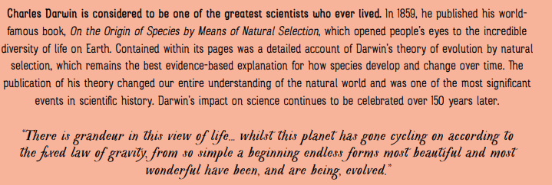
Time To Talk…
Looking at the quote below the paragraph – what understanding do you gain from it?
EXT: Explain what it means to ‘open people’s eyes.’

Slide 4

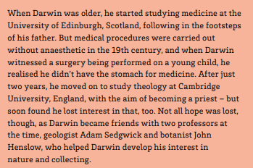
Think for yourself…
What do you think the author means by ‘ following in the footsteps of his father’. Explain your answer.
EXT: If you could choose to follow in someone’s footsteps, who would you choose? Why?

Slide 5
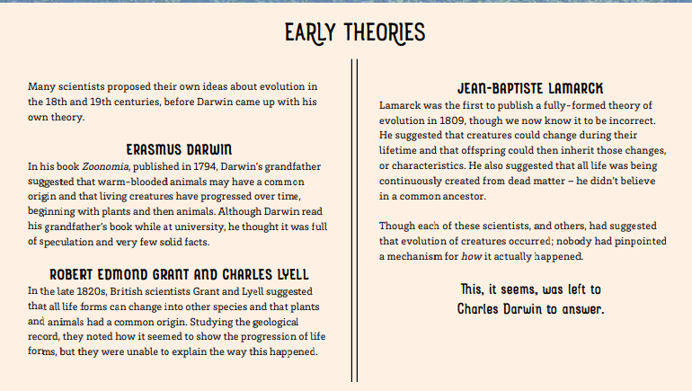
Time To Talk…
How did Darwin’s theories differ from these theories? Explain your answer.
EXT: How do you think these people felt when Darwin revealed his work?

Slide 6
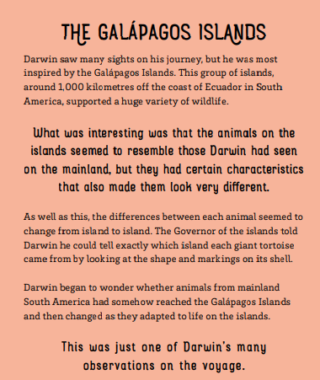
Think for yourself…
Why do you think Darwin was most inspired after visiting here?
EXT: Why do you think there is such variety of life on the Galapagos Islands?

Slide 7
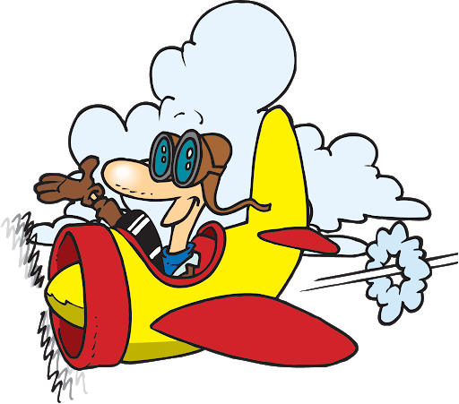
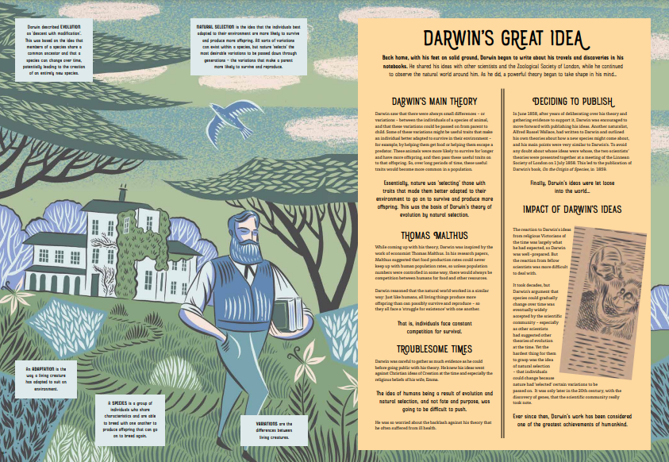
Flying Solo…
What was Darwin’s main theory?
Why was Thomas Malthus important to Darwin?
Discuss what impact you think Darwin had on humankind?
EXT: This book claims that Darwin was one of the greatest scientists who ever lived. Do you agree? Why?

Slide 8
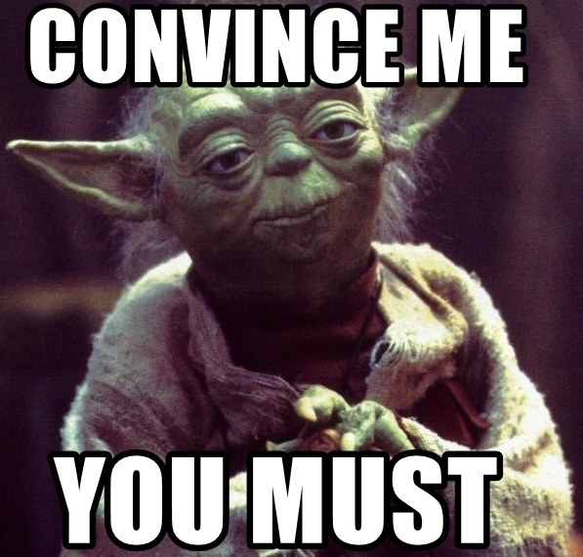
CHALLENGE:
Convince me that you understand Darwin’s theory of Natural selection.

Slide 9

Friday
This lesson should be used to complete a comprehension activity with your class, using either your class novel or an ‘at distance’ extract.
Children could work individually or in groups, with support as appropriate.
Notes:
No changes need to be made here.

