Slide 2
KS2
Katherine Johnson Presentation

Slide 4

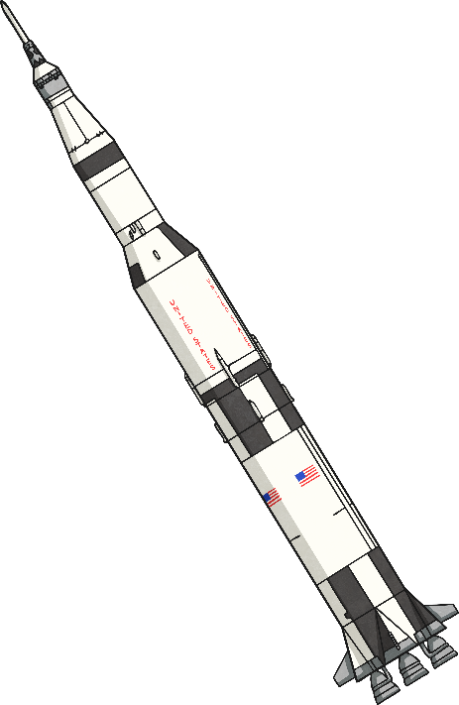
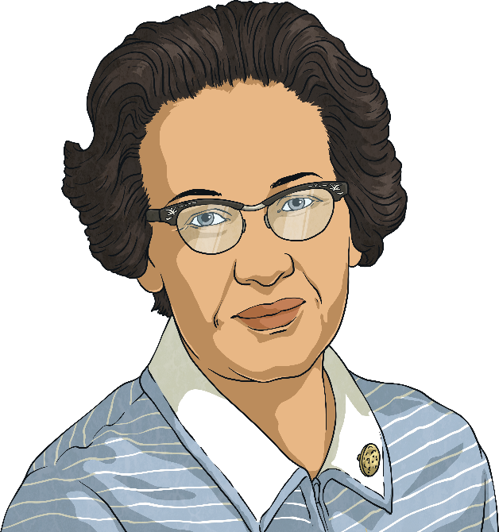

Katherine Johnson
Katherine Johnson loved numbers and mathematics. She worked for NASA, which is a special organisation that sends people to space. Katherine loved her job and was always finding new ways to explore space.
NASA stands for the National Aeronautics and Space Administration. The organisation is in charge of the science behind all things to do with space and space travel in the USA.

Slide 5

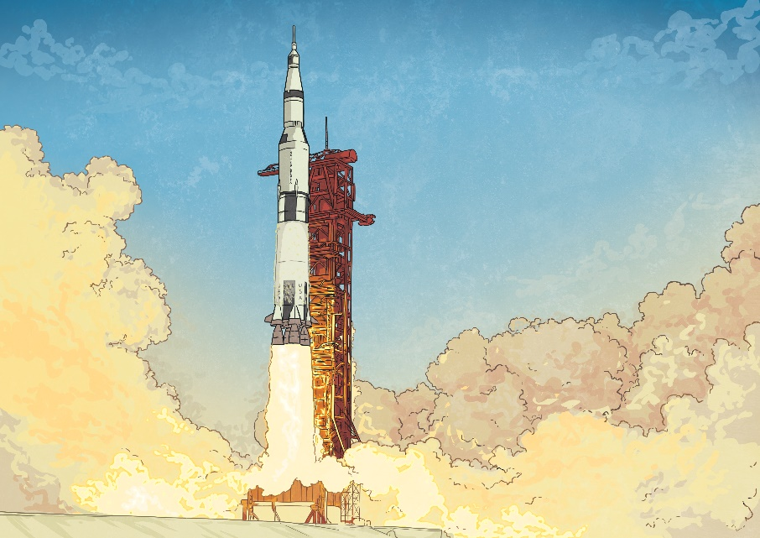
What Did She Do?
Katherine was really good at doing calculations and she used her skills to help astronauts go to space safely. She helped to launch rockets and bring them back to earth. One of the most important missions she worked on was the Apollo 11 moon landing in 1969.
In 1969, there were no calculators, computers or mobile phones. Instead, people had the role of doing the calculations that a computer would do today. Katherine was known as a ‘human computer’. She used her mathematical skills and knowledge to make predictions about the flight paths NASA needed to send their machines to outer space.

Slide 6
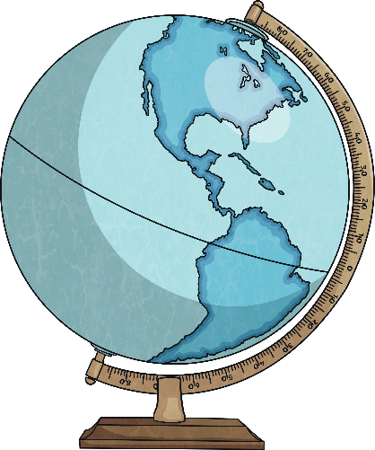
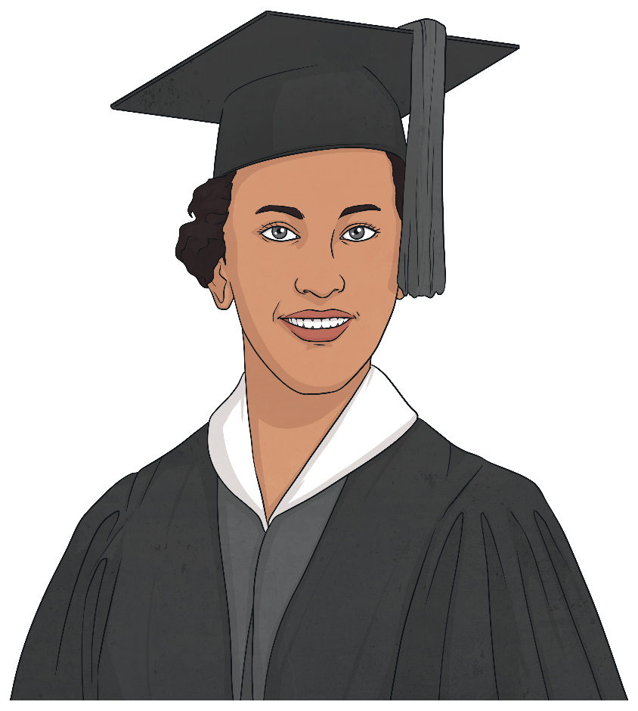
Early Life
Katherine Johnson was born on 26th August 1918 in West Virginia, United States of America (USA).
Her journey to becoming a mathematician started from a young age. As a child, she always loved counting and would use every opportunity she had to do so.
Because of her impressive skills, she started high school at only 10 years old, before any of her older siblings. When Katherine was 14 years old, she went to study French and Mathematics at West Virginia State University. She graduated from university at 18 years old, which is the time most people start at university!

Slide 7
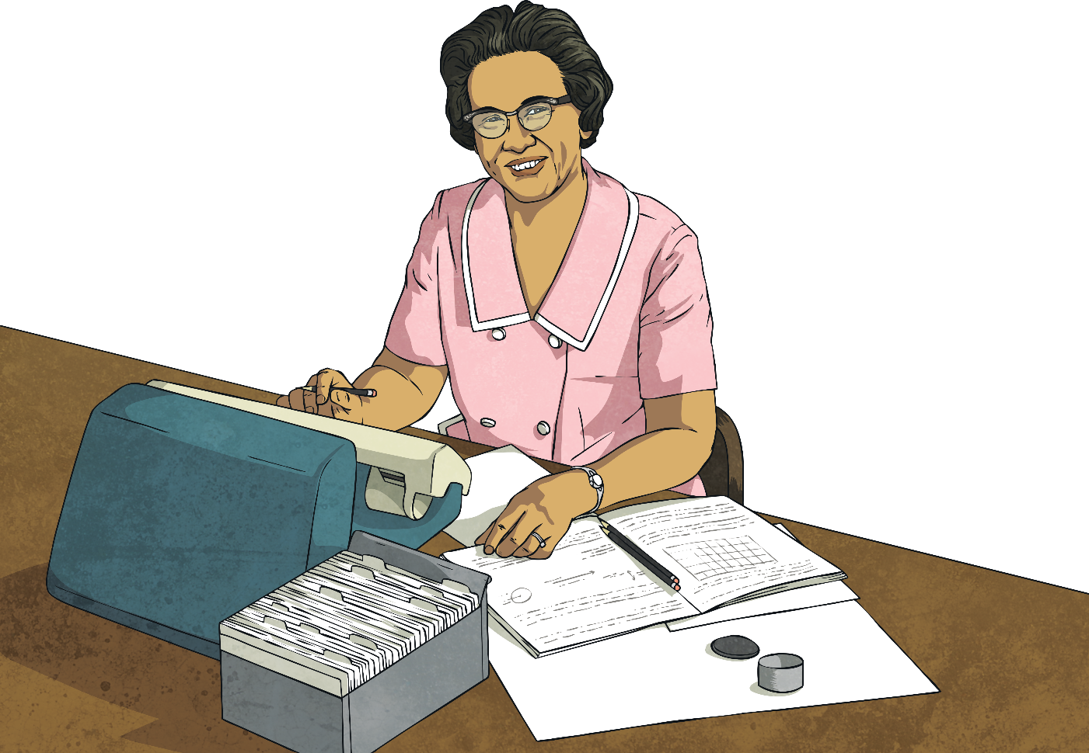
Early Life
Once she graduated, Katherine heard NASA were hiring women for the role of ‘computers’, especially those of African American heritage.
When Katherine applied for the job unfortunately all the roles were taken. However, she didn’t let that stop her. Katherine took the opportunity and wrote a detailed letter to NASA explaining why she was the right person for the job. NASA did not realise until Katherine began working for them, just how valuable she was to the team.

Slide 8
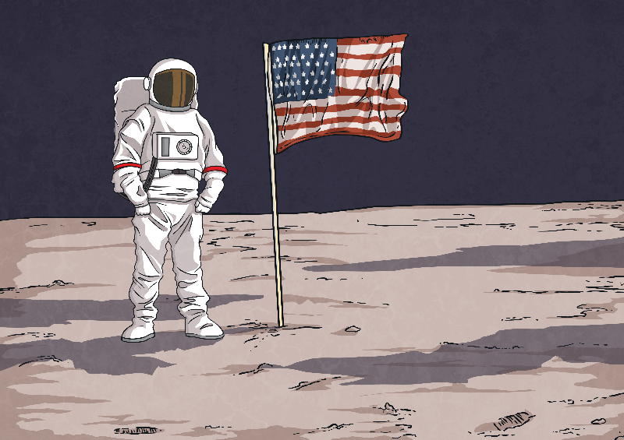
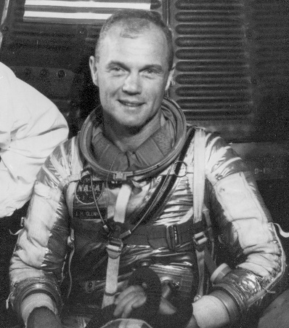
Key Achievements
Katherine’s mind and mathematical skills helped NASA send the first machine to orbit the Earth. It also helped the first team of astronauts, including Neil Armstrong, to walk on the moon and safely return back to Earth in 1969. This mission is very significant in history, and a great success for technology in spaceflight.
Did You Know…?
Astronaut John Glenn refused to set off on a space mission until Katherine had checked the calculations.

Slide 9
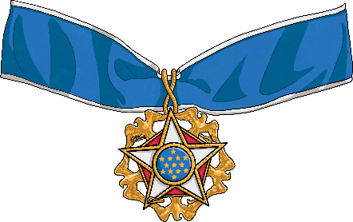
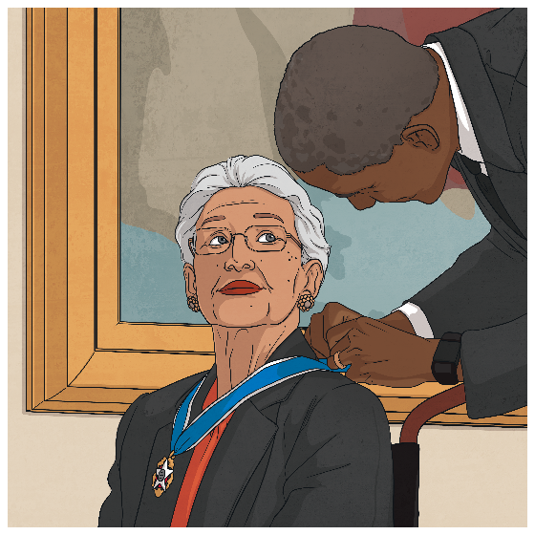
Key Achievements
Katherine received many awards throughout her career for her amazing work. She made important, correct predictions and made sure space missions were both safe and successful.
Katherine was awarded the ‘Presidential Medal of Freedom’ in 2015 by the president of the USA at the time, Barack Obama.
Katherine Johnson passed away on 24th February 2020, leaving behind a legacy in the field of mathematics and space exploration. Her dedication and hard work will always be remembered.
Presidential Medal of Freedom - The highest honour a person can receive from the President of the United States of America

Slide 10



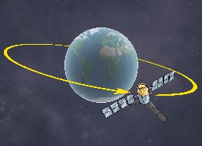
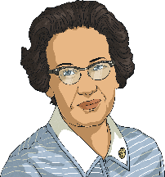

What We’ve Learnt
Can you write down three facts you’ve learnt about Katherine Johnson and share them with the class?
Katherine Johnson was seen as a brilliant mathematician.
She worked for NASA and helped send astronauts and machines to outer space. Her calculations were important for this to be a success.
Katherine received the Presidential Freedom Medal for her achievements.

Slide 11


Time to Reflect
Even when, computer machines were introduced, Katherine Johnson’s role was still crucial. She carried on with her computing job at NASA until 1986. Her work influenced important space programmes throughout her time working there.
How do you think it made Katherine feel to make such important decisions about important space missions?
Do you think the job was easy or difficult?
Would you ever consider working at NASA?

