Slide 1

Meet the Teacher
Year 5
Mr N Benson and Mrs N Metcalf
TAs- Mrs J Phillipson and Mrs A Knight
Notes:
NB - Unique opportunity for the children. Never done this before where both classes move up.

Slide 2
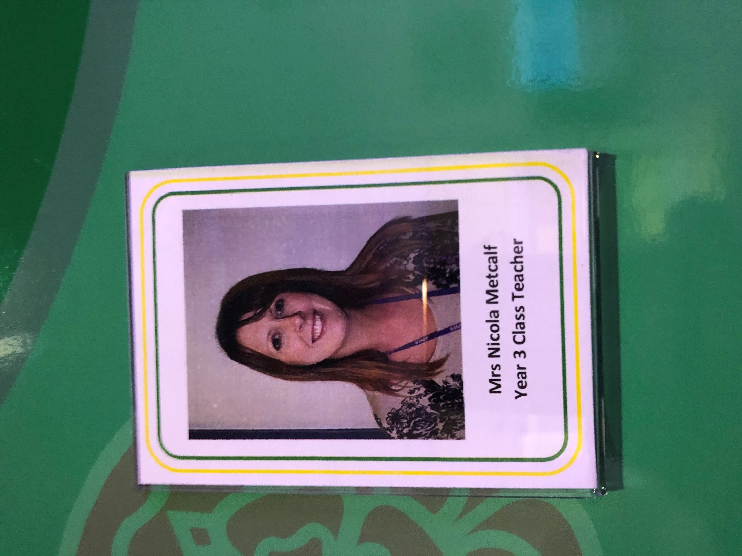
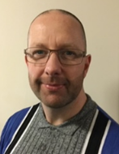
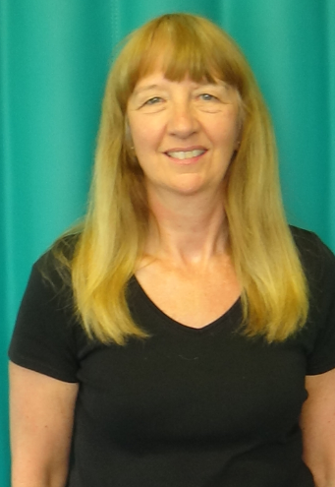
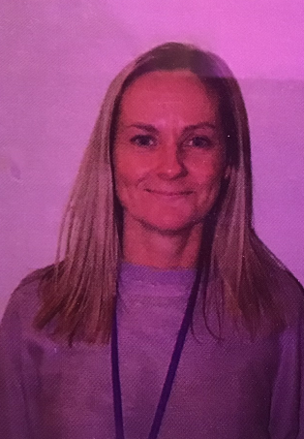
Meet the Year 5 staff
Mrs Metcalf
Mr Benson
Mrs Phillipson
Mrs Knight

Slide 3
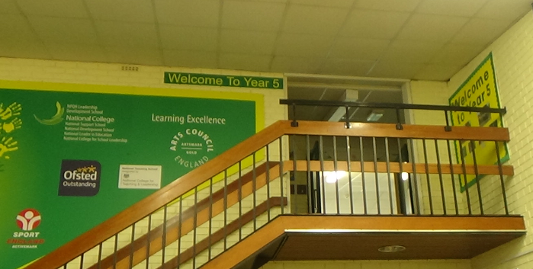
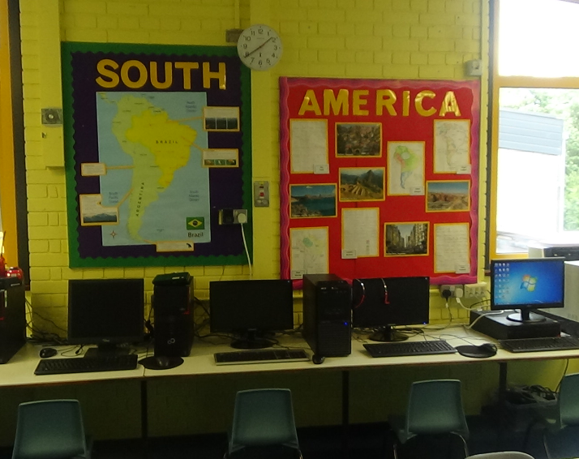
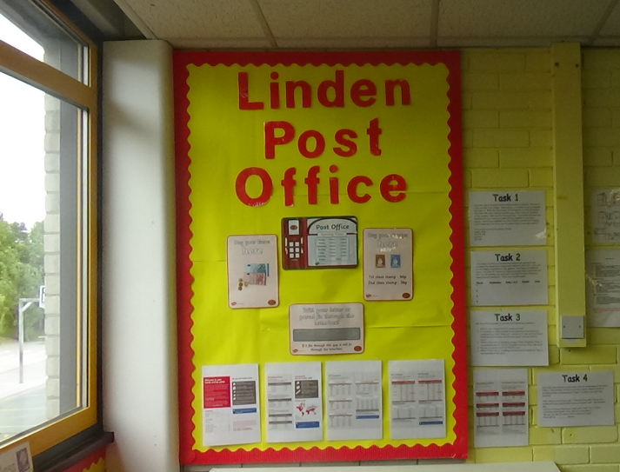
Year 5 learning areas
Welcome to Year 5
Middle area computers
Role play area

Slide 4
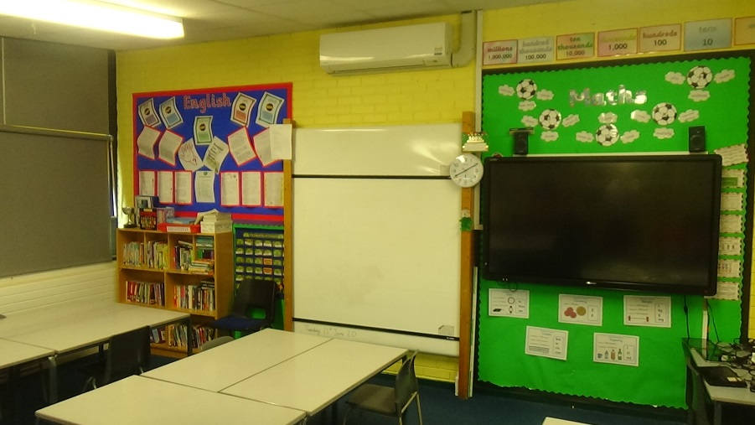
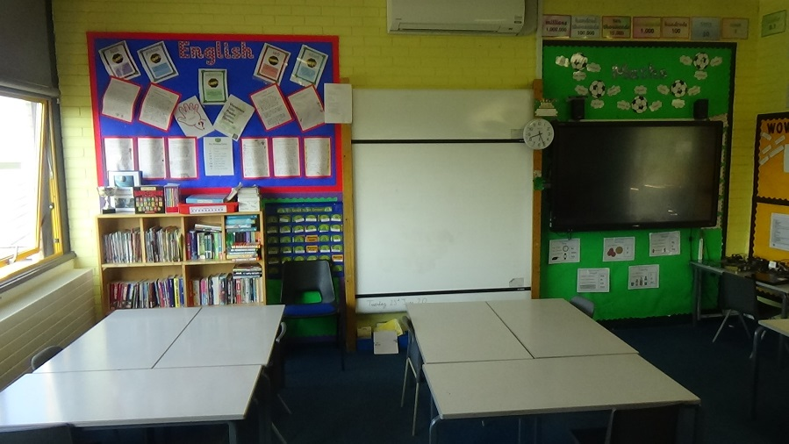
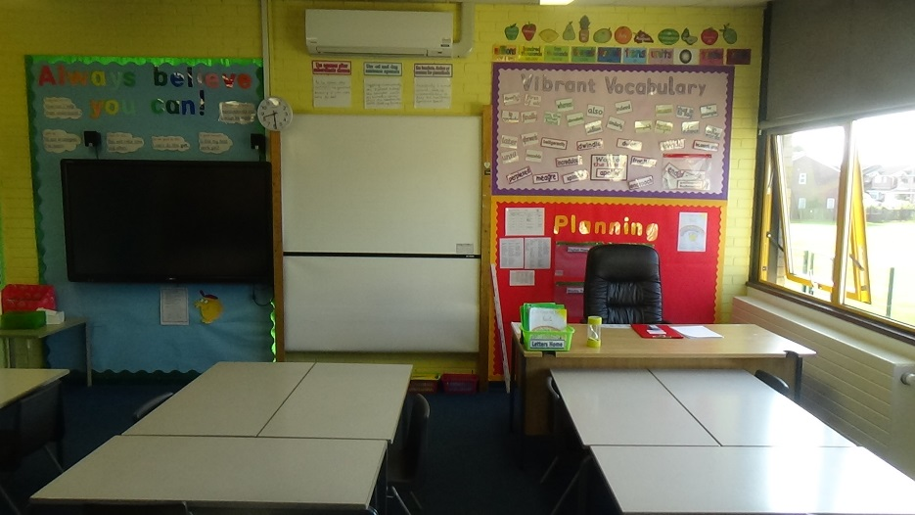
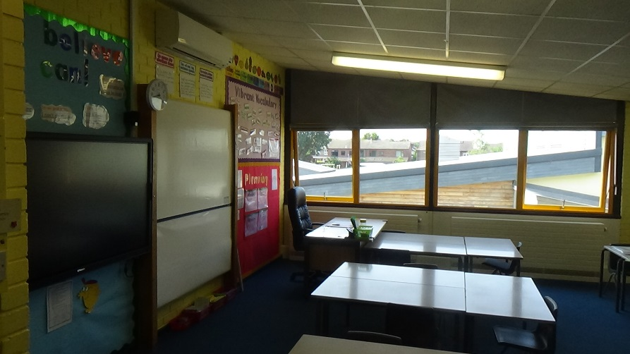
Year 5 classrooms
Welcome to class 5B
Welcome to class 5M

Slide 5
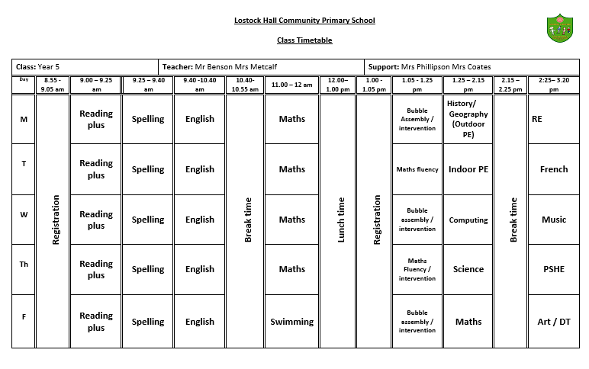
Timetable
Notes:
KS

Slide 6
Daily routines
8.45am – Whistle blows
8.55am – Registration/gate closed
9.00am – 9.20am – Maths Fluency or Phonics (streamed)
9.20am – 10.20am – Maths
10.20am – 10.35am – Break
10.35 -11.00am – Teacher and support staff – guided reading/Reading Plus session
11.00-12.05pm – English
12.05pm-1.00pm – Lunch
1.00 – 2:10pm –Foundation subject lessons (short comfort break)
2:10pm – 3.20pm – Foundation subject lessons and Assemblies/Intervention groups
Notes:
NB

Slide 7
Year Group information
Year 5 is a challenging and exciting year with children moving upstairs into the upper juniors.
Encouraging greater individual independence - such as remembering to bring resources and books on different days; writing comments in their own reading diaries as appropriate, a greater focus on personal assessment for learning.
Developing responsibilities such as reading buddies, playground buddies, arts ambassadors, school councillors and eco reps.
High school links – Priory Academy (autumn) Lostock Hall Academy and Walton-Le-Dale High School (summer)
Growing up and Relationships Education in PSHE – physical and emotional changes at puberty.
Exciting new topics such as Ancient Egypt, Harry Potter, Science fiction Avatar Unit, Amazon rainforest, Earth and beyond, making musical instruments, 3D sculpture, Samba, food inspired by South America.
Reading - a focus on novel studies, moving to whole class comprehension skills.
Home learning – regular reading of a range of genres, online home learning blog tasks, weekly spellings.
Notes:
KS first half NB second half

Slide 8
Key Stage 2 Targets
Developing Reading skills and progression
Focussed teaching of reading skills within lessons – a focus on fluency and comprehension and use of a range of challenging and engaging texts.
Reading Plus daily online sessions – linked to home learning.
Weekly guided reading and one to one reading sessions.
Ongoing targeted intervention groups.
Developing Writing skills and progression
Personalised teaching and support within lessons.
Ongoing targeted intervention groups and one to one support.
Developing grammar and punctuation skills.
A focus on widening vocabulary across all subjects.
Developing Maths mastery and fluency in arithmetic
Personalised teaching and support within lessons.
Timetabled arithmetic sessions twice per week.
Ongoing targeted intervention groups and one to one support.
Strong focus on mental maths and times-tables recall. Use of online support materials such as Times Tables Rock stars, Education city and Purple Mash.
Notes:
NB

Slide 9
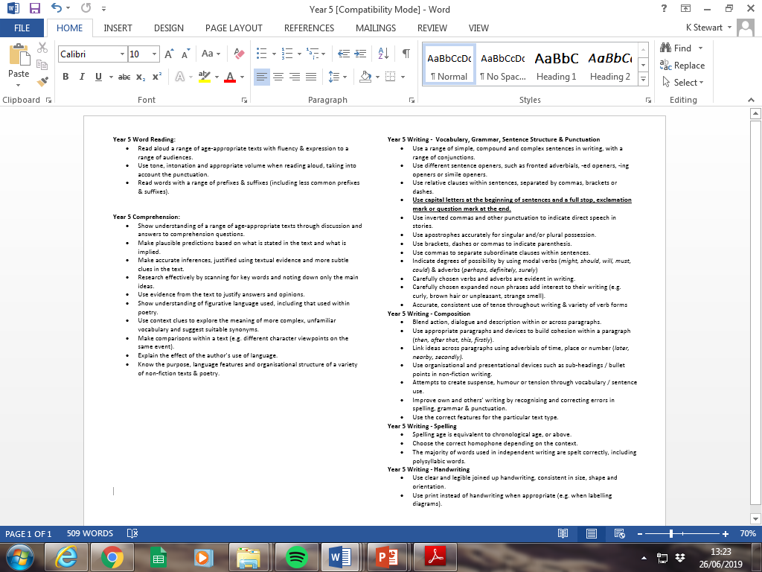
Year Group Key Skills/Objectives
English
Notes:
KS

Slide 10
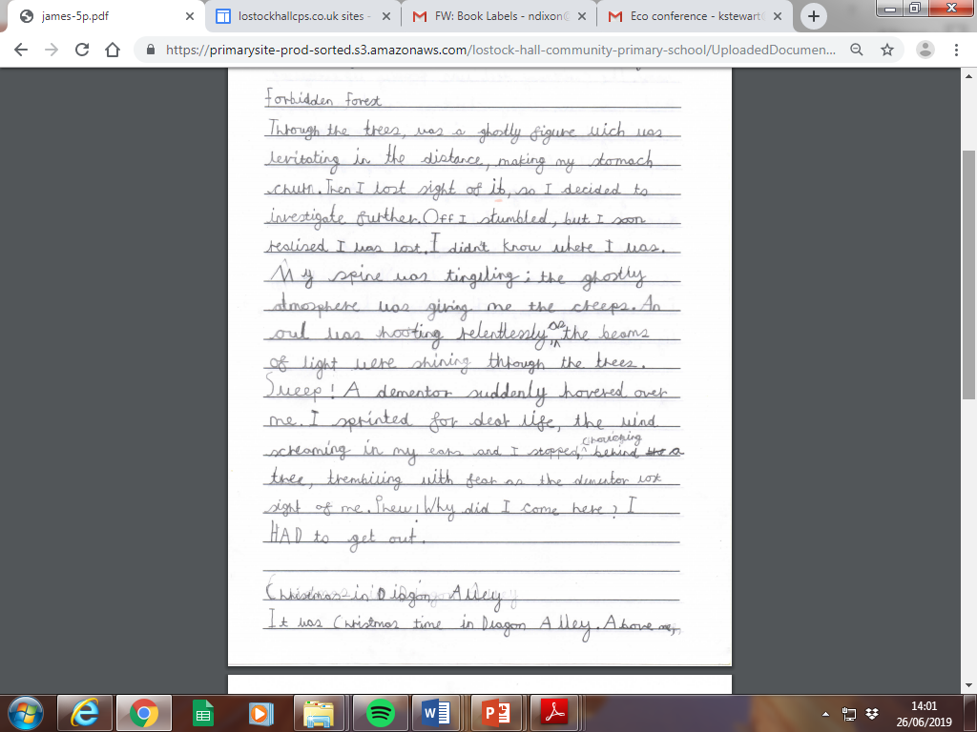
English writing example (WIN)
Notes:
NB

Slide 11
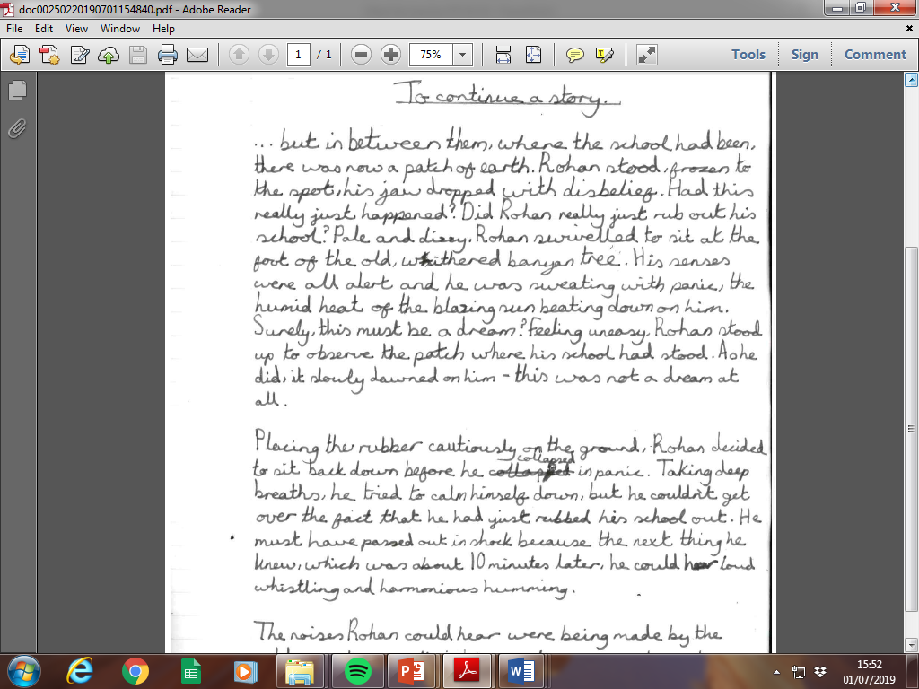
English writing example (GD)
Notes:
NB

Slide 12
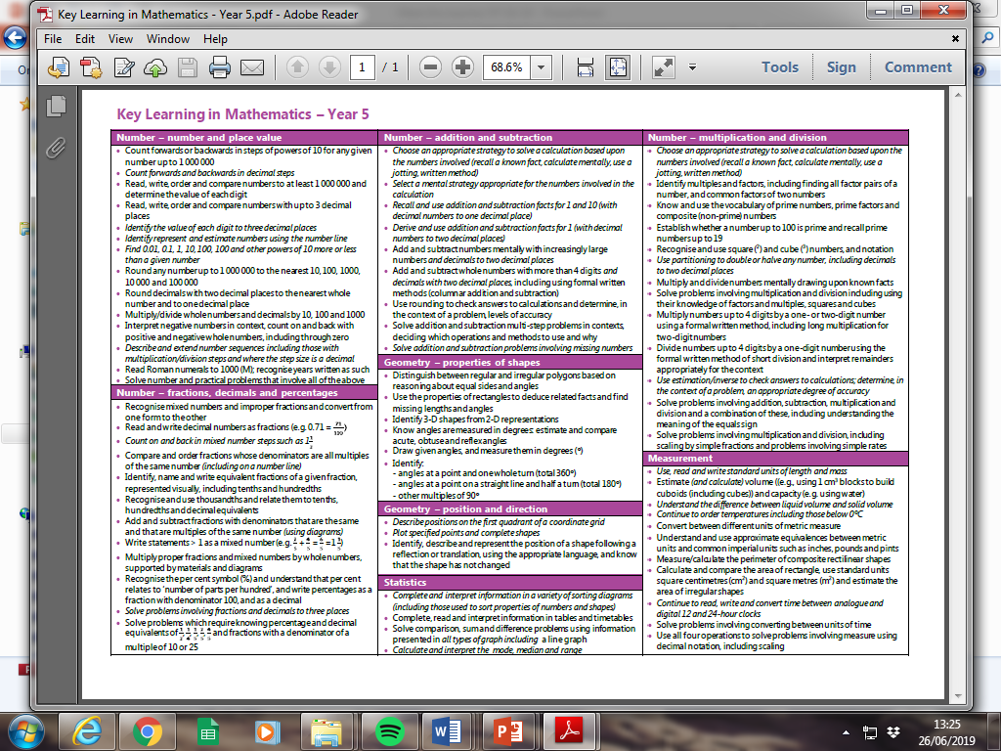
Year Group Key Skills/Objectives
Maths
Notes:
Teaching for Mastery –
Focus on Number during autumn term – addition, subtraction, multiplication, division
Fractions – spring term
Assessment week
Weekly mental maths homework
Half termly maths homework

Slide 13
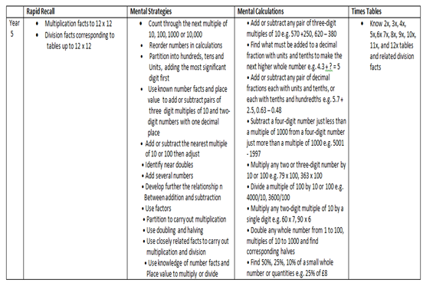

Slide 14
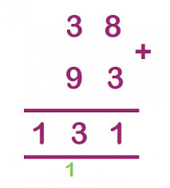

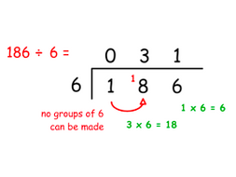
Maths strategies
Addition – column method 12 +24 36 | Subtraction – column method 34 -12 22
Multiplication – grid method 52 x 7 = 350 + 14 = 364 | Division – Short division method.
x | 50 | 2
7 | 350 | 14
Notes:
NB

Slide 15
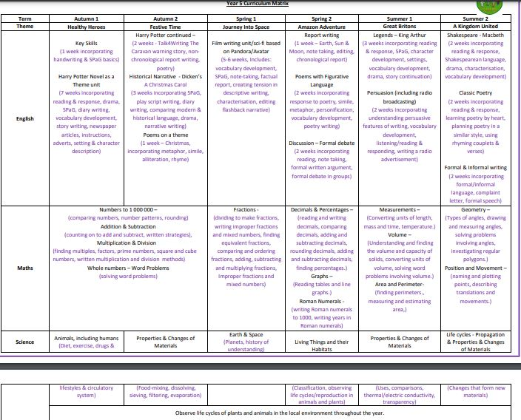
Curriculum Matrix
Notes:
KS

Slide 16
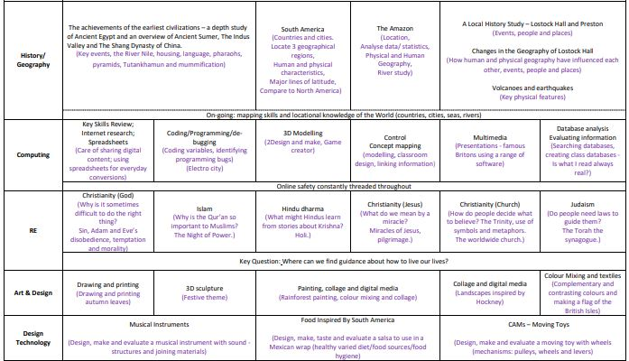
Curriculum Matrix
Notes:
KS

Slide 17
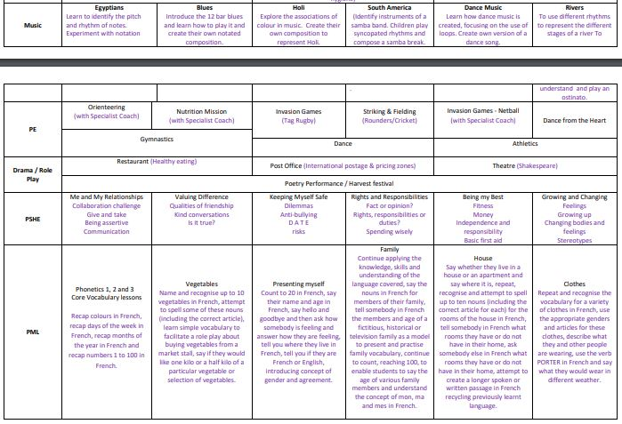
Curriculum Matrix
Notes:
KS

Slide 18
Trips and Curriculum enhancement
Visits – Liverpool World Museum, High School visits, Waddecar.
Performances for parents– Harvest assembly
Themed weeks – Life skills/online safety, creative arts week, STEAM week.
Autumn – Ancient Egypt, animals including humans, coding and Electro City, health and wellbeing, developing relationships, Christianity, Islam, gymnastics, creating musical instruments.
Spring – South America and the Amazon, Earth and Space, graphical modelling, Hindu Dharma, programming, painting, collage and digital media, Samba, food inspired by South America, dance.
Summer – Local study of Lostock Hall, life cycles, properties and changes of materials, multimedia, national anthems, Judaism, famous Britons, athletics, ‘Dance from the Heart,’ moving toys.

Slide 19
We are delighted to welcome your child into Year 5. We look forward to an exciting year filled with learning, challenge, creativity, enrichment and fun!

