Slide 1
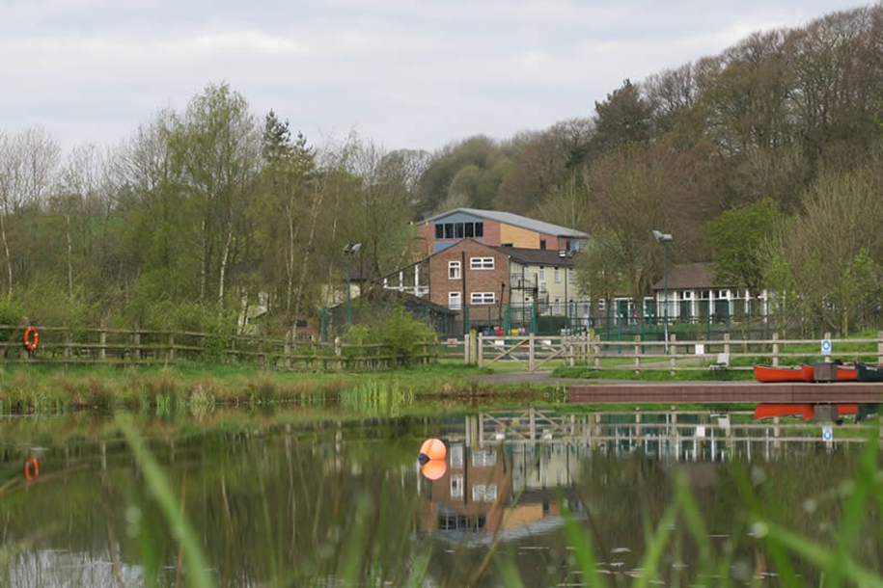
YEAR 4 OVERNIGHT RESIDENTIAL VISIT
HOTHERSALL LODGE
25th – 26th March 2026

Slide 2
Questions
As we discuss each part in turn, if you have any questions, please feel free to ask.
We will note any questions asked and respond to any question we cannot answer at this stage

Slide 3
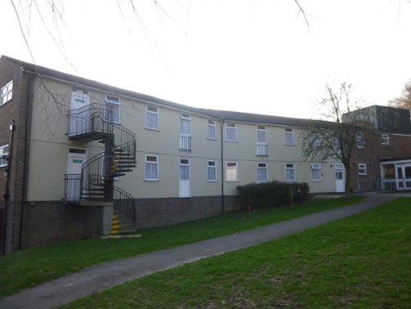
Accommodation, Night Protocol & Sleeping Arrangements
Hothersall Lodge has a duty manager on site who monitors the site & grounds to ensure the children’s safety. The duty manager will alert the staff to any incidents during the night if at all necessary.
The accommodation is never left unsupervised at night.

Slide 4
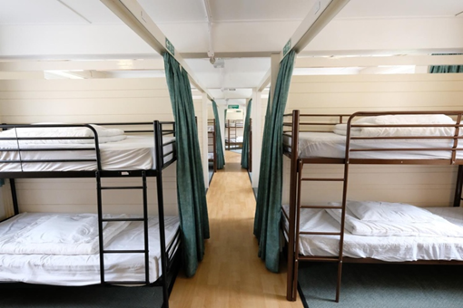
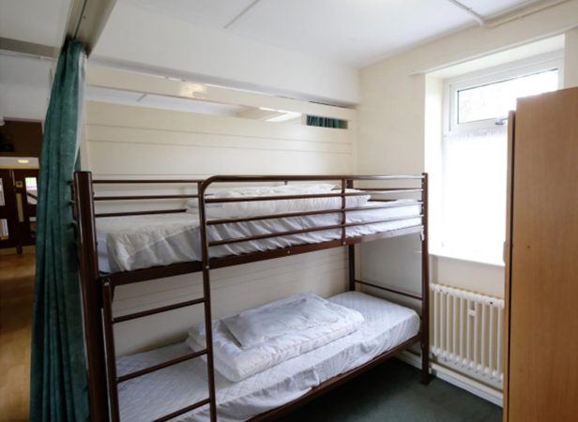
We will be in a residence block which will be locked internally and the children will be in gender-segregated dorm rooms.
Members of school staff will be on hand to assist the children with any issues during the night.
The children will sleep in bunk beds and have to prepare their own beds upon arrival when they drop their bags off.
After the evening meal, which will be pre-selected closer to the date of departure, the children will have a chance to shower and change into their pyjamas.
We will then head into one of the recreation rooms to have a movie night with a snack before heading to bed at around 8:45pm with lights out at 9:30 PM.

Slide 5
Showering
The children will access the individual shower rooms, fully clothed with a bag of their pyjamas, showering items and a bin liner to put their dirty clothes into.
They will change, shower and dress independently and then exit, and store their dirty clothes in their bags to bring home.
They will then head to the recreation room to wait for the rest of our group.
There are 4 shower rooms per floor, so efficiency will be important and clearly labelled items and packed clothes will help speed this process up.
We thank you in advance!

Slide 6
Activities
The children are encouraged to participate in all activities. However, no child will be forced to do an activity if they don’t want to.
Climbing Team Challenge ZipLine
Canoeing Caving (not in a real cave) Film night!

Slide 7
Supervision by LHCPS staff
The children will be split into groups chosen by us.
Our staff will always be on hand for the children throughout the day and night.
Most activities will be led by specialist Hothersall Lodge staff, our staff will also accompany the children.

Slide 8
Supervision of activities & Behaviour Code of Conduct
All the activities are led by specialist staff from Hothersall Lodge. The centre adheres to National Governing Body (NGB) guidelines on staff qualifications, staff-to-pupil ratios and operational procedures.
We expect a high standard of behaviour at all times during the visit, just as we would do at school.
Children must follow instructions immediately and show respect to all group leaders.
Any children displaying unacceptable behaviour will not continue their visit. Parents will be expected to collect their children. In this situation, a refund will not be made.

Slide 9
Kit List
We have provided a list of items which we recommend as a guide to pack our visit. The emphasis is on old clothes.
Please ensure that ALL items are clearly labelled with your child’s name.
Please check that children are familiar with their own clothing items and that your child can carry and repack their case ready for the return home.
Your child is welcome to bring a teddy for the night but it is their responsibility.

Slide 10
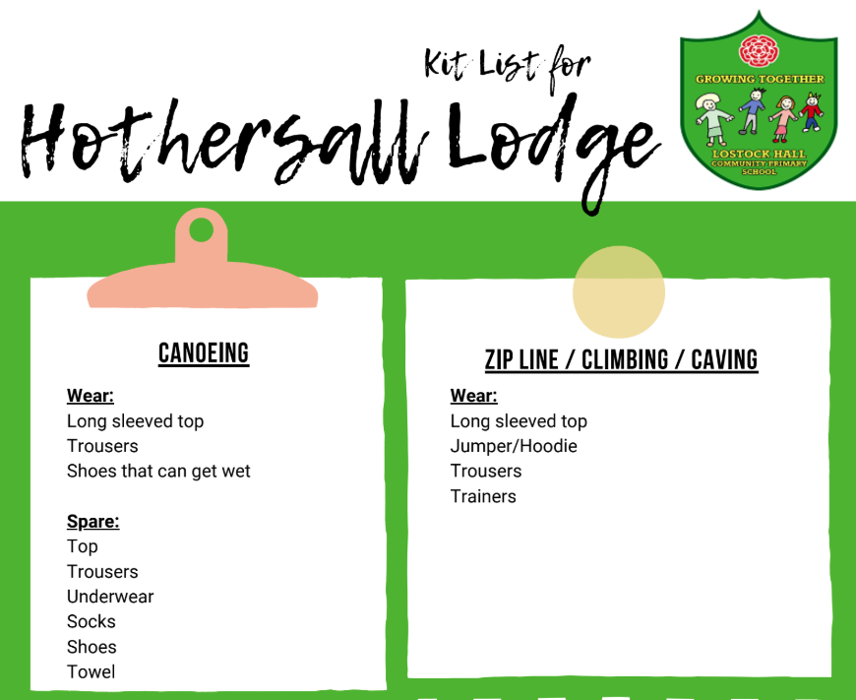
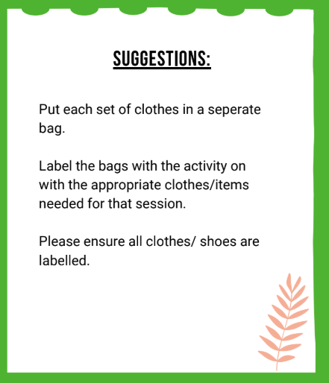

Slide 11
The children should come to school on day one ready for activities to begin when we arrive.
Purple PE Hoodie, tracksuit bottoms/ leggings, trainers/ walking boots, waterproof jacket.
Nightwear/ Pyjamas |  | Other essentials
Underwear |  | 1 Large towel
Socks |  | Wash bag (soap, toothbrush and toothpaste, shampoo, hair brush) etc.
An extra fleece or sweatshirt |  | Labelled plastic bags/bin Bin Liners (for day 1 items)
T-Shirt or long-sleeved T-Shirt |  | Labelled plastic bottle for drinks
Pairs of old trousers (not jeans) for activities on day 2 |  | Weather appropriate items to consider closer to the time
Pair of shorts |  | Sunscreen
An extra pair of trainers |  | Sun cap / hat
1 pair shoes or trainers for indoors |  | Wooly hat / gloves
Waterproof clothes

Slide 12
Please do not bring
Electricals, such as phones, tablets or game consoles.
Aerosols or sprays
Gum
Earrings
Wellies

Slide 13
Packed Lunch on the first day
On the day of travel, please can you provide, or order a packed lunch, which is entirely disposable to avoid losing lunchboxes / Tupperwares.
Lunch is not provided on day one.
Lunch IS provided on the second day.

Slide 14
Spending Money
We are asking for a contribution of £2 towards the children’s snack/treat during the film night.
Each child will receive a drink, a packet of crisps and a chocolate bar.
Please can the contribution be handed in with their suitcase on 25th March.

Slide 15
Medicines
Medicines, prescription or non-prescription, must be handed in on the morning of travel.
Medicine administration forms must be completed and handed into Miss Batey on 25th March with the labelled medicines. This also applies to travel sickness medicine.
Money will be handed into Mrs Coates on 25th March. Please could this be put in an envelope with their name on it.
Children with inhalers will take them to each activity. Inhalers should be named (including our school name) These will be kept in a medical bag carried by the teacher leading their group. Please ensure these are up-to-date and full.

Slide 16
25th March
8.55 AM | Bring all bags into school and place them in the ICT suite. Hand in medicines to Miss Batey.
10:00 AM | Coaches leave. Parents are welcome to wave us off, but please do not block Linden Drive with cars.
11:00 AM | Arrive at Hothersall Lodge. Children are shown to their dorms. Meet Hothersall Lodge Group leaders. Explanation of Fire Procedures and Rules. Children will make their own beds with the bed linens provided. Children then head to their first activity.
12:00 - 1:00 PM | Lunch in the dining room, eating their packed lunches.
1:00 PM – 4:00 PM | Activities
4:00 – 6:00 PM | First-day activities, then children head to the dining room for their evening meal, children will then shower and change ready for the evening.
7:00 – 8:45 PM | Snack and movie night, once the film has finished, the children will head back to the dormitories to get ready for bed with lights out at 9:30 PM

Slide 17
26th March
7:30 – 8:30 AM | Children get up and head to the dining room for breakfast- a cereal selection and toast.
8:30 – 9:00 AM | Children dress and prepare for the day’s activities.
9:00 – 12:00 PM | Day 2 activities
12:00 – 1:00 PM | Lunch- Provided
1:00 – 1:30 PM | Final goodbyes and closing ceremonies, packing the coach and heading home!
2:00 PM (Approx.) | Arrive back at school. Please do not obstruct the coach with cars. Please make sure that your child is collected promptly. Children can be collected when the coach arrives and all children are back in school.

Slide 18
Helpful tip
If your child has not spent the evening away from home, we advise that the children spend at least one night away e.g. family friend/grandparents in a new setting. This supports the children with their independence.
The Year 4 Team

