Slide 1

Meet the Teacher
Year 5
Teachers - Mr Law & Mrs Stewart
TAs – Mrs Parkinson and Mrs Williams
HLTA – Ms Lucas

Slide 2
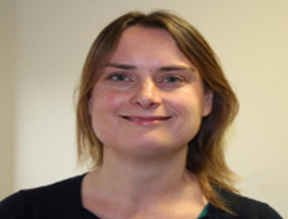
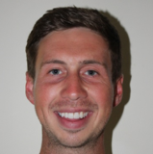
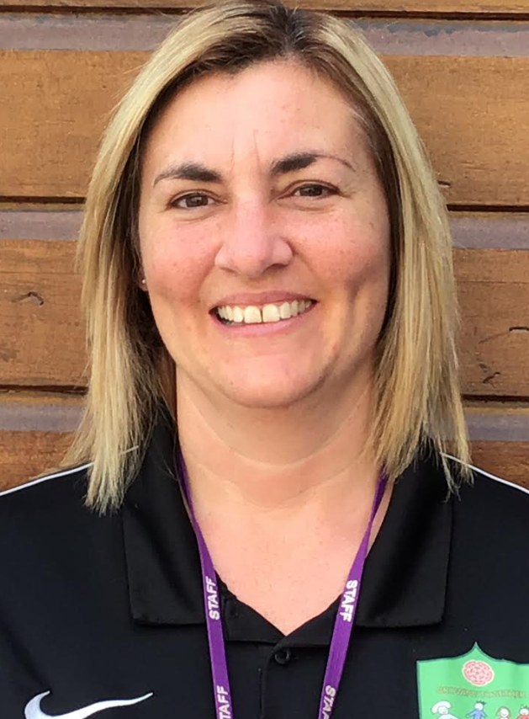
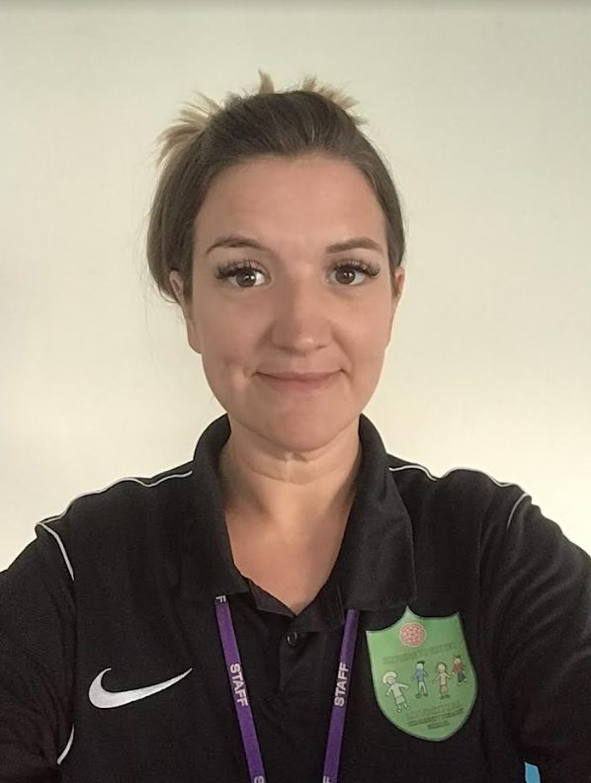
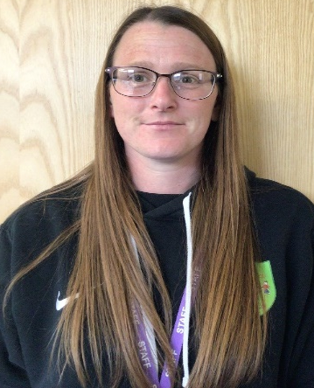
Year 5 Staff
Mrs Stewart
Mr Law
Ms Lucas
Mrs Parkinson
Mrs Williams

Slide 3
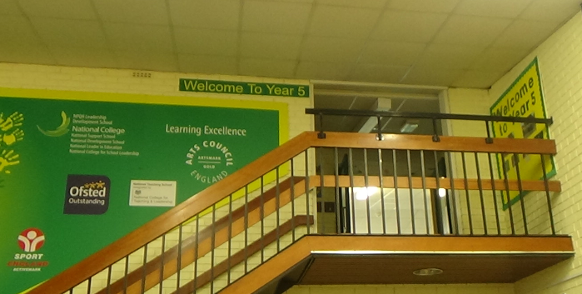
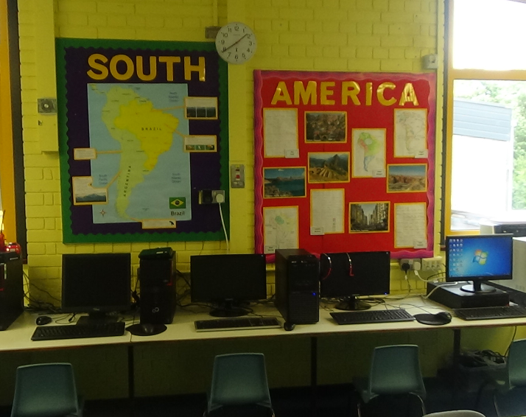
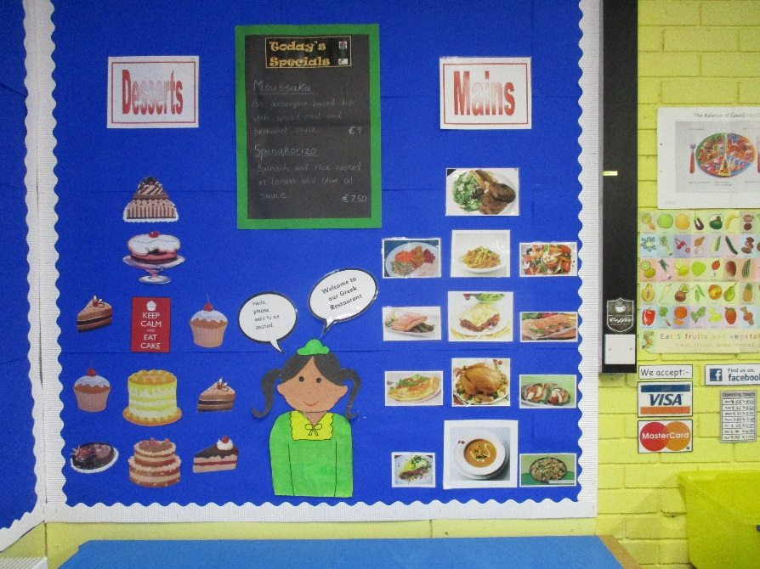
Year 5 Learning Areas
Welcome to Year 5
Middle area computers
Role play area

Slide 4
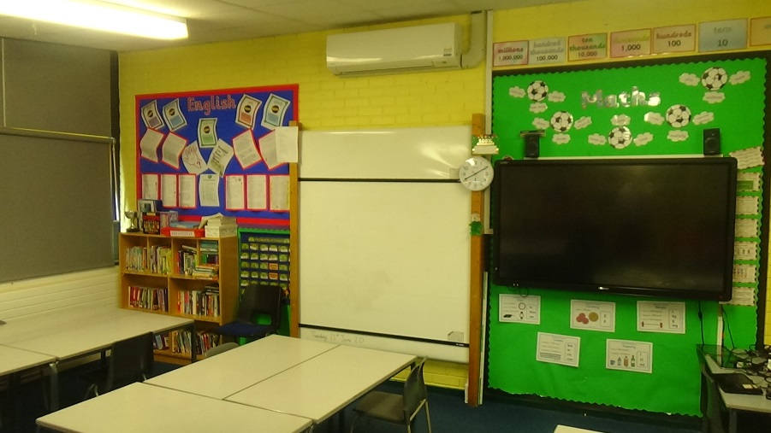
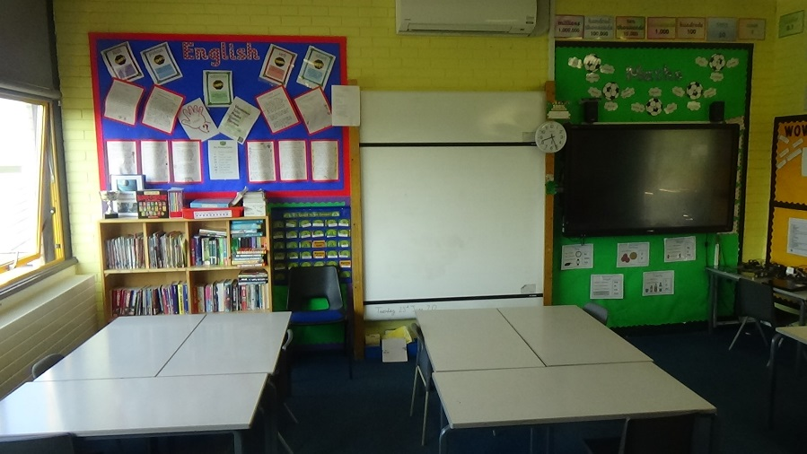
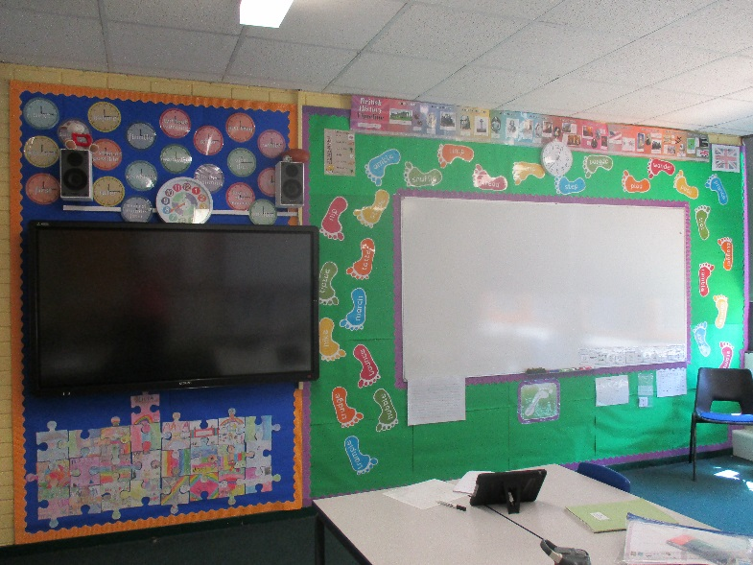
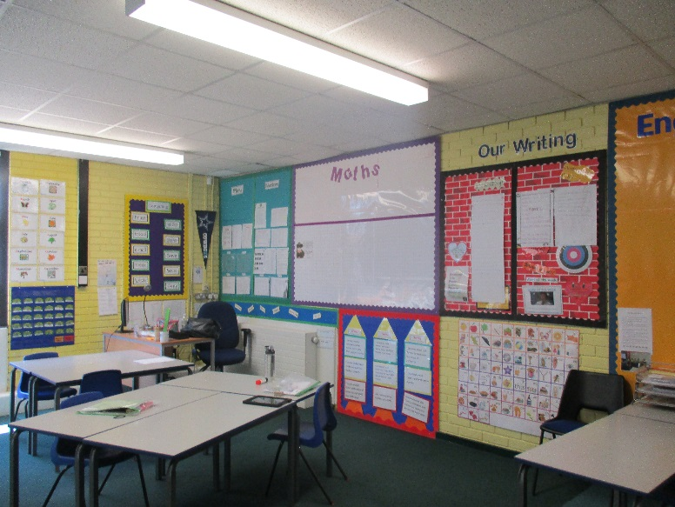
Year 5 Classrooms
Welcome to Class 5S
Welcome to Class 5L

Slide 5
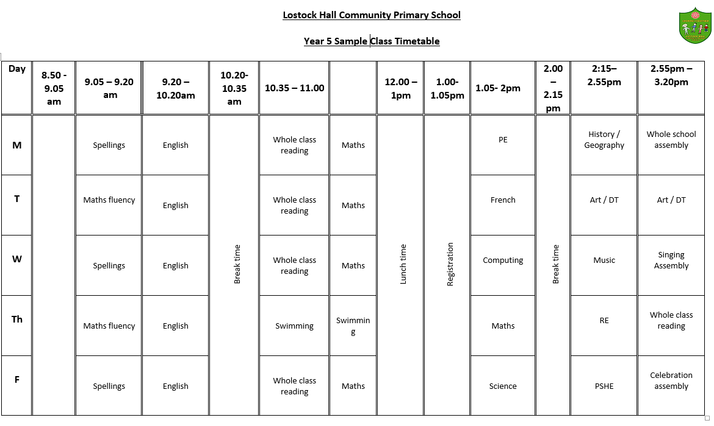
Timetable example

Slide 6
Daily routine
8.45 am – Whistle blows.
8.55 am – Registration/gate closed.
9-9.20 am –Phonics & Spelling / Maths fluency
9.20am – 10.20 am– English.
10.20am-10.35 am – Break.
10.35am-11 am – Whole Class Reading
11am-12 – Maths.
12-1pm – Lunch.
1.00pm – 2.55 pm – Foundation subject lessons (short comfort break).
2.55pm – 3.20 pm – Assembly/intervention groups

Slide 7
Year Group information
Moving to Year 5 – Encouraging greater responsibility, independence, more challenging work.
Exciting new topics – Harry Potter novel study, Science fiction Avatar unit, The United States, Earth and Beyond, design and make a musical instrument, 3D sculpture, landscape weaving.
Whole class reading - Novel focus and range of texts.
Swimming- Sessions during the Autumn Term
Forest School – Outdoor sessions in groups of 15
Harvest Festival – Poetry and drama performance.
Developing responsibilities- Reading buddies, eco reps, playground buddies, sports leaders, school councillors

Slide 8
Key Stage Targets
Developing Reading skills and progression
Focussed teaching of reading skills within lessons – a focus on fluency and comprehension and use of a range of challenging and engaging texts.
Daily whole class reading sessions.
Range of class novels throughout the year.
Developing Writing skills and progression
Personalised teaching and support within lessons.
Ongoing targeted intervention groups and one to one support.
Developing grammar and punctuation skills.
A focus on widening vocabulary across all subjects.
Developing Maths mastery and fluency in arithmetic
Personalised teaching and support within lessons.
Timetabled fluency sessions twice per week.
Ongoing targeted intervention groups and one to one support.
Strong focus on mental maths and times-tables recall. Use of online support materials such as Times Tables Rock stars and Purple Mash.

Slide 9
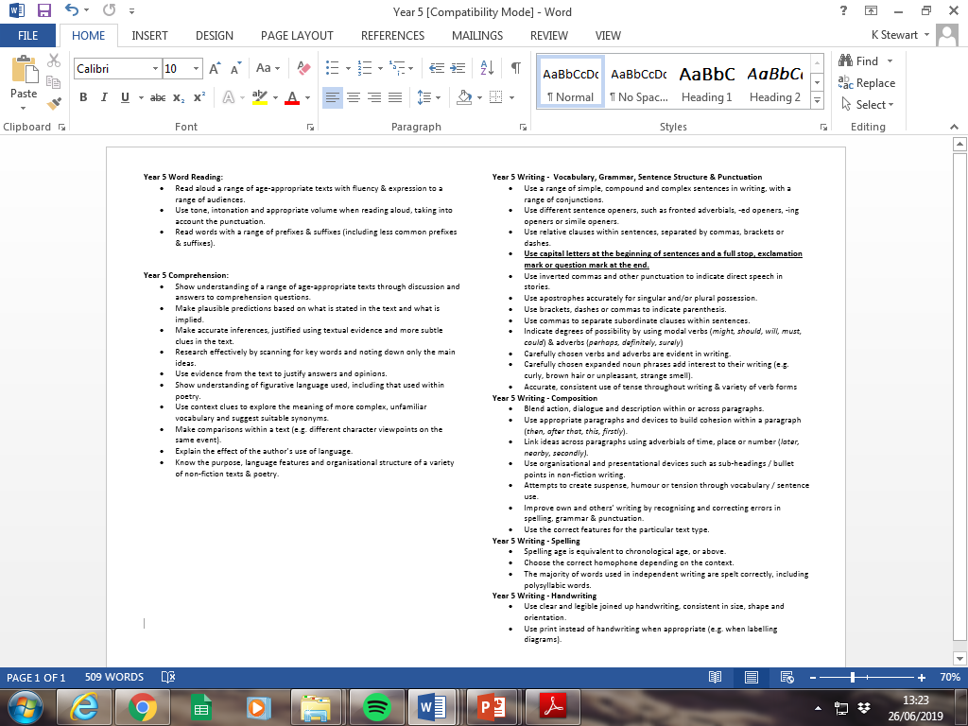
Year Group Key Skills/Objectives
English

Slide 10
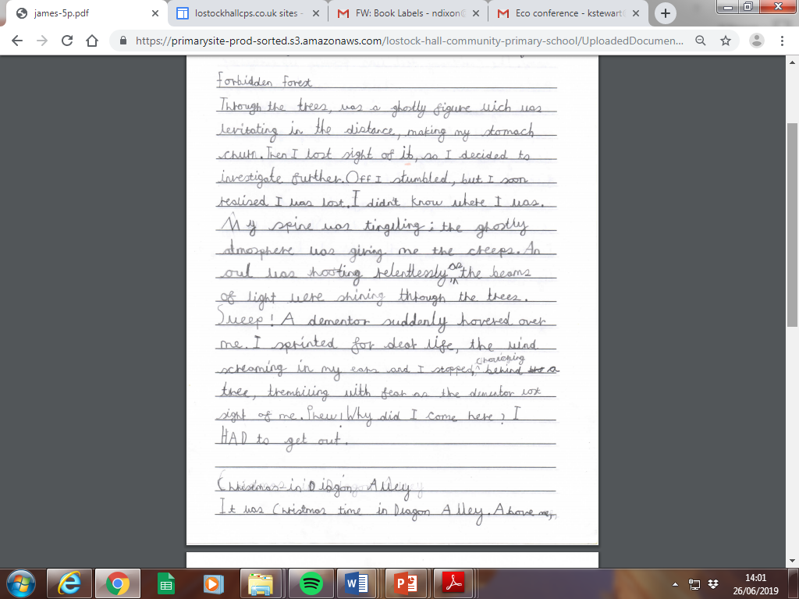
English writing example (WIN)
Notes:
Involve ourselves with LHA to access Forest Schools for Y5 & 6
Explore

Slide 11
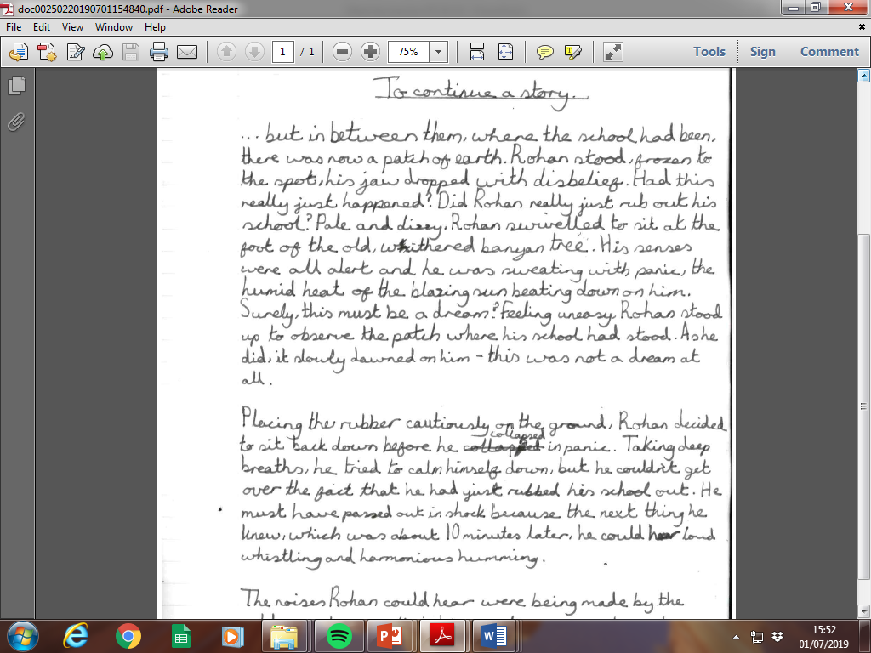
English writing example (GD)
Notes:
Involve ourselves with LHA to access Forest Schools for Y5 & 6
Explore

Slide 12
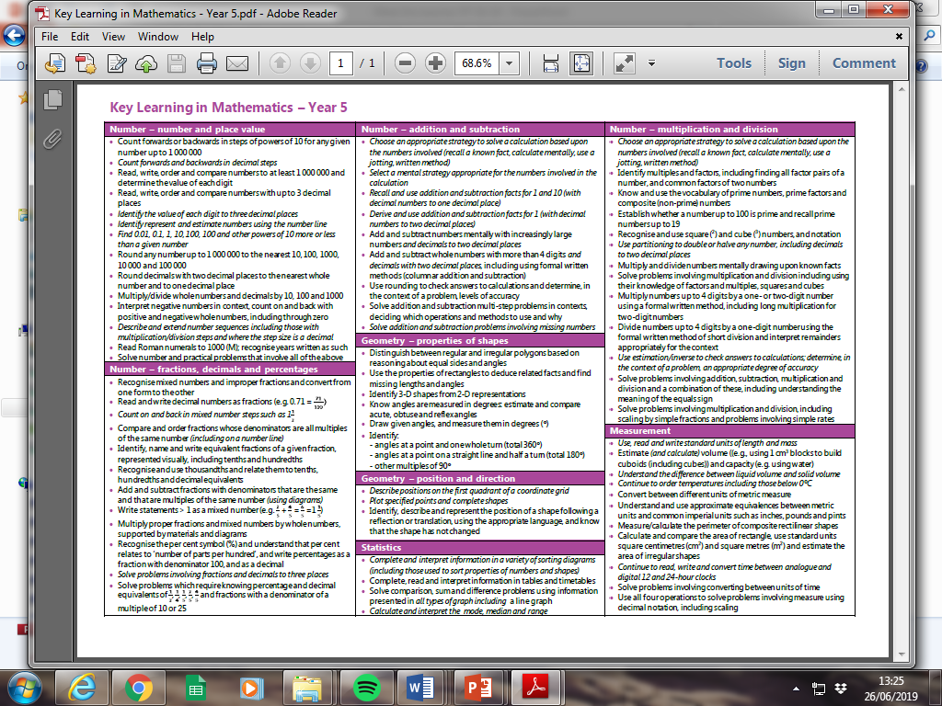
Year Group Key Skills/Objectives
Maths
Notes:
Teaching for Mastery –
Focus on Number during autumn term – addition, subtraction, multiplication, division
Fractions – spring term
Assessment week
Weekly mental maths homework
Half termly maths homework

Slide 13
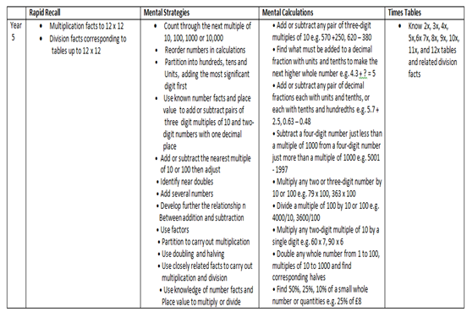

Slide 14
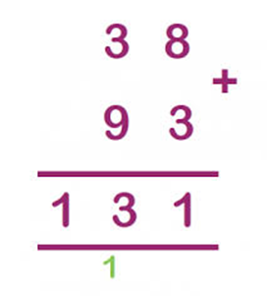
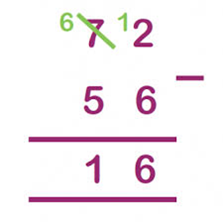
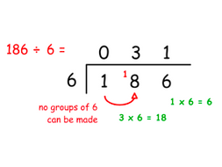
Maths strategies
Addition – column method 12 +24 36 | Subtraction – column method 34 -12 22
Multiplication – grid method 53 X 7 = 350 + 18 = 368 | Division – Short division method.
X | 50 | 3
7 | 350 | 18
Notes:
Involve ourselves with LHA to access Forest Schools for Y5 & 6
Explore

Slide 15
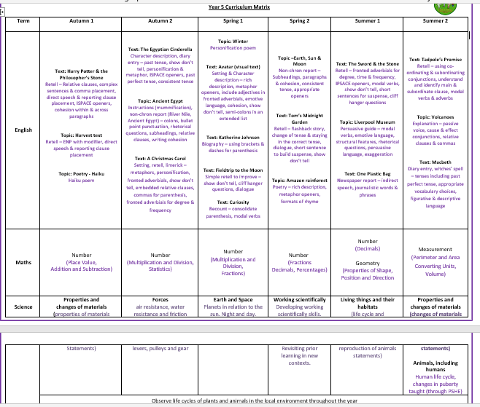
Curriculum Matrix

Slide 16
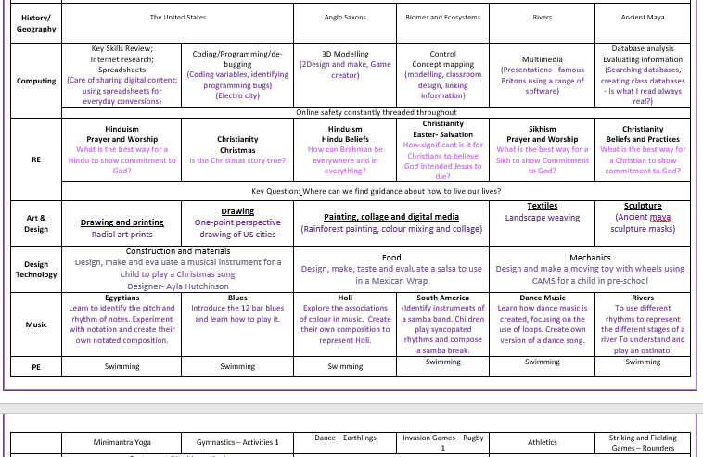

Slide 17
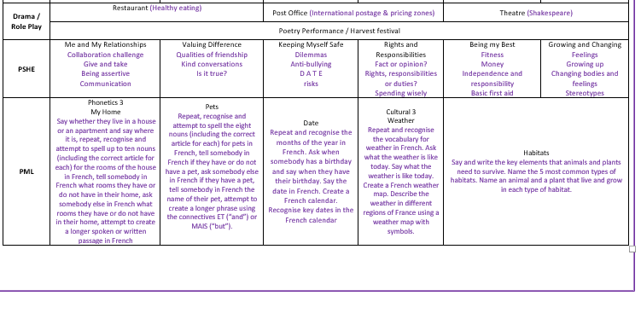

Slide 18
Trips and Curriculum Enhancement
Visits – Liverpool World Museum,
Performances for parents– Harvest poetry performance assembly
Themed weeks – Life skills/Online safety, Creative arts week
Autumn – A Christmas Carol novel study, United States, properties of materials, forces, coding, health and wellbeing, developing relationships, Christianity, Islam, gymnastics, creating bridge structures, radial art printing.
Spring – Anglo-Saxons, Biomes and Eco-Systems, Earth and Space, graphical modelling, Hindu Dharma, programming, painting, collage and digital media, dance, keeping safe, Tom’s Midnight Garden study.
Summer – Rivers, Ancient Maya, life cycles, properties and changes of materials, multimedia, Growing up PSHE programme, Judaism, Living things and their habitats athletics, ‘Dance from the Heart,’ Landscape Sculpture.

Slide 19

We are delighted to welcome your child into Year 5. We look forward to an exciting year filled with learning, challenge, creativity, enrichment and fun!

