Slide 1


Meet the Teacher
Year Two
Mrs Cookson, Mrs Dixon, Mrs Allen, Mrs Jamieson, Miss Worsfold, Miss Gardener, Miss Lucas, Miss Beattie

Slide 2
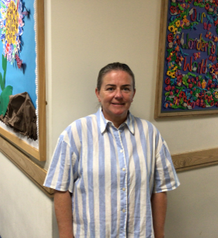
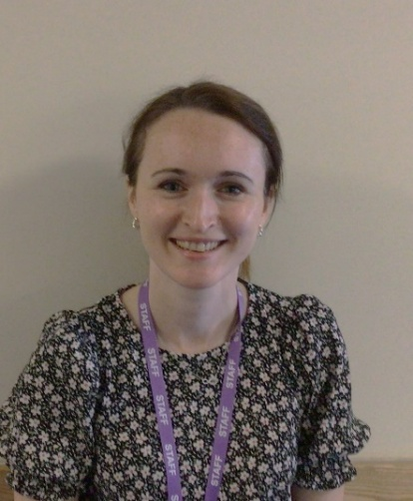
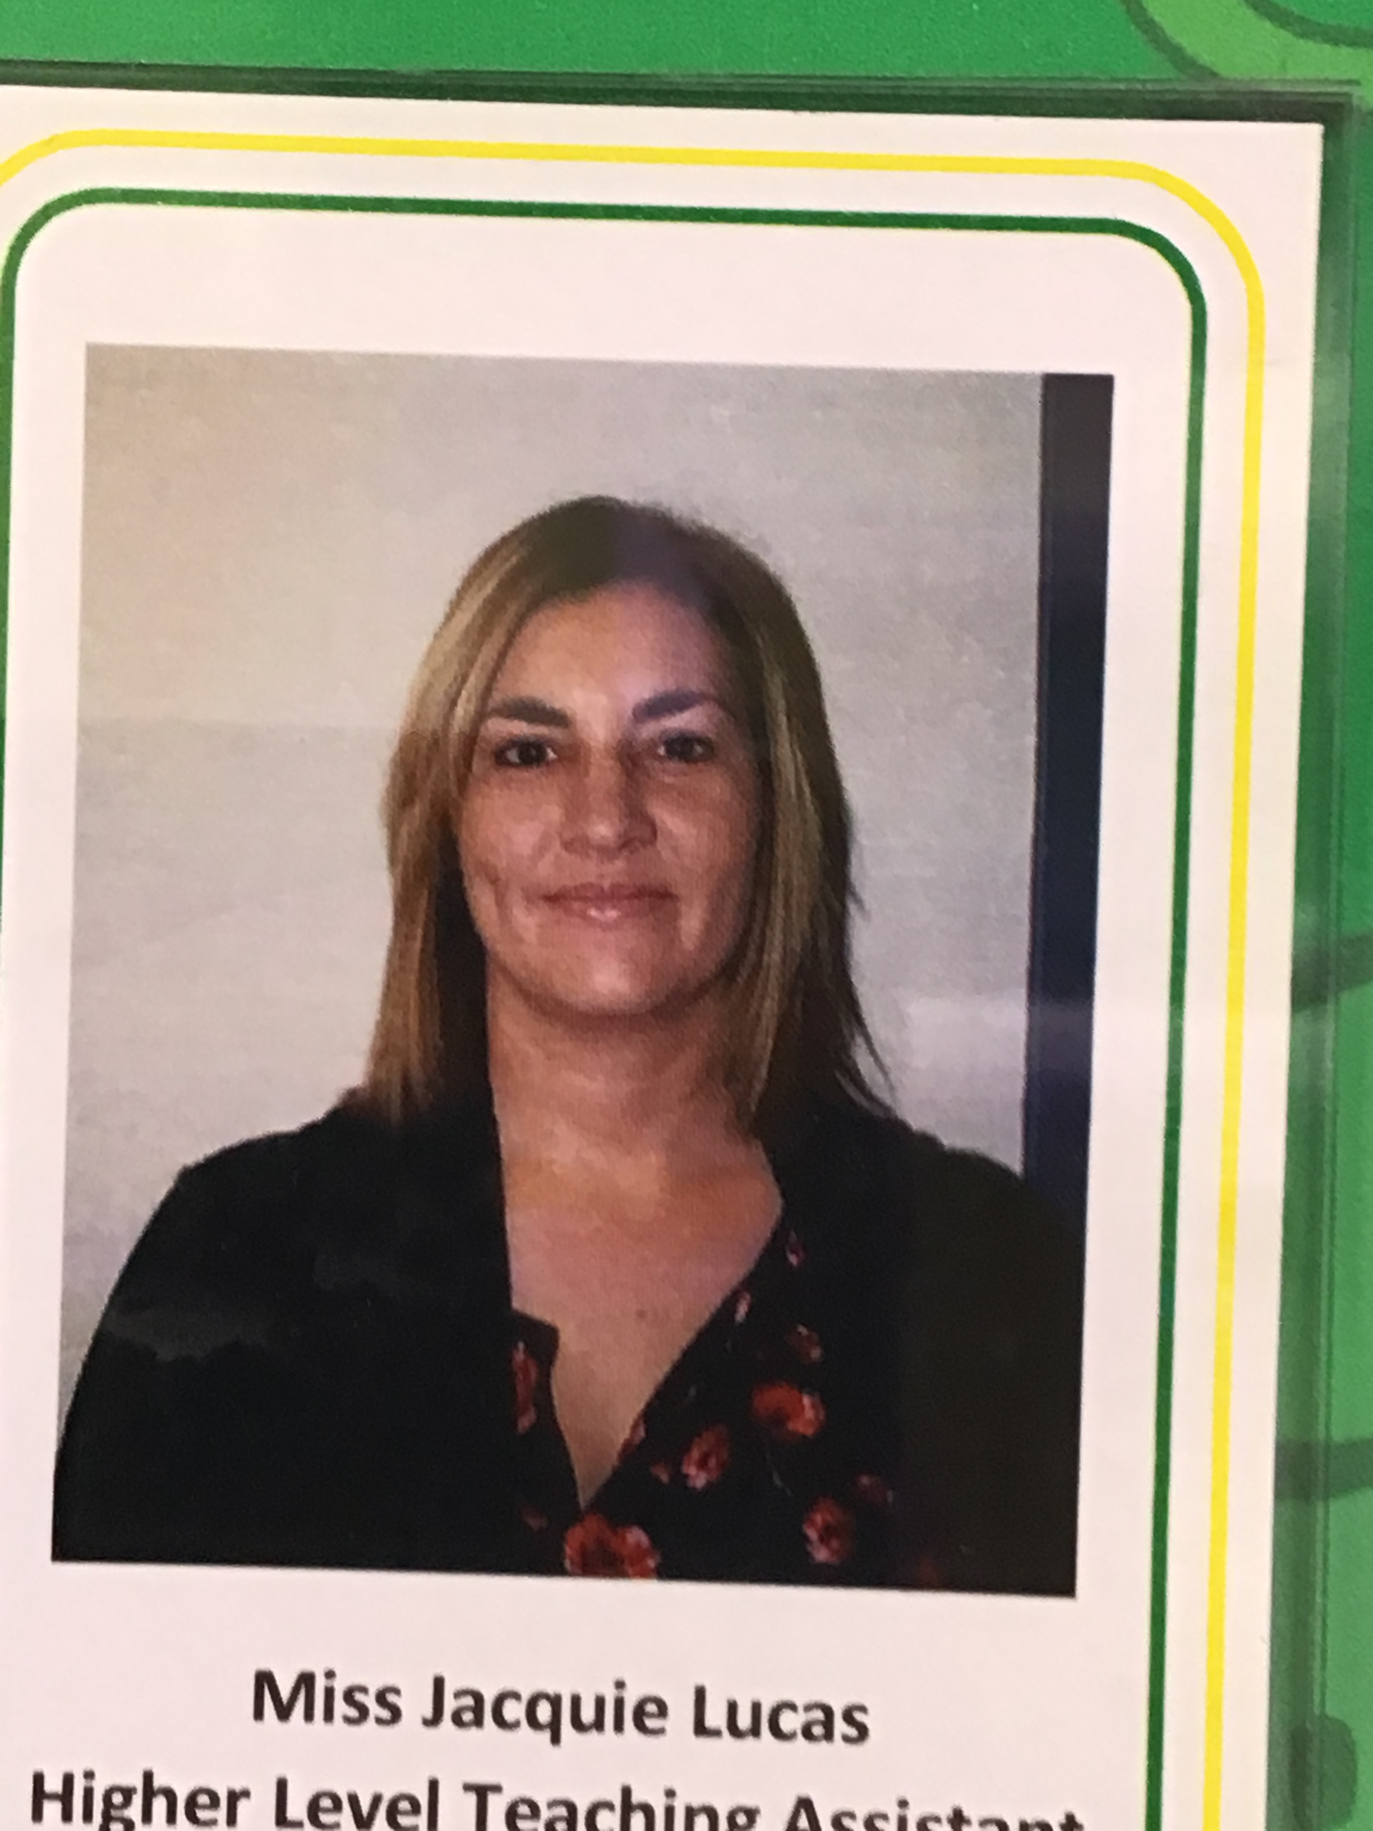
Staff Photographs- 2A
Mrs Dixon
Miss Lucas
Mrs Allen
Class teacher from
January 2027

Slide 3
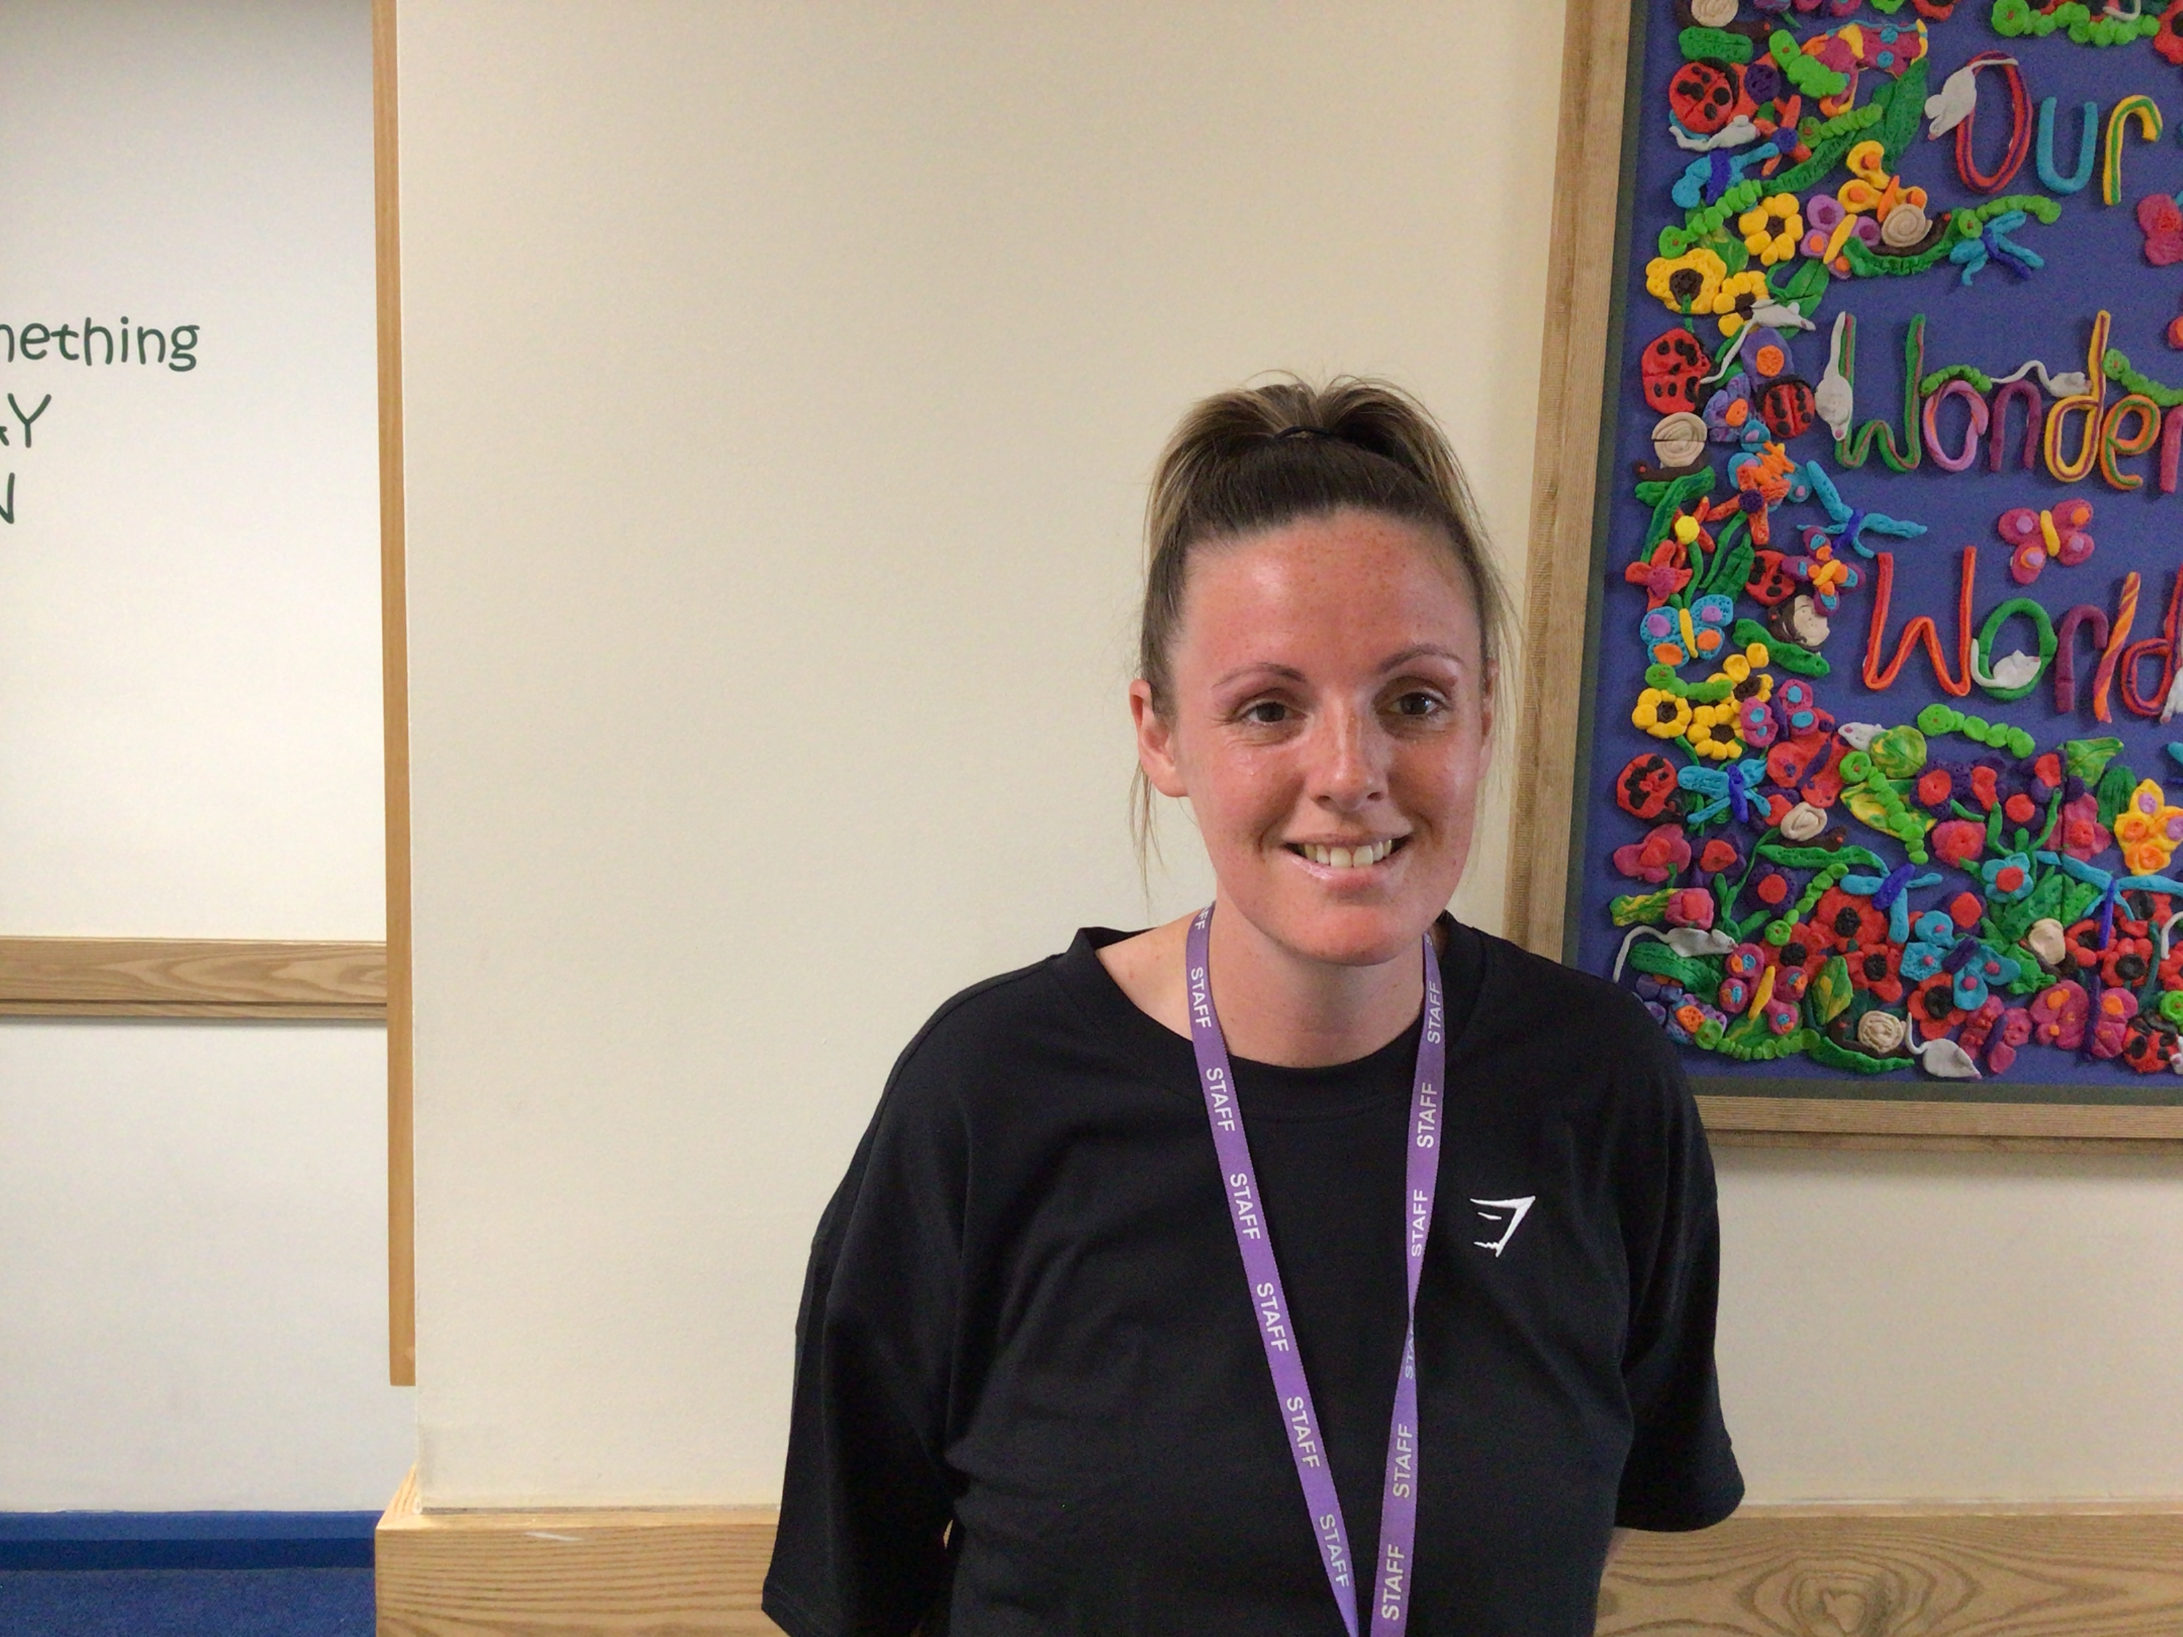
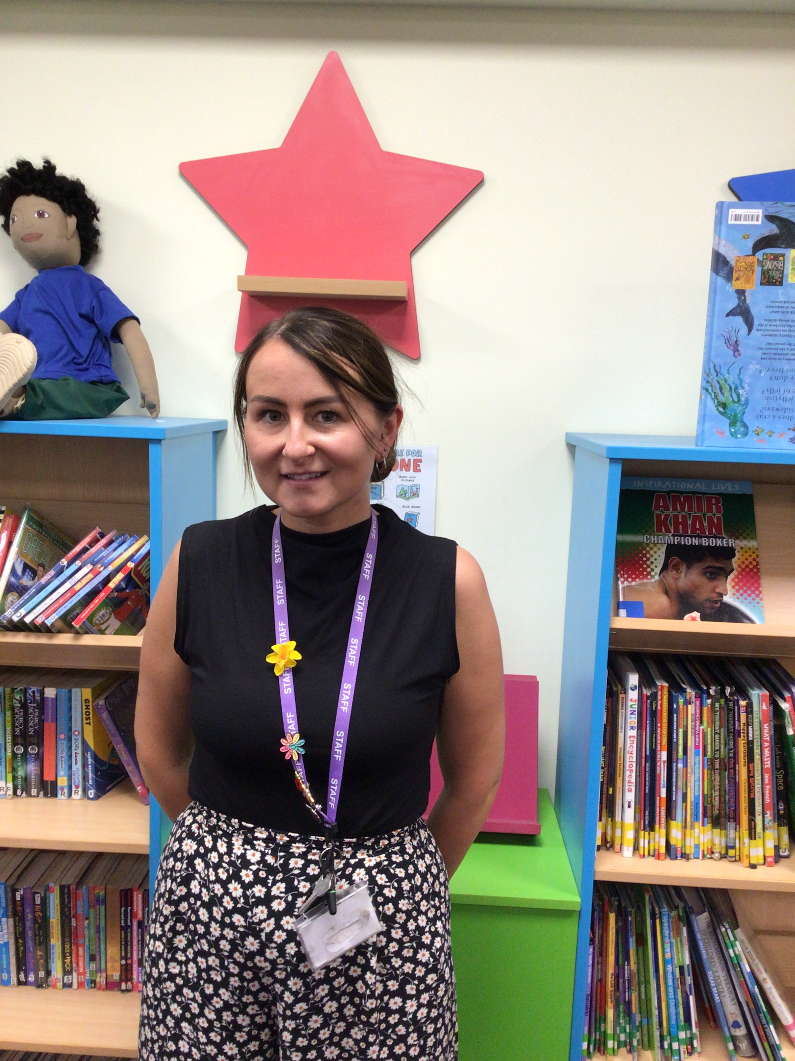
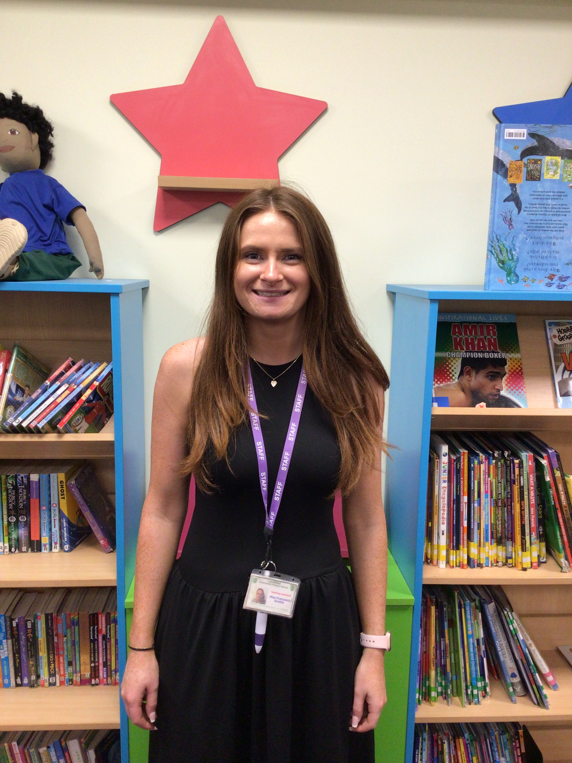
Staff Photographs- 2A Support Staff
Miss Danaher
Miss Gardener
Miss Beattie

Slide 4
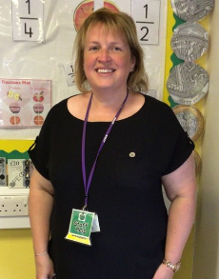
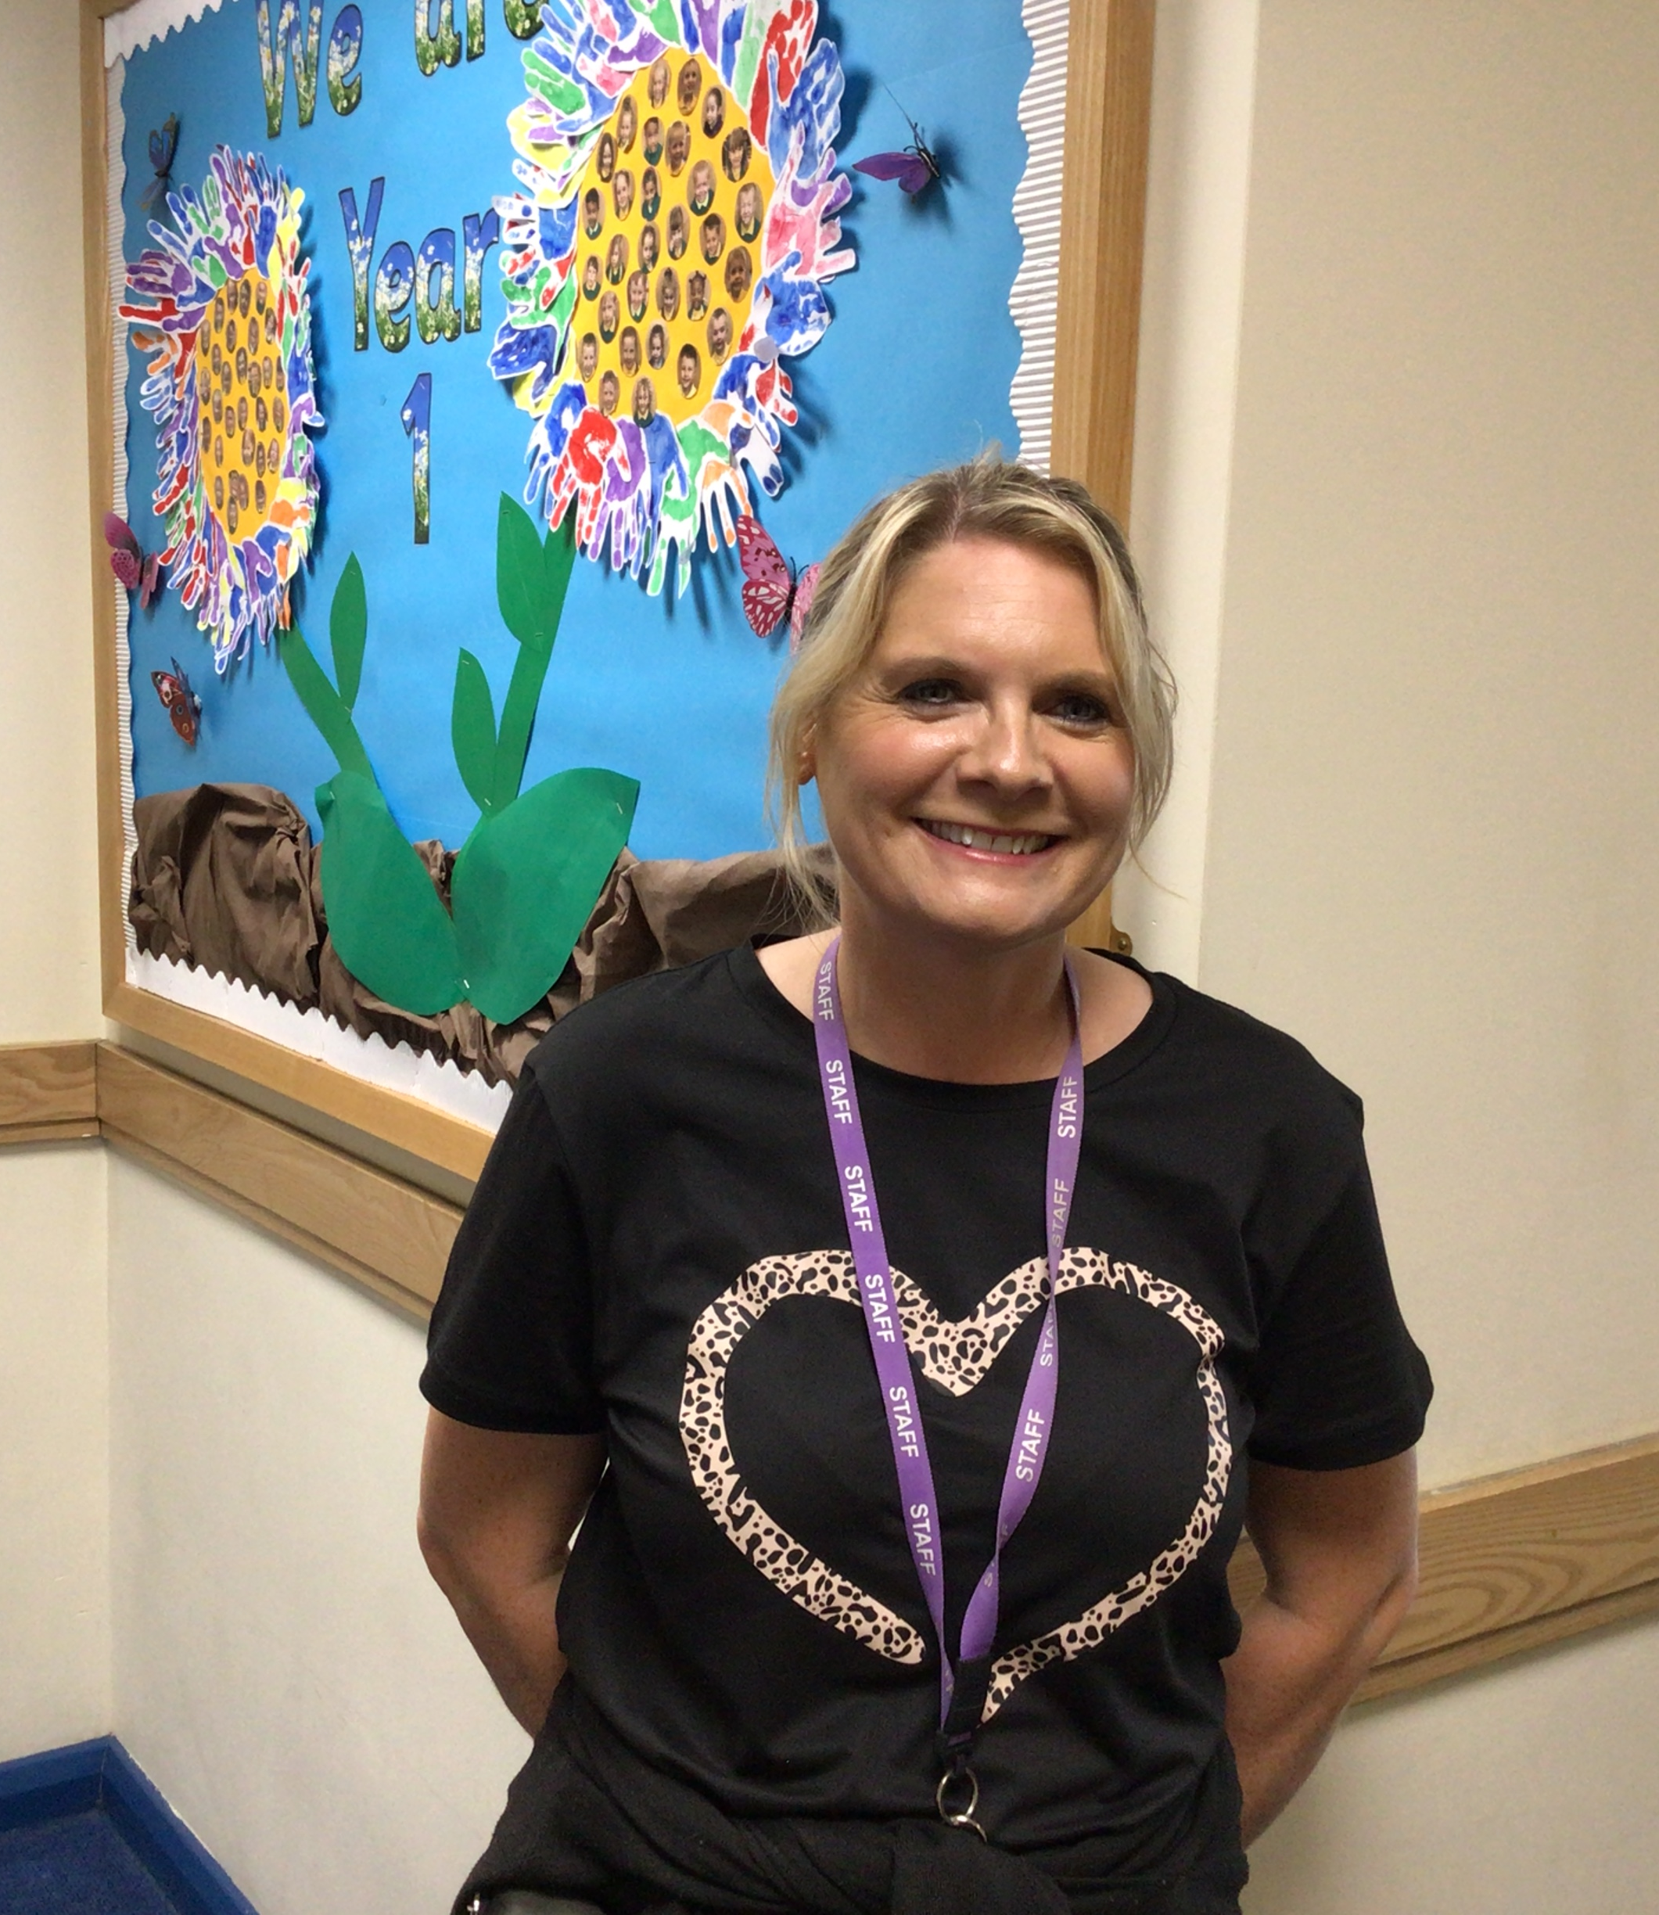
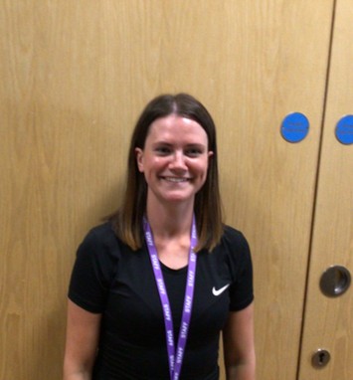
Staff Photographs- 2C
Mrs Cookson
Miss Gardener
Mrs Jamieson
Miss Worsfold

Slide 5
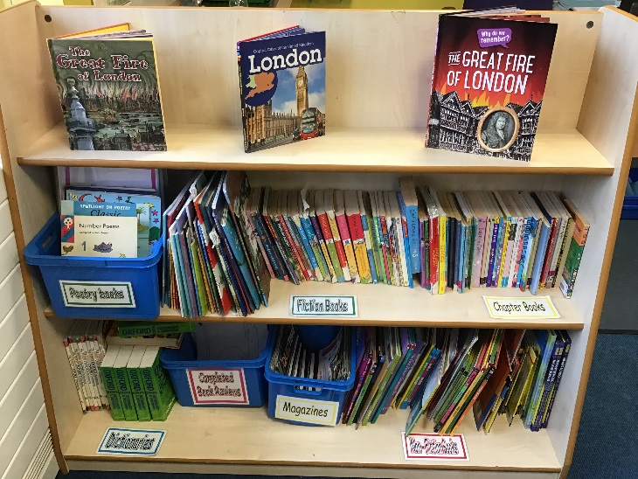
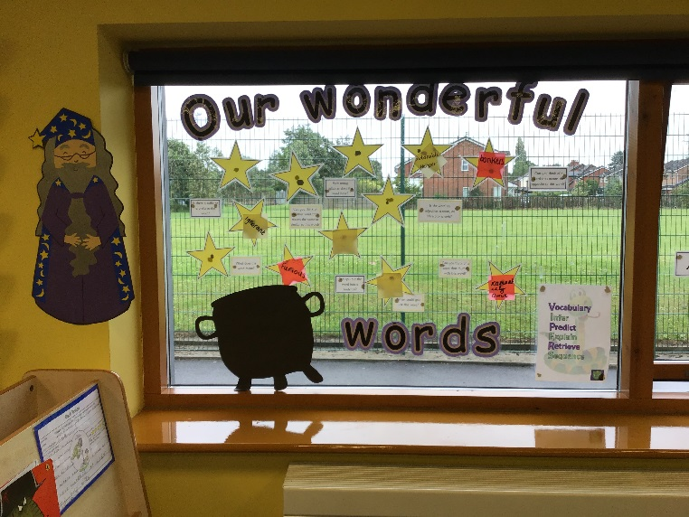
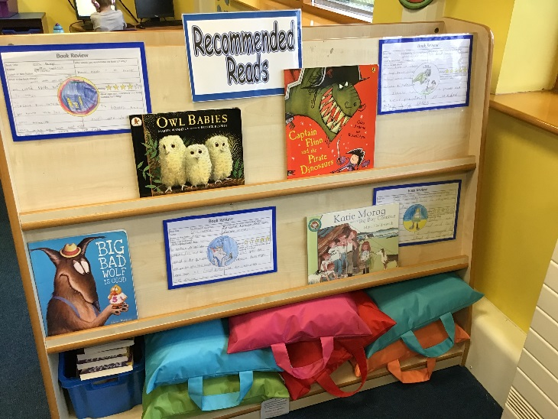
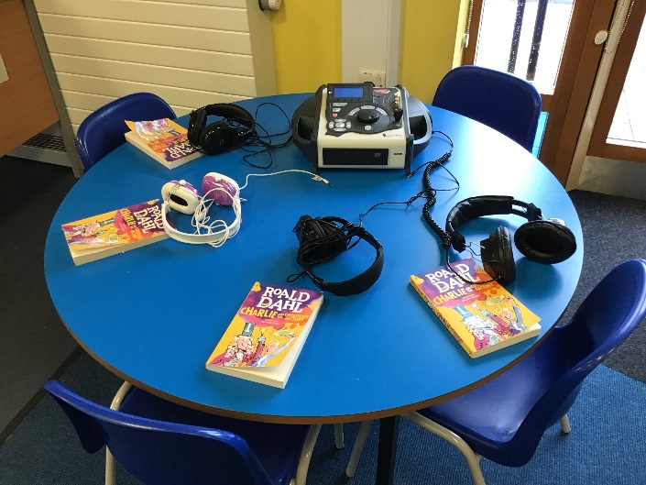
Year Two Classrooms

Slide 6
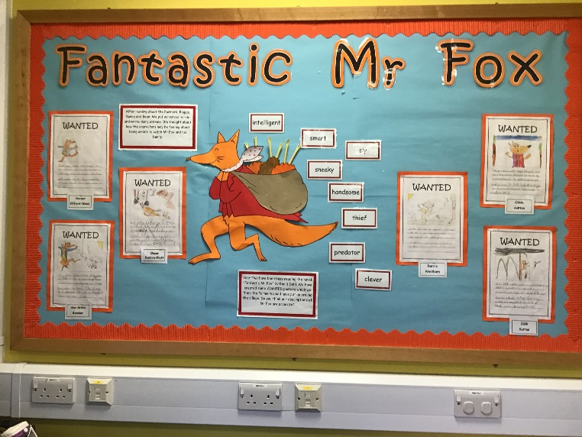
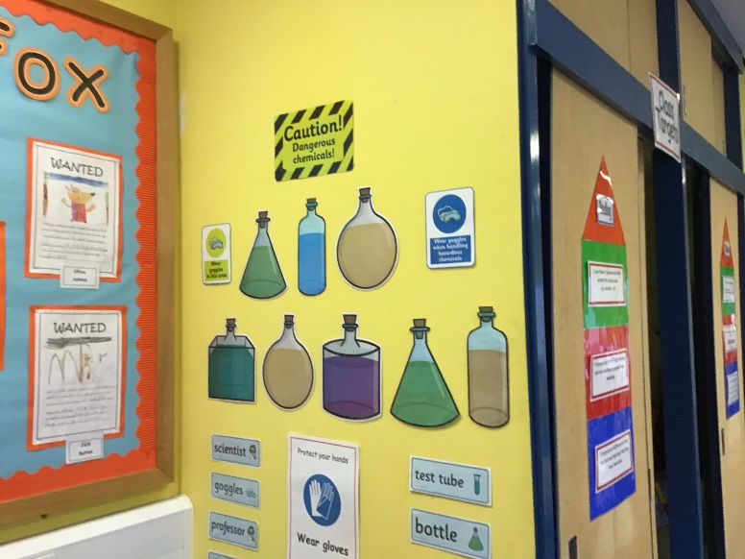
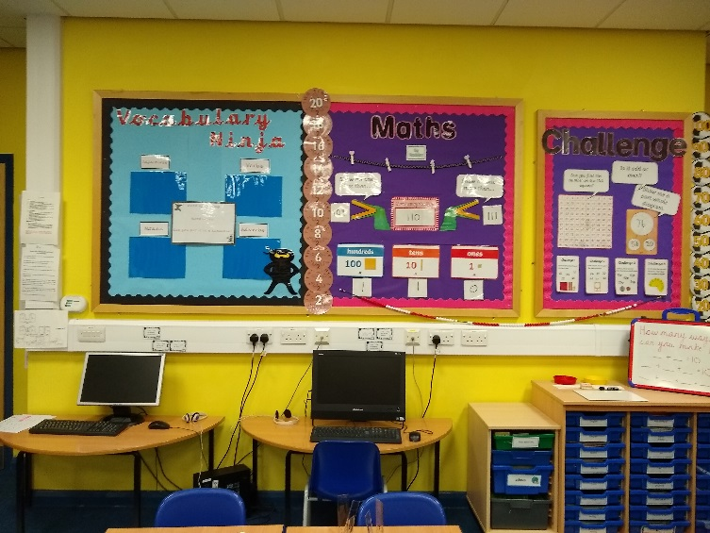
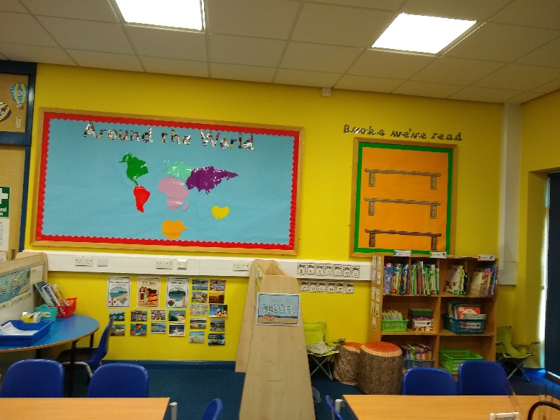
Year Two Classrooms

Slide 7
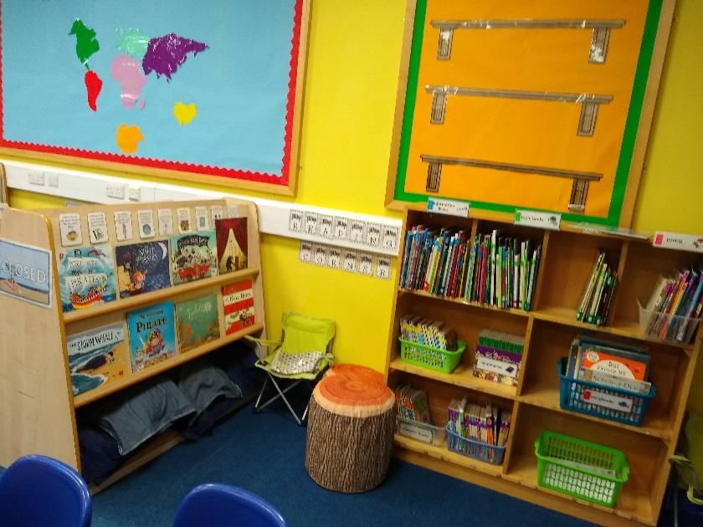
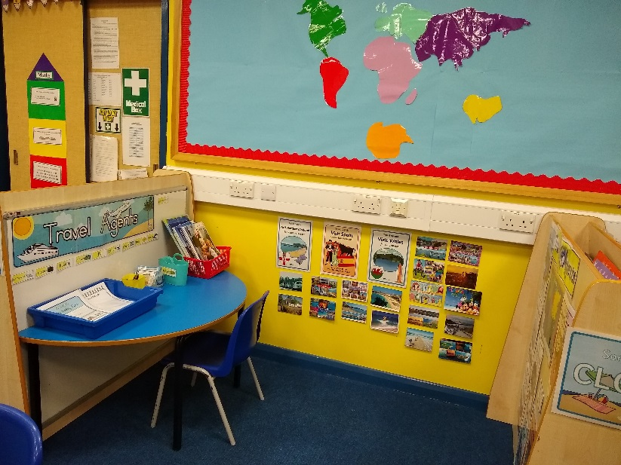
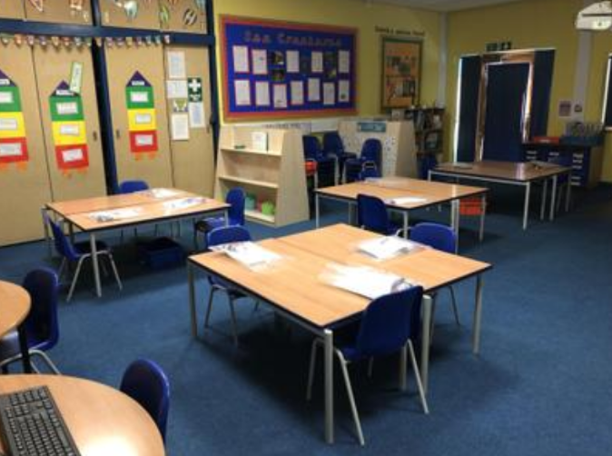
Year Two Classrooms

Slide 8
Timetable and daily routines
8.45am – Children come into the classroom via the year 2 classroom
8.55am – Registration/gate closed
9-9.30am – Phonics & Spelling
9.30 – 9.50am –Teacher and support staff – Guided Reading
9.50-10.45am – English/Maths
10.45-11am – Break
11-12.00pm – English/Maths
12.00pm-1pm – Lunch
1.05 – 2.00pm- KS1 Skills based and thematic lesson
2.00 – 2.15pm – Break
2.15 – 3.10pm – KS1 skills based and thematic lesson
3.20pm – Home time

Slide 9
Year Group information
The year two curriculum will require children to become more independent learners.
We will have some exciting new topics such as: The Great Fire of London, Famous Explorers and Mexico.
Reading is very important and we reward children who read at home regularly with badges and certificates.
Children are set homework every half term. Some tasks will be computer-based and others will be completed in their homework books.
We have weekly spelling tests every Friday. These words are stuck in their spelling books each week.

Slide 10
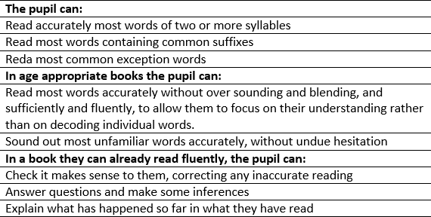
Key Stage Targets –Reading

Slide 11
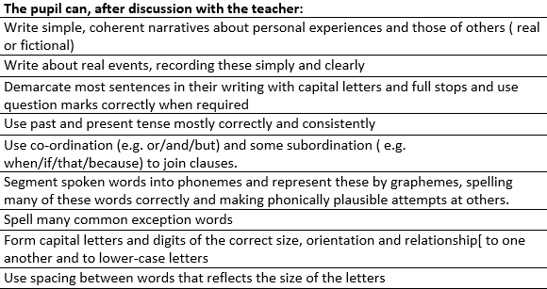
Key Stage Targets – Writing

Slide 12
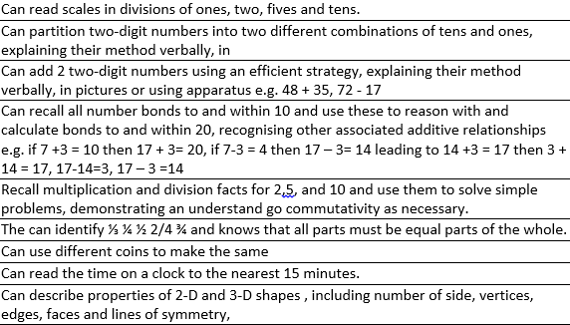
Key Stage Targets –Maths

Slide 13
Year Group Key Skills/Objectives
Maths
Autumn 1: Number bonds to 10 and 20, doubles, halves and place value within 100
Autumn 2: Addition and subtraction (mental and written methods) within 100
Multiplication (2s, 5s and 10s)
Spring 1: Division, fractions
Spring 2: Time, money, shape
Summer 1: Measures (length, height, mass, capacity, temperature)
Summer 2: Statistics, position and direction, further problem solving and application

Slide 14
Maths strategies
Fluency (number bonds, counting, adding and subtracting 10, recall of multiplication and division facts)
Reasoning: Show your working out and explain how you found the answer
Problem Solving: Apply your arithmetic skills to work out word problems

Slide 15
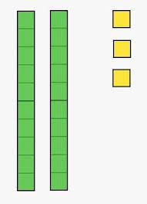
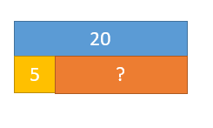
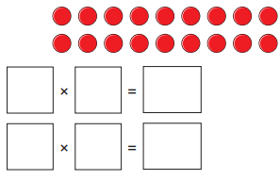
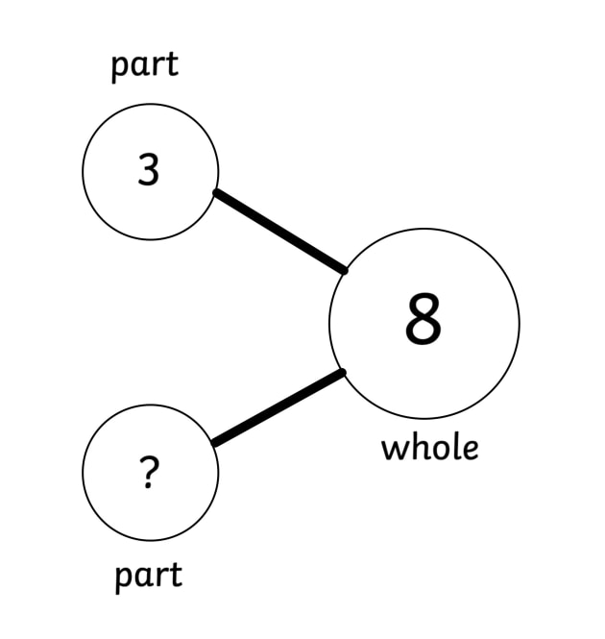
Maths strategies
Bar models
Dienes and ones
Multiplication and division arrays
Part whole diagrams

Slide 16
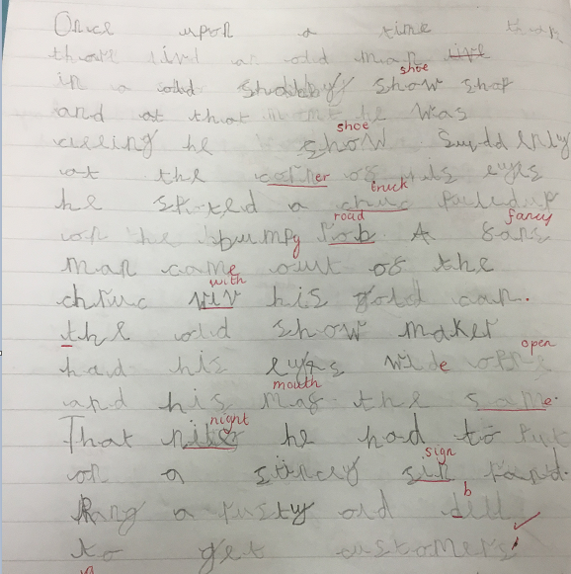
English writing example (WT)

Slide 17
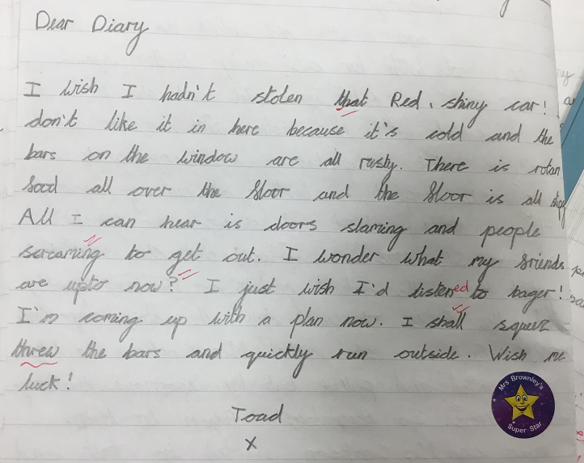
English writing example (EXS)

Slide 18
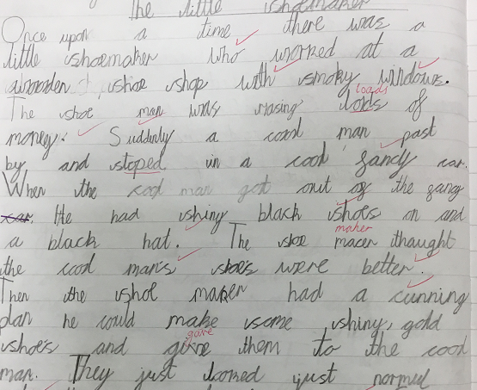
English writing example (WIN)

Slide 19
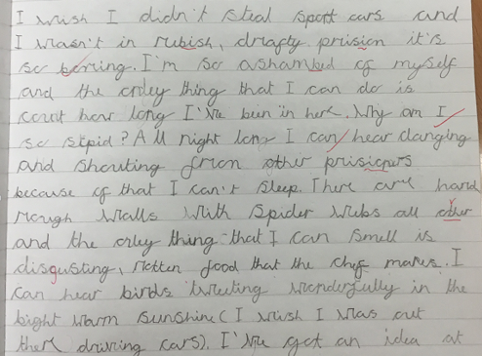
English writing example (WIN)

Slide 20
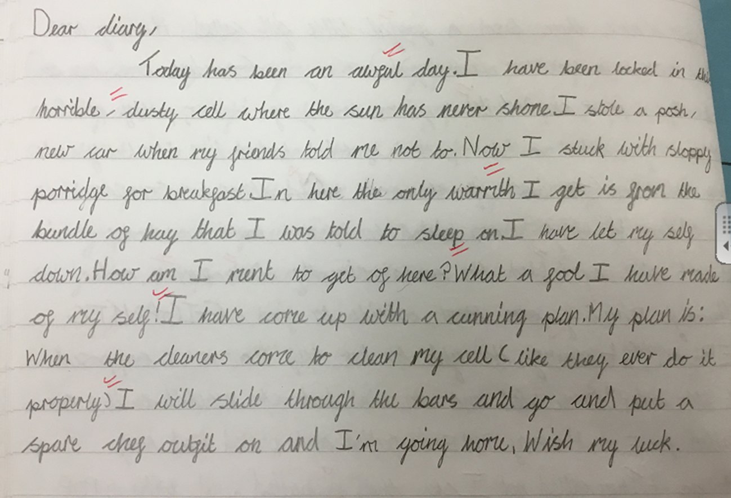
English writing example (GDS)

Slide 21
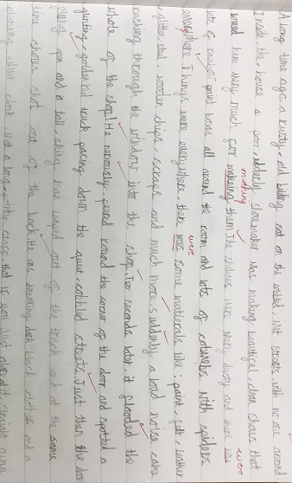
English writing example (GDS)

Slide 22
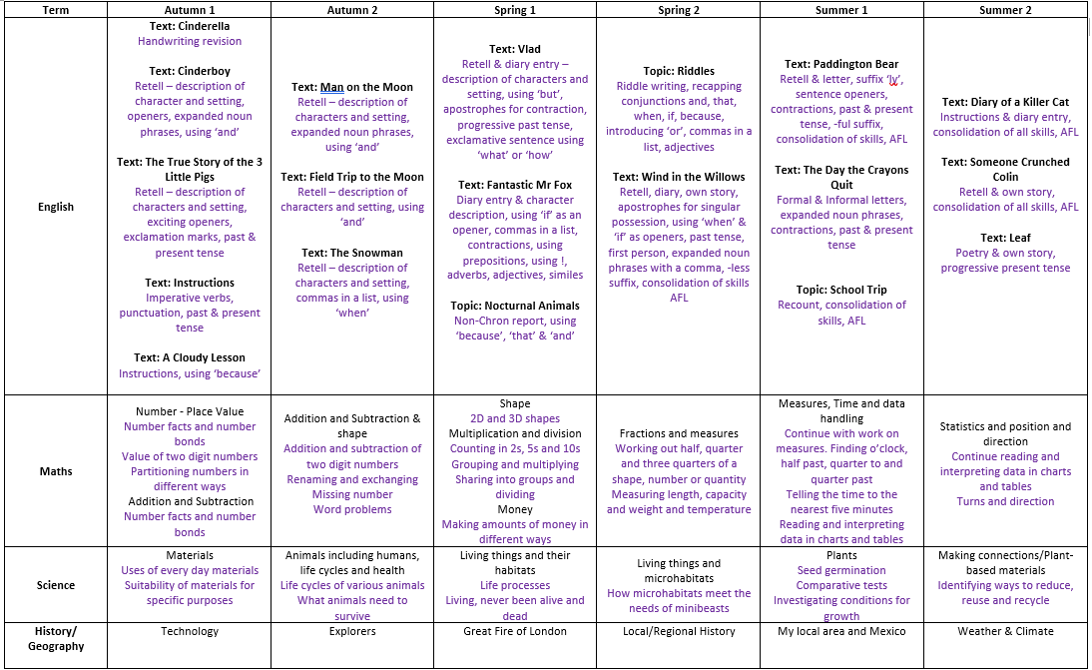
Curriculum Matrix
Please click this link for a more detailed version of our matrix
https://www.lostockhallcps.co.uk/curriculum/

Slide 23
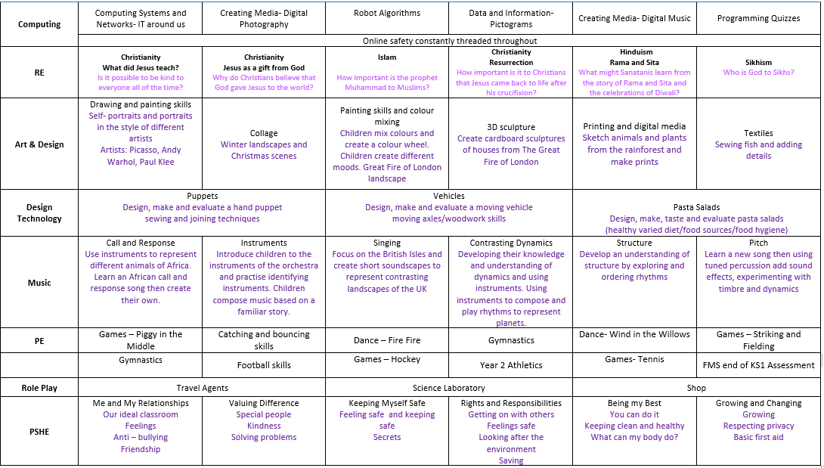
Curriculum Matrix
Please click this link for a more detailed version of our matrix
https://www.lostockhallcps.co.uk/curriculum/

Slide 24
Trips and Curriculum enhancement
Fire Safety Visit delivered by the Fire Service
A Nativity play- two performances during December
Visit to Martin Mere to support our work on habitats
PE coaches visiting to further enhance the children’s PE skills
A visit from Lego Bricks to enhance our DT work
Outdoor learning
Life skills week (workshops and activities)
Creative arts week (workshops and activities)

