Slide 1


Meet the Teacher Year 1
1J & 1M
Mr Jardine & Mr Monckton
Support Staff: Mrs Cross, Mrs Goldsmith & Miss Gardener
HLTA’s: Mrs Jamieson

Slide 2
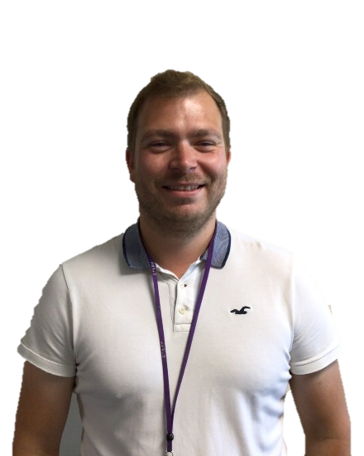
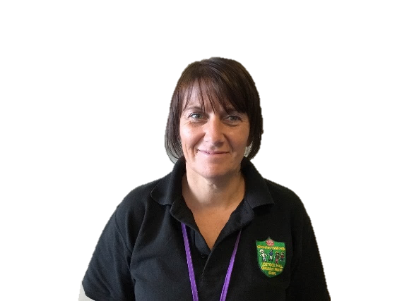
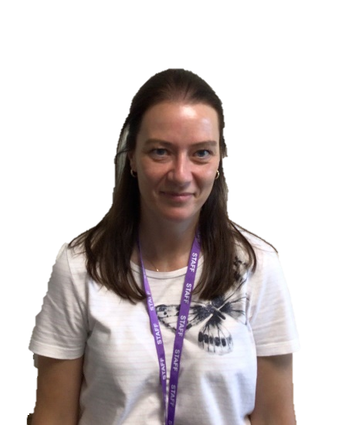
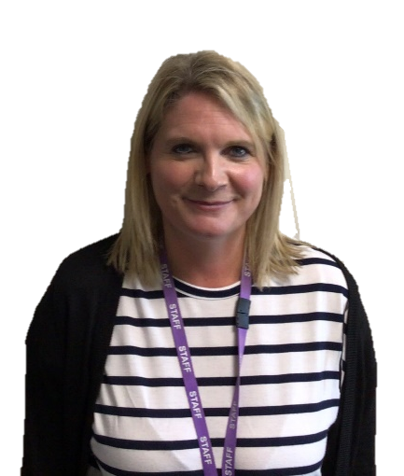

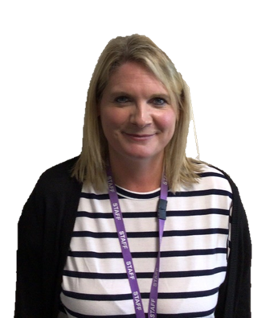
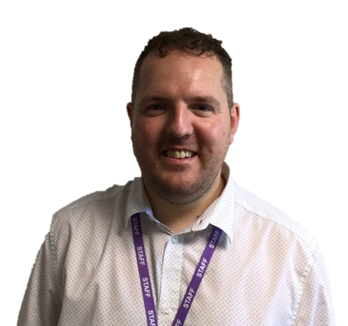
Year 1 Staff
1J
Mr Jardine
Mrs Cross
Mrs Goldsmith
Mrs Jamieson
1M
Mr Monckton
Miss Gardner
Mrs Jamieson

Slide 3
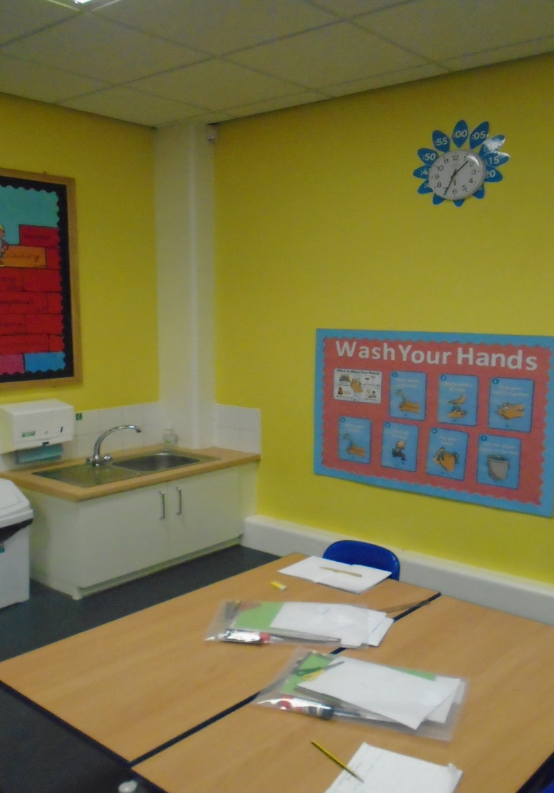
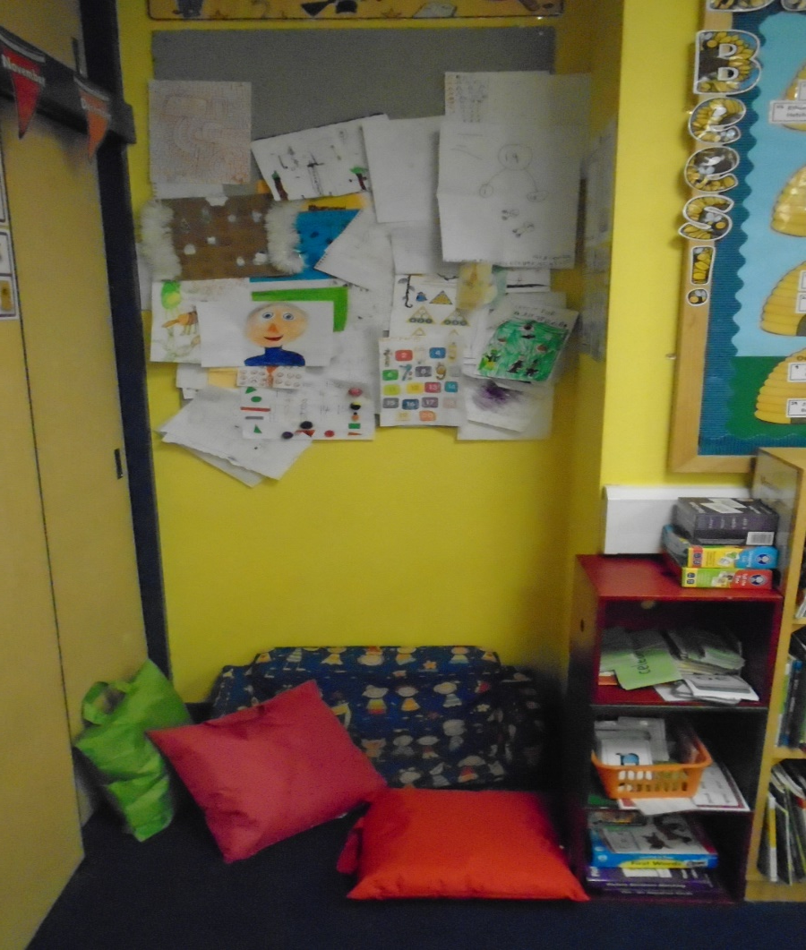
Year 1 Classrooms
Silent Reading areas to sit in with your favourite story books.
Washing corners (these come in very handy after painting)

Slide 4
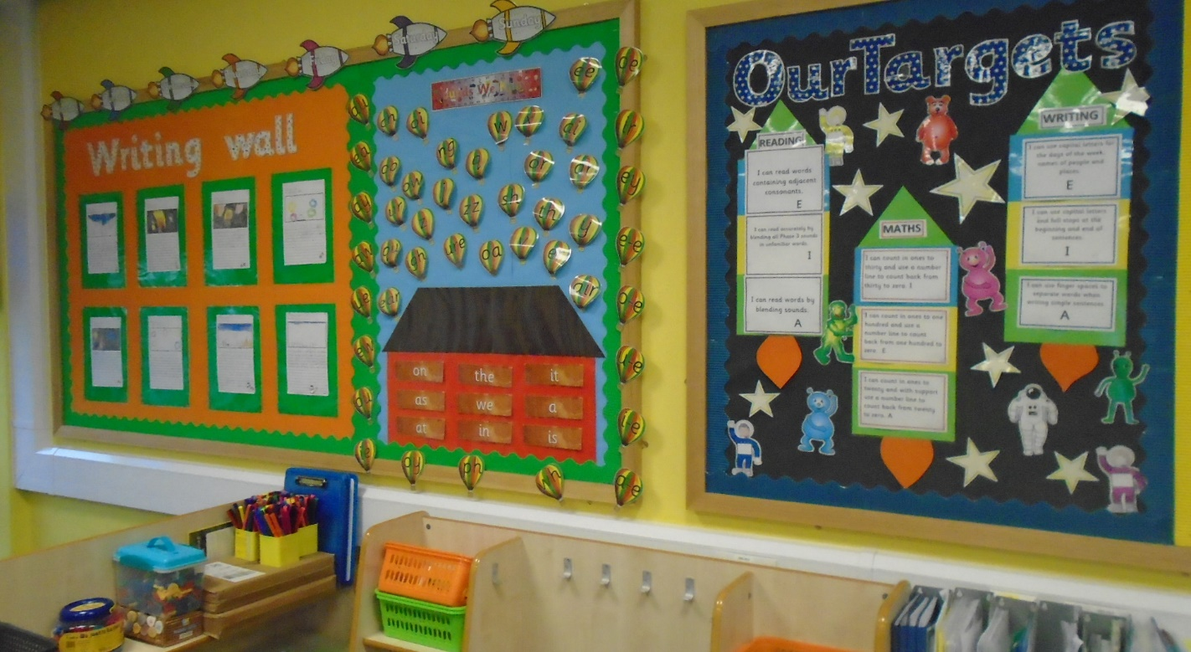
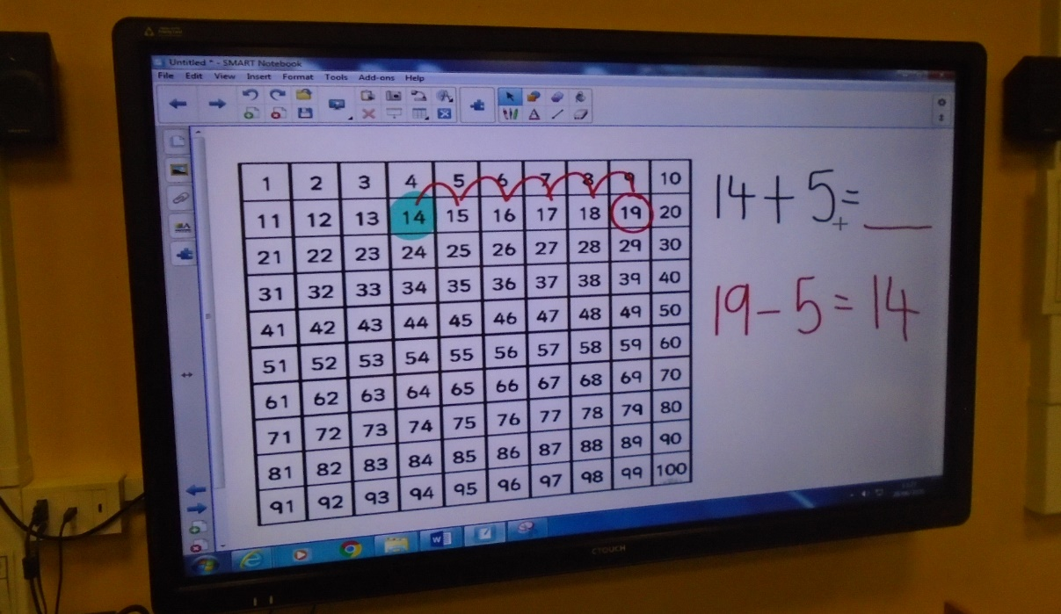
Our wall displays
are kept up to date
with examples
of our amazing
pieces of work.
Each classroom also has a working ‘word wall’ where we can showcase our growing vocabulary.
To support teaching and learning across all subjects, both Year 1 classrooms have their own fantastic interactive whiteboards.

Slide 5
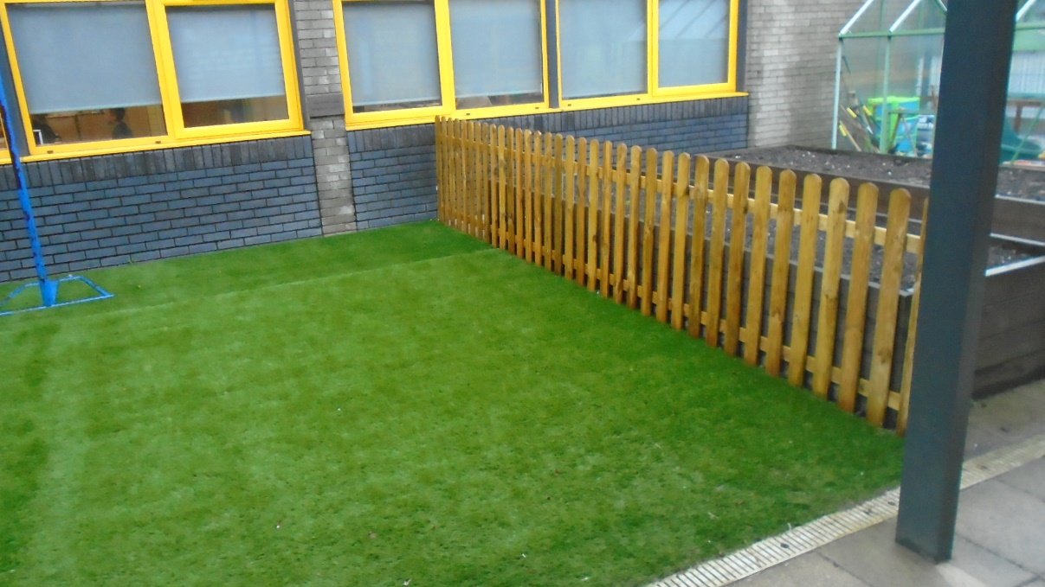
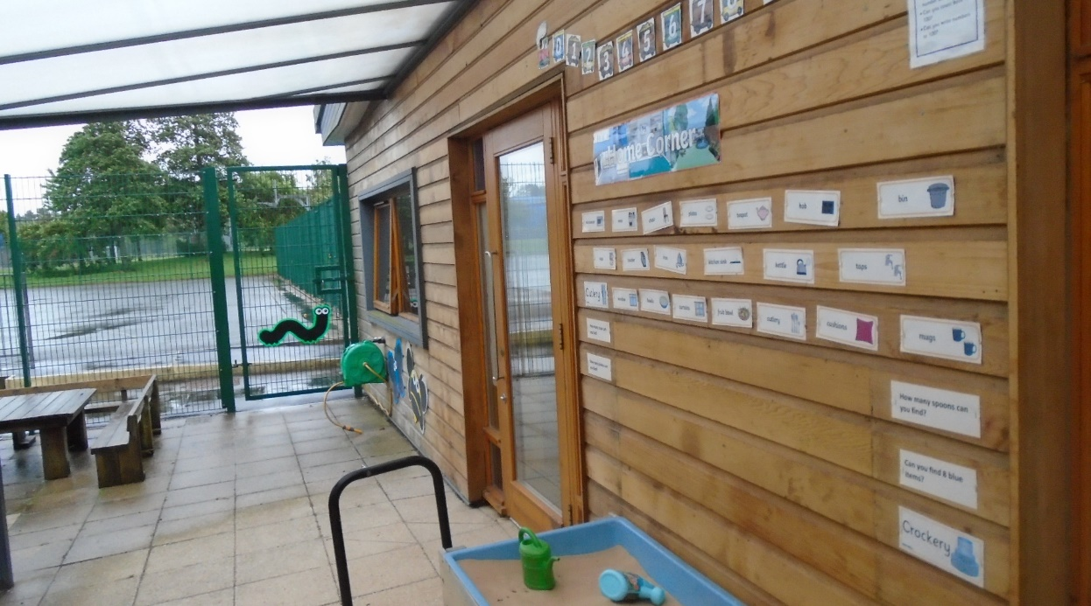
Our outdoor space to take our learning outside of the classroom; lets hope for plenty of warm and dry days next year!
Different role play areas are set up outside, throughout the year, depending on what we are learning about.
Children seem to love the history topic on ‘Toys’ the most!

Slide 6
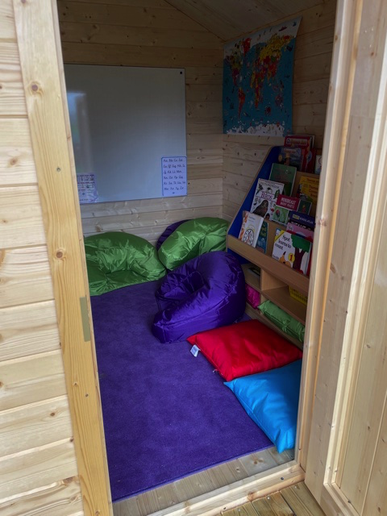
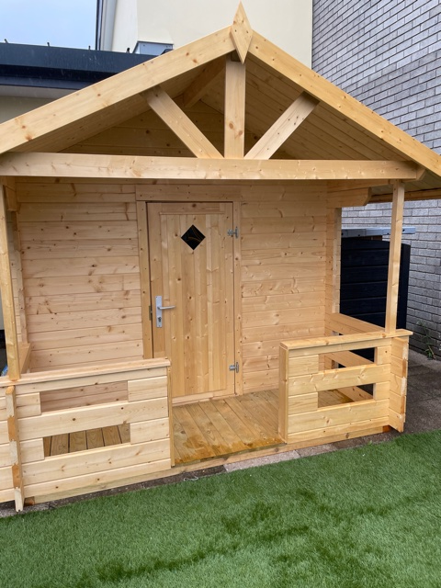
We also have a special reading hut. The children will be able to read their favourite books in peace and quiet and have their own mini ‘sofa’ to sit comfortably on as they enjoy their story.

Slide 7
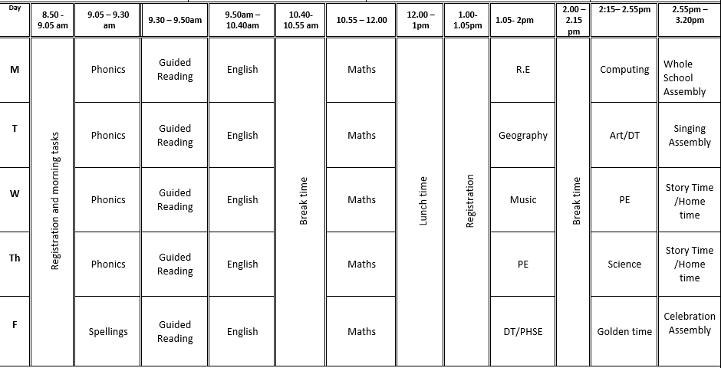
Timetable

Slide 8
Daily routines
8.50-8.55 Children enter from KS1 yard
8.55-9.05 Morning Register / order lunches
9.05-9.35 Phonics (streamed)
9.35-10.05 Guided reading
10.05 -10.40 English / Maths
10.40 – 10.55 Break
10.55 – 11.55 English / Maths
11.55-13.00 Lunch
13.00-13.15 Handwriting/Mental maths
13.15-14.00 Foundation subject
14.00-14.15 Break time
14.15-14.50 Foundation subject
14.50 – 15.15 Monday, Tuesday, Friday – Assembly or story time.
15.20 Home time; 1J exit through 2A classroom doors & 1M exit through 2C classroom doors

Slide 9
Year Group information
Homework – each term, homework challenges will be set and we will ‘show & tell’ these in class; handwriting homework will also be added later in the year.
Reading requirements – we read lots in Year 1 and you will have a reading diary to record any additional reading done at home; we should be completing at least 20 minutes of home reading each day.
Spellings / Phonics – we have a spelling test each Friday (differentiated) and these spellings go out each Friday for the following week; our spelling tests support the phonics’ focus of that given week; we will also provide pupils with ‘Reading Eggs’ log in details to help support their phonics and reading development.
Reading Books– each week, two reading books will be sent home and these will be swapped each Monday; practice reading these books at home and record any reading that you do in their reading diary daily; staff in school will also use these books to read with your child in class during Guided Reading sessions each morning.
PE Kit – Children should come to school wearing PE uniform on PE days which are Wednesdays and Thursdays.
Awards Assembly – each Friday, we will celebrate the achievements of our wonderful pupils; weekly certificates will be awarded for English, Maths and Star of the Week; we will also recognise and celebrate a ‘word of the week’ and exemplary behaviour.
School councillors – two councillors (a boy & girl from each class) will be elected to represent their class as part of the school council.
Sports Leaders – two sports leaders (a boy & girl from each class) will be elected to represent their class as a sports leader.

Slide 10
Key Stage Targets
To begin working much more independently with a gradual move away from continuous provision.
To know, on sight, the correct sound to grapheme for all 44 phonemes; (National Phonics Screening Test for Year 1 pupils – held in June 2026)
To learn all of the key words for Year 1; these words will be in the front of the Reading Diary
To learn several poems off by heart and perform these to the rest of the school.
To develop a ‘I am a Clever Writer’ strategy and become clear about what they want to write.

Slide 11
Year Group Key Skills/Objectives
English
Say sentences, before writing, and hold them in memory.
Write simple sentences using finger spaces, capital letters and
full stops.
Re-read sentences to check for errors.
Use capital letters for the pronoun I , days of the week, places and names.
Sequence events and ideas in the correct order.
Use simple phrases from their reading to open and close
stories.
To independently write simple stories, recounts, information texts and poems.
To apply their phonics knowledge when attempting to spell unfamiliar words.

Slide 12
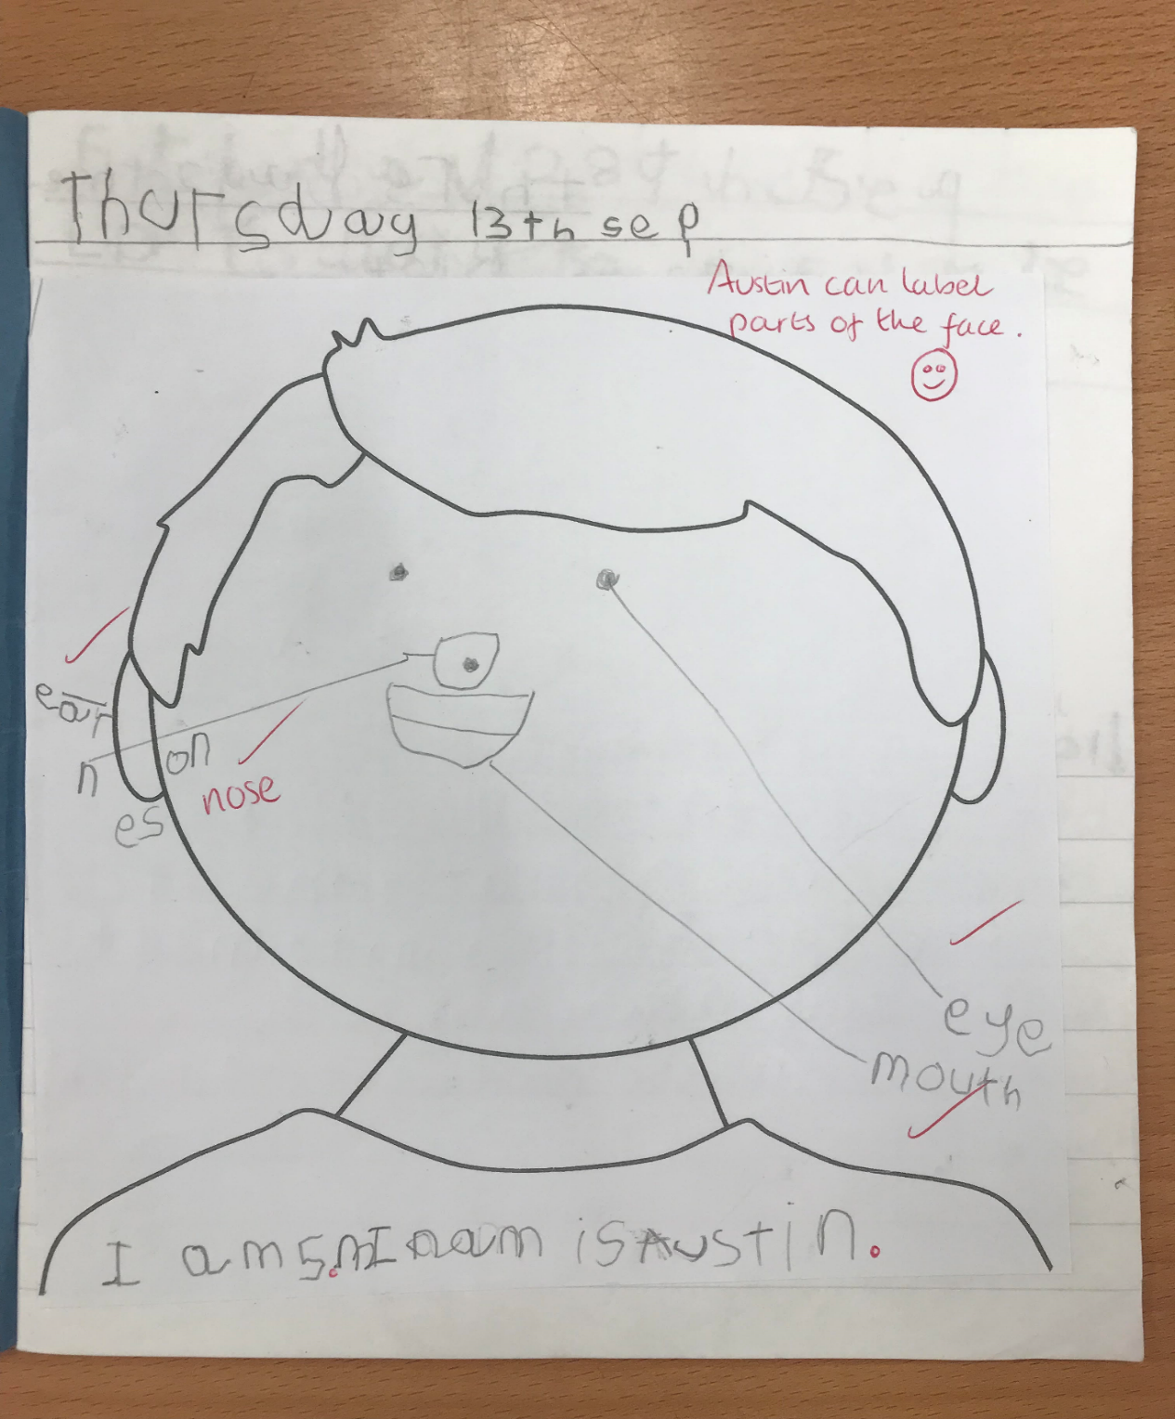
English writing example
(Pre Key Stage)
Notes:
Involve ourselves with LHA to access Forest Schools for Y5 & 6
Explore

Slide 13
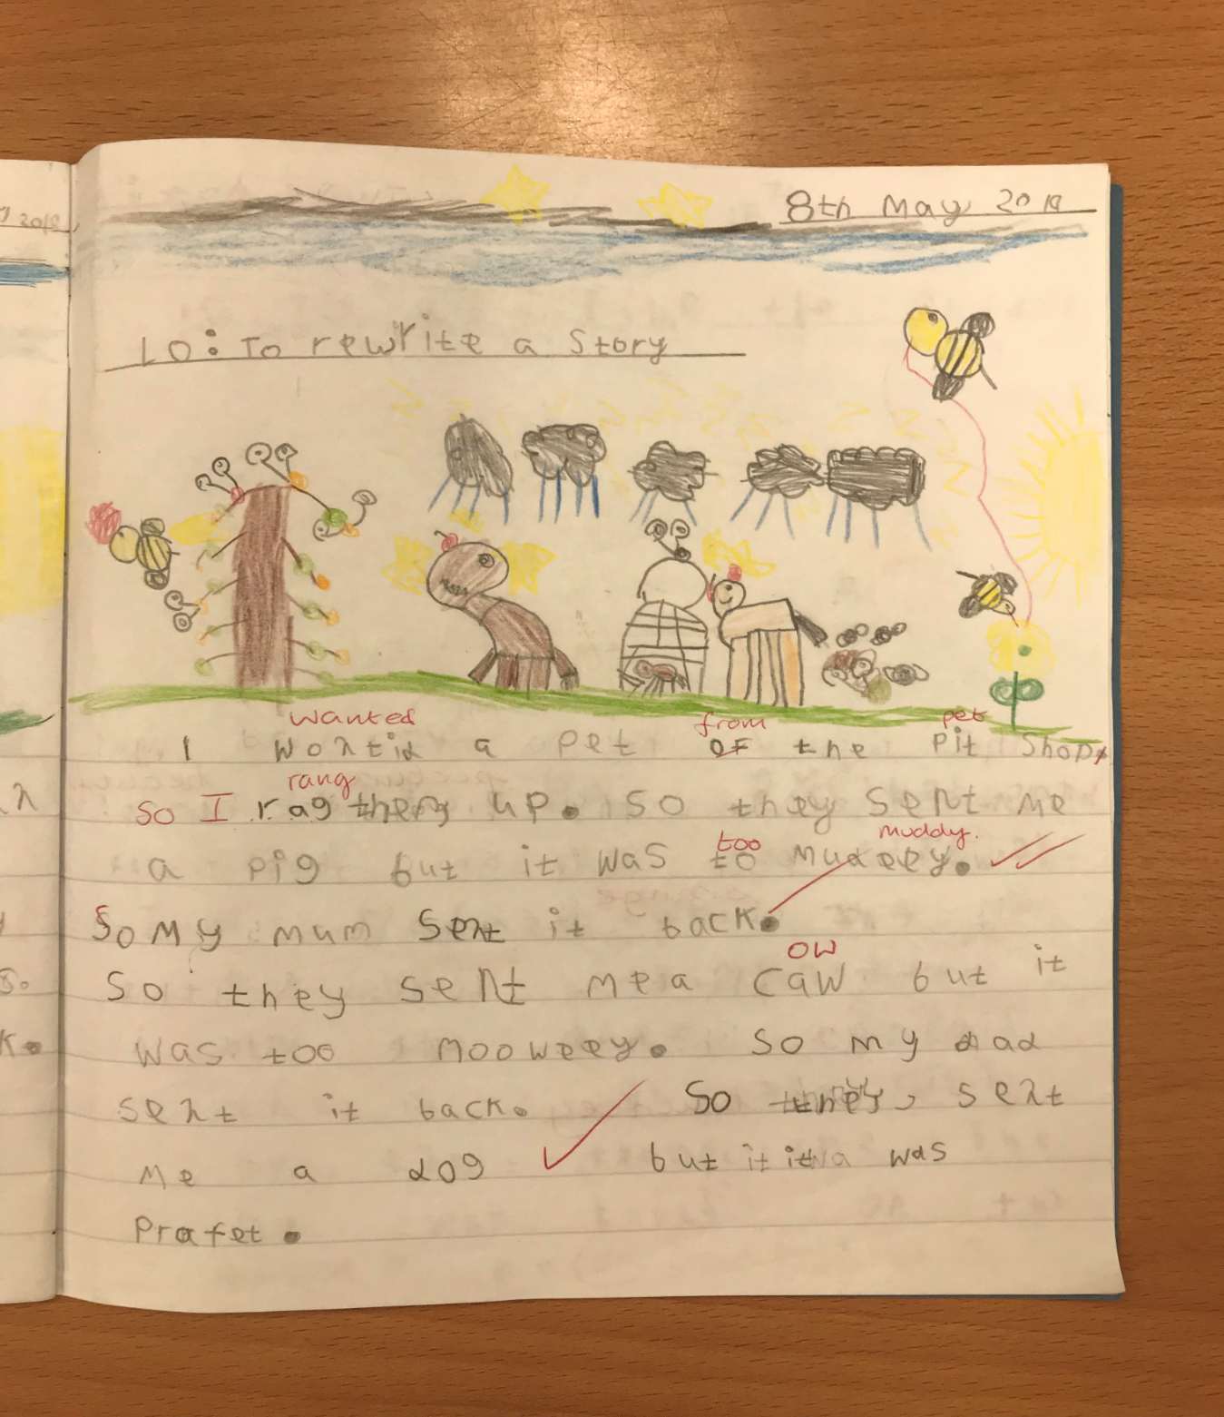
English writing example
(WT)
Notes:
Involve ourselves with LHA to access Forest Schools for Y5 & 6
Explore

Slide 14
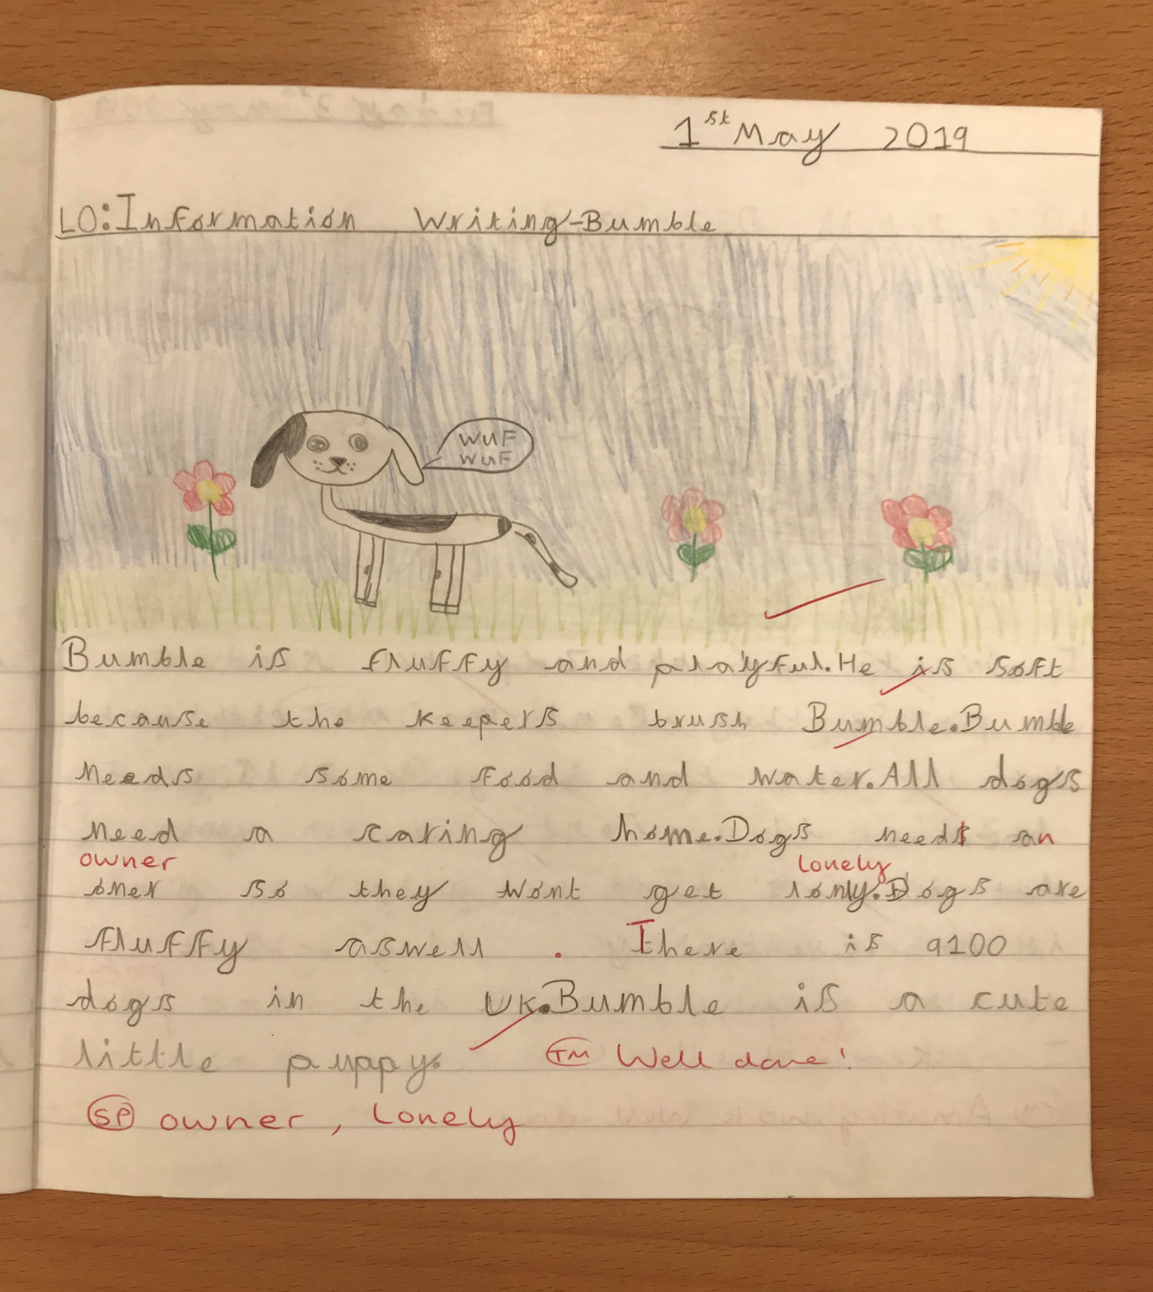
English writing example
(WIN)
Notes:
Involve ourselves with LHA to access Forest Schools for Y5 & 6
Explore

Slide 15
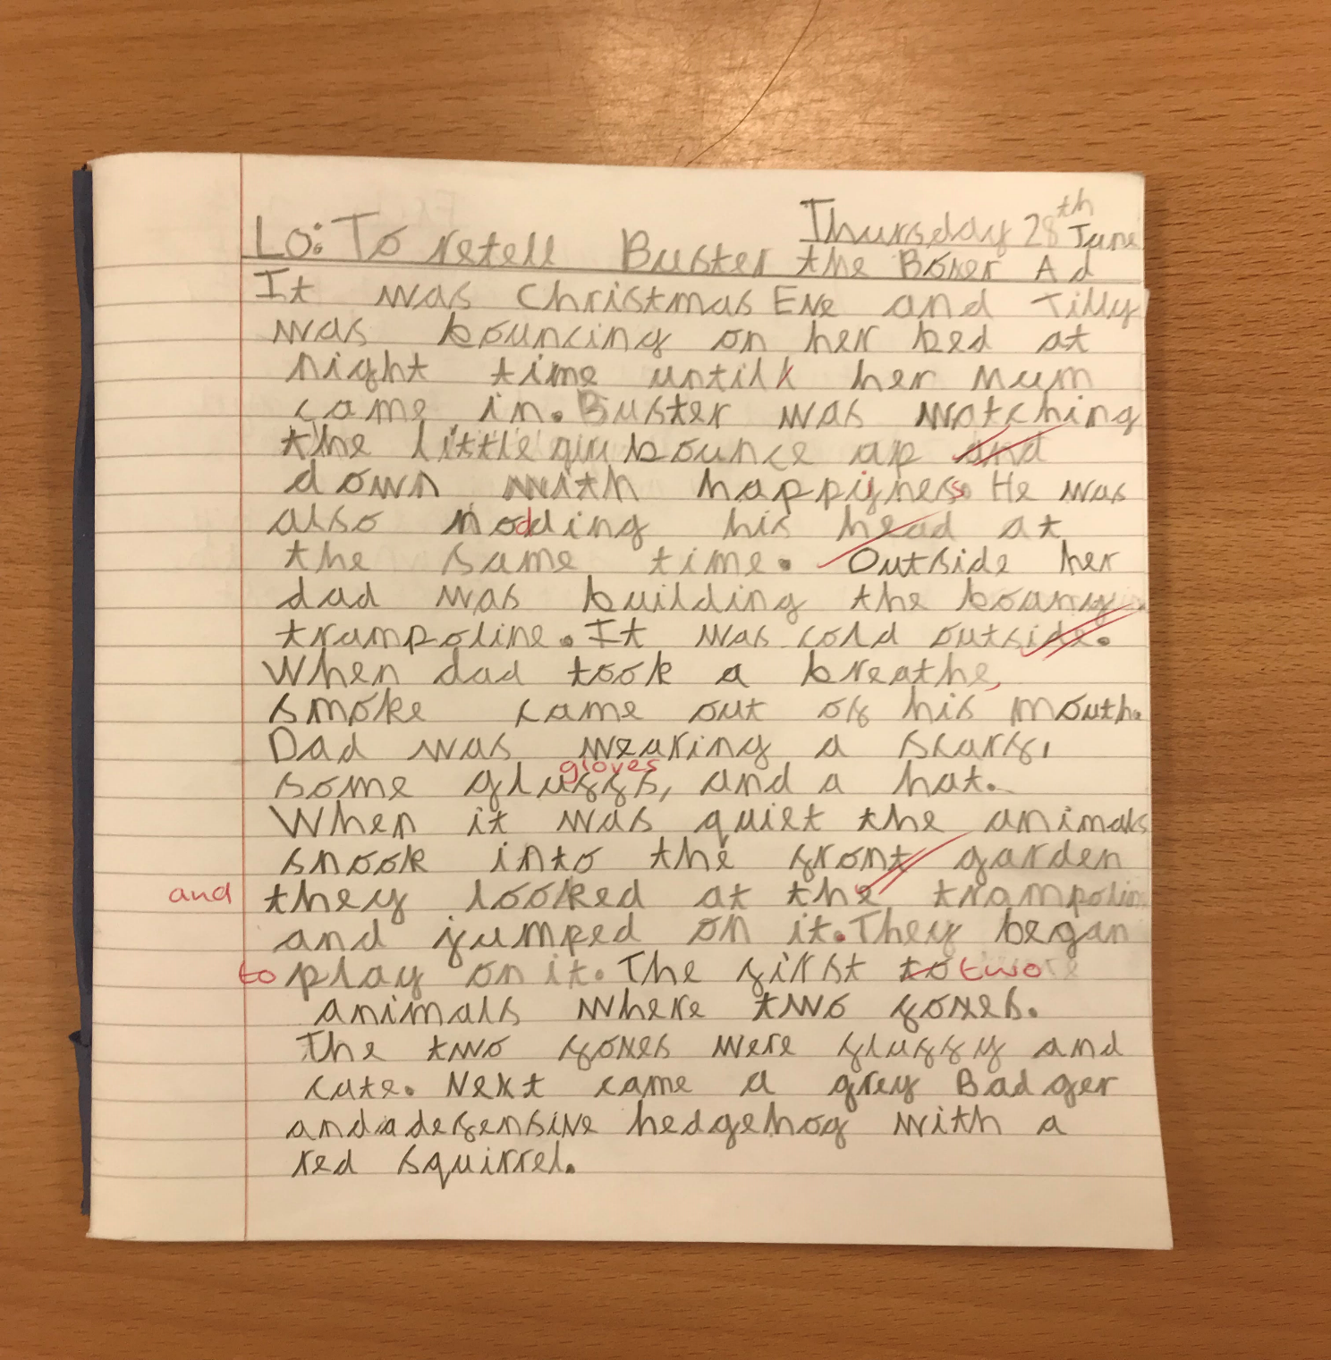
English writing example (GD)
Notes:
Involve ourselves with LHA to access Forest Schools for Y5 & 6
Explore

Slide 16
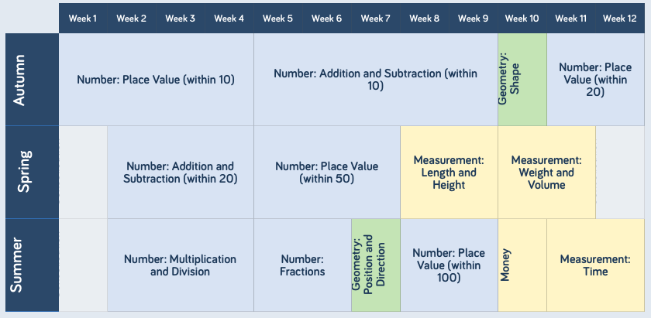
Year Group Key Skills/Objectives
count to and across 100, forwards and backwards, beginning with 0 or 1, or from any given number
count, read and write numbers to 100 in numerals; count in multiples of 2s, 5s and 10s
given a number, identify 1 more and 1 less
identify and represent numbers using objects and pictorial representations including the number line, and use the language of: equal to, more than, less than (fewer), most, least
read and write numbers from 1 to 20 in numerals and words
read, write and interpret mathematical statements involving addition (+), subtraction (−) and equals (=) signs
represent and use number bonds and related subtraction facts within 20
add and subtract one-digit and two-digit numbers to 20, including 0
solve one-step problems that involve addition and subtraction, using concrete objects and pictorial representations, and missing number problems such as 7 = ? − 9

Slide 17
Year Group Key Skills/Objectives
solve one-step problems involving multiplication and division, by calculating the answer using concrete objects, pictorial representations and arrays with the support of the teacher
recognise, find and name a half as 1 of 2 equal parts of an object, shape or quantity
recognise, find and name a quarter as 1 of 4 equal parts of an object, shape or quantity
compare, describe and solve practical problems for:
  lengths and heights [for example, long/short, longer/shorter, tall/short, double/half]
  mass/weight [for example, heavy/light, heavier than, lighter than]
  capacity and volume [for example, full/empty, more than, less than, half, half full, quarter]
  time [for example, quicker, slower, earlier, later]
measure and begin to record the following:
  lengths and heights
  mass/weight
  capacity and volume
  time (hours, minutes, seconds)
  recognise and know the value of different denominations of coins and notes
  sequence events in chronological order using language [for example, before and after, next, first, today, yesterday, tomorrow, morning, afternoon and evening]
recognise and use language relating to dates, including days of the week, weeks, months and years
tell the time to the hour and half past the hour and draw the hands on a clock face to show these times
recognise and name common 2-D and 3-D shapes, including:
  2-D shapes [for example, rectangles (including squares), circles and triangles]
  3-D shapes [for example, cuboids (including cubes), pyramids and spheres]
describe position, direction and movement, including whole, half, quarter and three-quarter turns

Slide 18
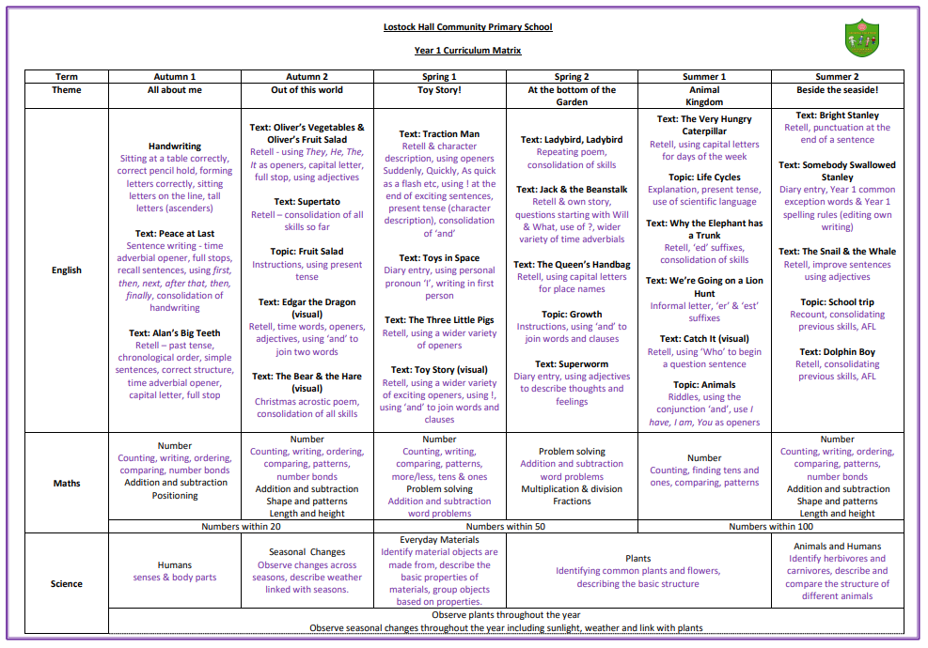
Curriculum Matrix
Notes:
Involve ourselves with LHA to access Forest Schools for Y5 & 6
Explore

Slide 19
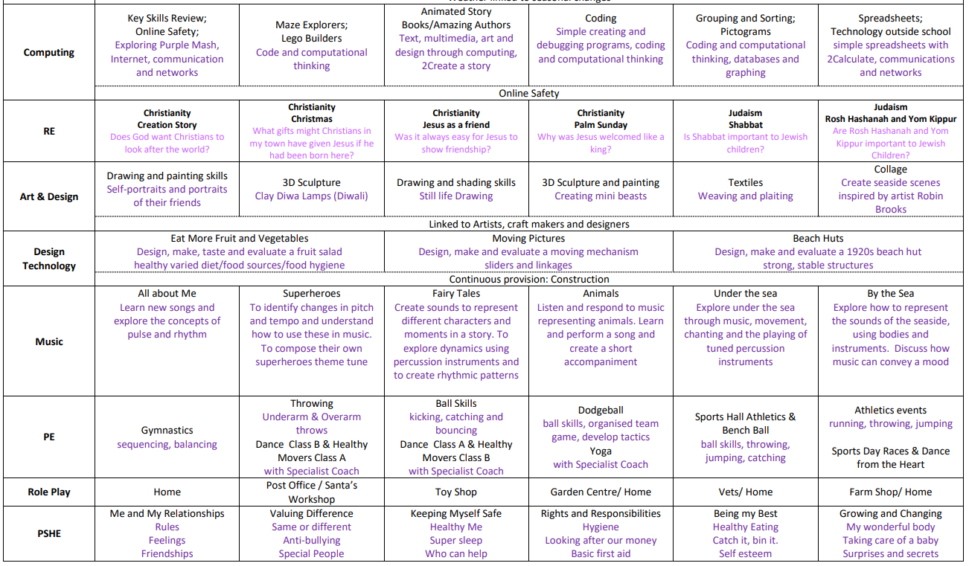
A copy of this Year 1 Curriculum Matrix can
also be found on the school website; this will
also include any updates and changes for
the upcoming year 2025-26.

Slide 20
Trips and Curriculum Enhancements
Blackpool Zoo
Poetry performance (for parents)
Key Stage 1 Sports Day (for parents)
Arts Week presentation
Specialist sports coaching
Afterschool club opportunities
Key Stage 1 Sports competitions with South Ribble School Sport Partnership
Academic – intervention groups, (phonics, maths booster, Talkboost) Precision teaching and maths enhancements.
Reading Buddies and streamed phonics intervention groups

Slide 21
Questions
We sincerely hope that this presentation has covered most aspects of
Year 1, if however you do have any questions ahead of next year,
please do not hesitate to send an email to:
year1@lostockhallcps.co.uk
Should you ever require a formal meeting with your class teacher, speak with them directly (either before school or at home time) and we can arrange a specific date or time to meet.
As a Year 1 staff, we are very much looking
forward to seeing all of you in September and
embarking on an exciting new school year!

