Slide 1

Addition and subtraction
www.grammarsaurus.co.uk

Slide 2



Let’s build
Take 1 counter.
Add 1 more.
How many do you have now?
One more than is
1
2
2
is one more than
1
Notes:
Children to build alongside the slides

Slide 3
Let’s build
Take 2 counters.
Add 1 more.
How many do you have now?
One more than is
2
3
3
is one more than
2
Notes:
Children to build alongside the slides

Slide 4
Let’s build
Take 3 counters.
Add 1 more.
How many do you have now?
One more than is
3
4
4
is one more than
3
Notes:
Children to build alongside the slides

Slide 5
Let’s build
Take 4 counters.
Add 1 more.
How many do you have now?
One more than is
4
5
5
is one more than
4
Notes:
Children to build alongside the slides

Slide 6




Which five frame matches?
One more than is
2
3
Have a think

Slide 7
Which five frame matches?
4
is one more than
3
3
Have a think

Slide 8
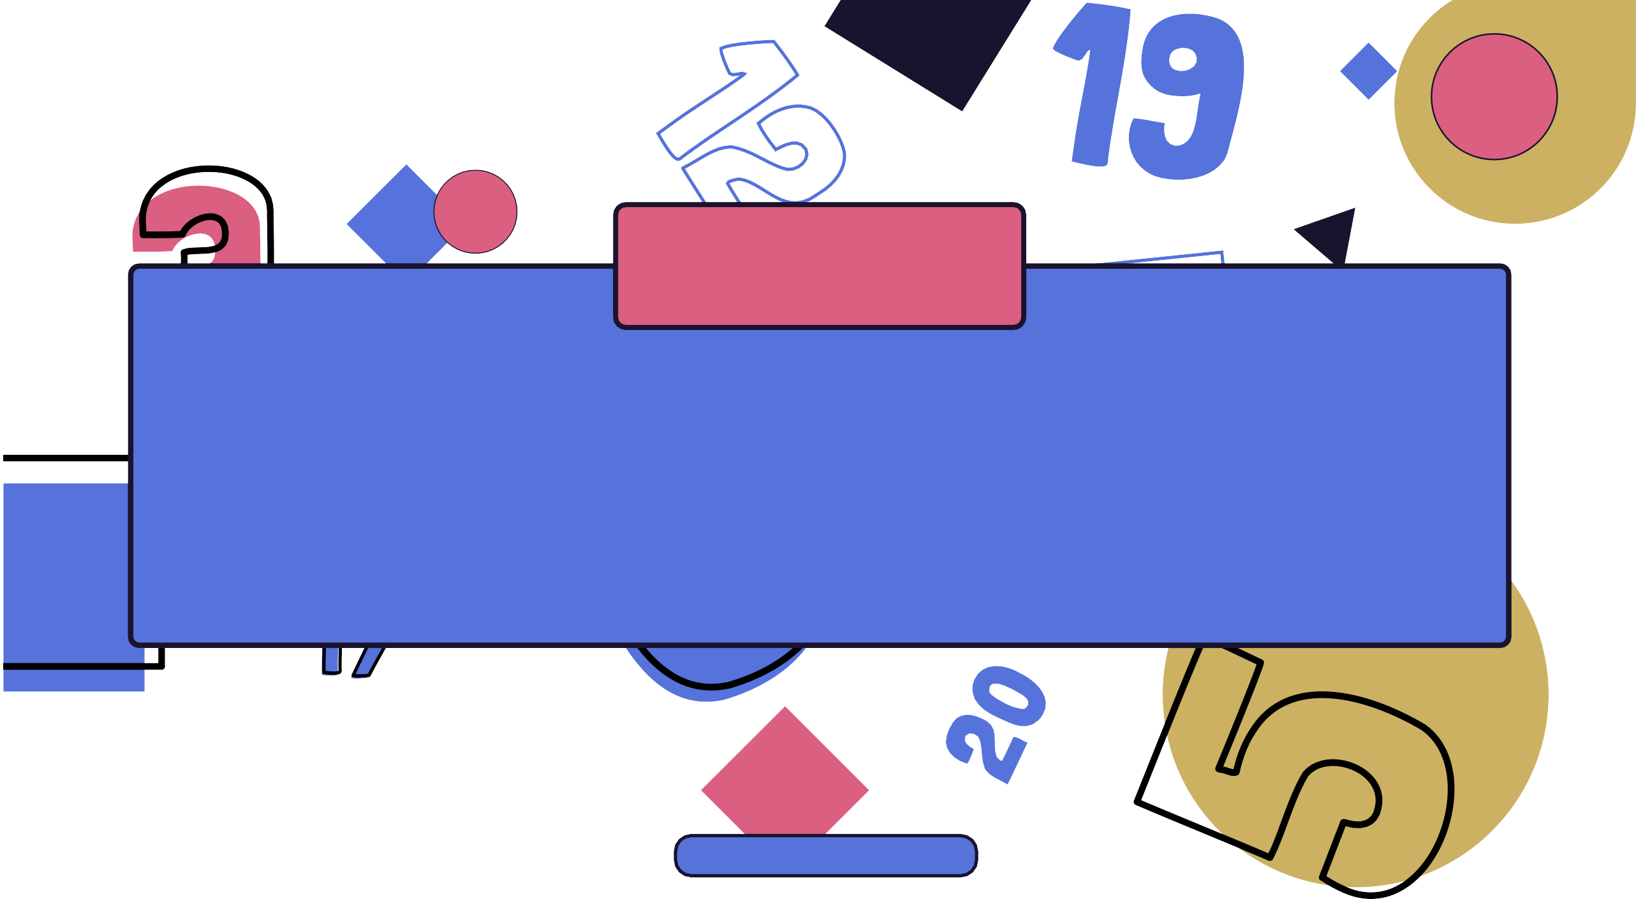

Lesson 8
Add together
www.grammarsaurus.co.uk

Slide 9



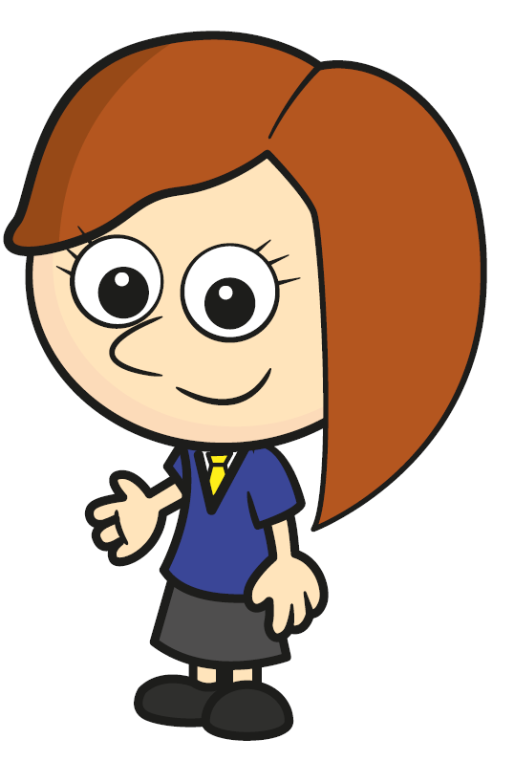
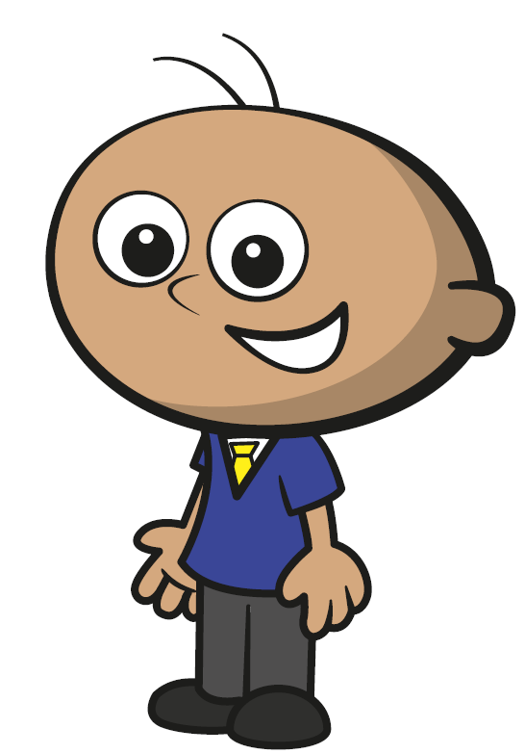
Year 1 | Week 6| Day 3
1) Draw the whole.
2) Put the groups in order starting with the smallest.
3) 7, 6, 5,
4) Who is shorter?
Tommy
Rosie

Slide 10
Year 1 | Week 6| Day 3
1) Draw the whole.
2) Put the groups in order starting with the smallest.
3) 7, 6, 5,
4) Who is shorter?
4
Tommy
Tommy
Rosie

Slide 11

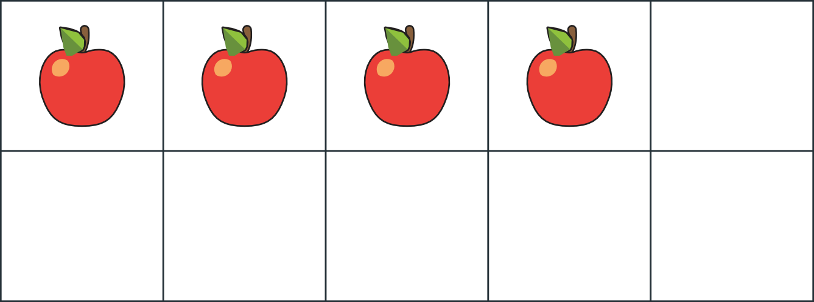

Starter
1
1
Number bond to 10:
+
= 10
I need 10 apples to make a pie.
How many more do I need?
www.grammarsaurus.co.uk

Slide 12

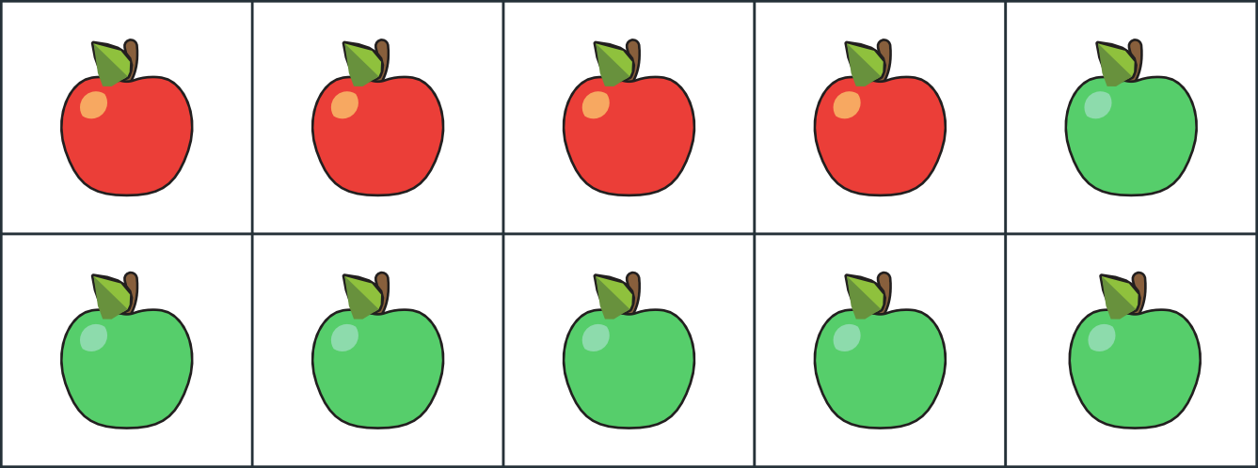
2
Starter
2
answers
Number bond to 10:
4 + 6 = 10
I need 10 apples to make a pie.
How many more do I need?
www.grammarsaurus.co.uk

Slide 13

Add together
3
3
Ben has 4 sweets.
Inaya has 2 sweets.
How many sweets do they have altogether?
www.grammarsaurus.co.uk

Slide 14
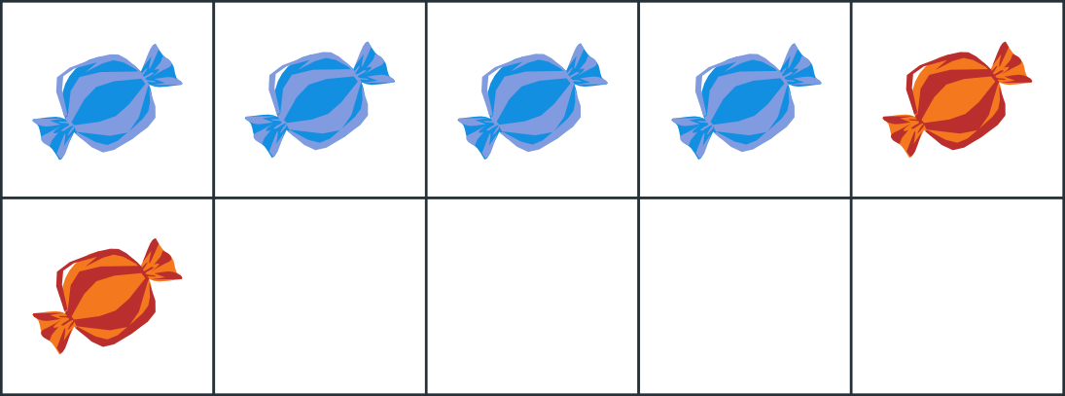
4
4
Add together
Inaya has 2 sweets.
Ben has 4 sweets.
+ =
plus is equal to .
How many sweets do they have altogether?
www.grammarsaurus.co.uk

Slide 15


5
answers
5
Add together
Inaya has 2 sweets.
Ben has 4 sweets.
4 +2 =6
4 plus 2 is equal to 6 .
How many sweets do they have altogether?
www.grammarsaurus.co.uk

Slide 16

6
6
Here, there are 4 blue counters and 3 yellow counters.
+ =
plus is equal to .
How many counters are there altogether?
www.grammarsaurus.co.uk

Slide 17
7
answers
7
Here, there are 4 blue counters and 3 yellow counters.
+ =
plus is equal to .
How many counters are
there altogether?
www.grammarsaurus.co.uk

Slide 18
8
answers
8
Here, there are 6 blue counters and 3 yellow counters.
3 ₊ 4 ₌ 7
3 plus 4 is equal to 7 .
How many counters are there altogether?
7 counters
www.grammarsaurus.co.uk

Slide 19
I have built a tower out of blue cubes and yellow cubes.
9
9
How many cubes are
there altogether?
www.grammarsaurus.co.uk

Slide 20
10
10
answers
I have built a tower out of blue cubes and yellow cubes.
+ =
plus is equal to .
How many cubes are
there altogether?
www.grammarsaurus.co.uk

Slide 21

2 ₊ 5 ₌ 7a
11
11
I have built a tower out of blue cubes and yellow cubes.
2 plus 5 is
equal to 7 .
How many cubes are there altogether?
7 cubes
www.grammarsaurus.co.uk

Slide 22

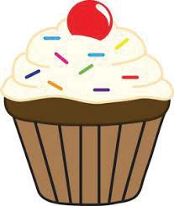
12
12
I have 5 chocolate cupcakes and 3 vanilla cupcakes.
+ =
plus is equal to .
How many cupcakes do I have altogether?
www.grammarsaurus.co.uk

Slide 23


13
answers
13
I have 5 chocolate cupcakes and 3 vanilla cupcakes.
8
5 + 3 = 8
5 plus 3a is equal to 8 .
How many cupcakes do I have altogether?
8 cupcakes
www.grammarsaurus.co.uk

Slide 24

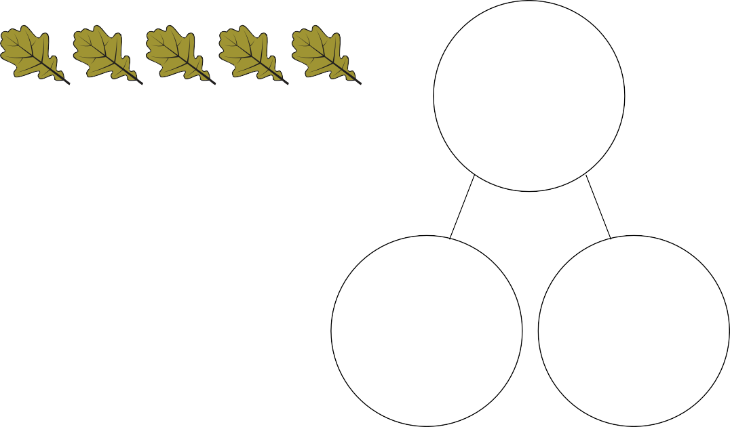
14
14
answers
I found 4 red leaves and 5 green leaves.
+ =
plus is equal to .
How many leaves do I have altogether?
www.grammarsaurus.co.uk

Slide 25
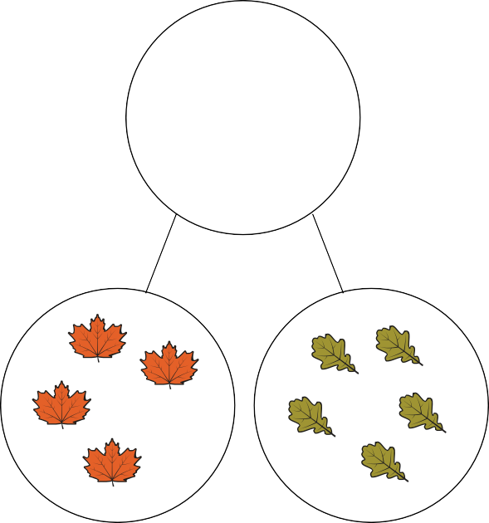
15
15
answers
I found 4 red leaves and 5 green leaves.
9
4 + 5 = 9
4 plus 5 is equal to 9 .
How many leaves do I have altogether?
9 leaves
www.grammarsaurus.co.uk

Slide 26




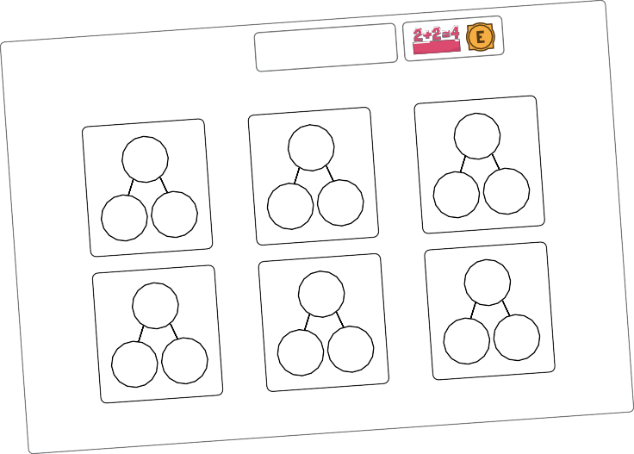
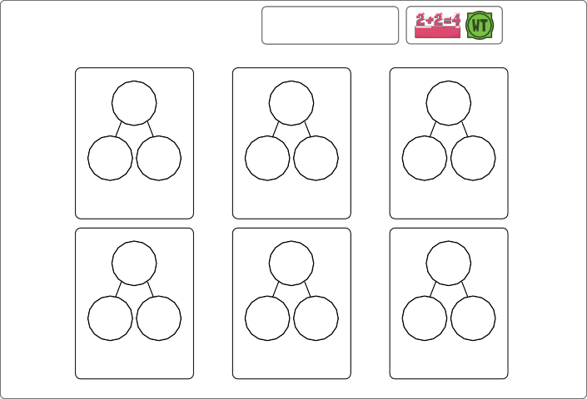
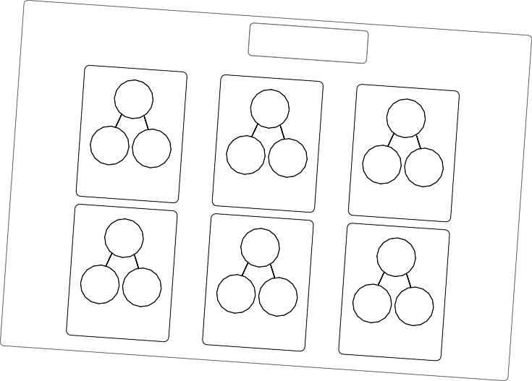

Your turn!
16
16
Try the challenge at your tables
Add together
Part-whole models
Fluency
Add together
Add together
Part-whole models
Fluency
Part-whole models
Fluency
+ =
+ =
+ =
+ =
+ =
+ =
grammarsaurus.co.uk
grammarsaurus.co.uk
grammarsaurus.co.uk
www.grammarsaurus.co.uk

