Slide 1

PSHE and Citizenship
Anti-bullying
PSHE and Citizenship | KS1 | Anti-Bullying

Slide 3
Aim
I can talk about unkind behaviour like teasing and bullying.
Success Criteria
I can say if behaviour is joking, teasing or bullying.
I can describe what to do if I see teasing or bulling.
This resource is fully in line with the Learning Outcomes and Core Themes outlined in the PSHE Association’s Programme of Study.

Slide 4

The Big Questions

Slide 5

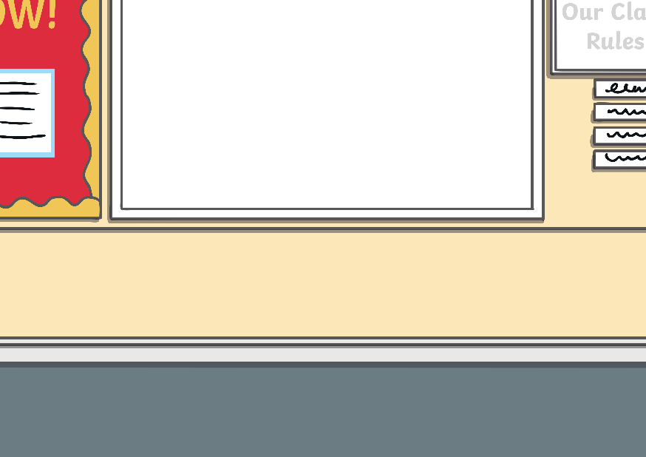
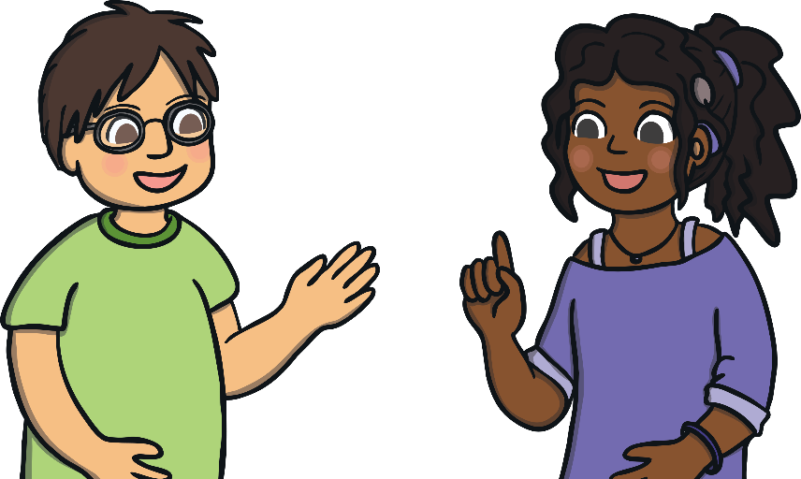
The Big Questions
Talk about these questions in pairs before sharing your thoughts.
What can we do if we see someone being teased or bullied, or if it happens to us?
What types
of unkind behaviour
are there?

Slide 6




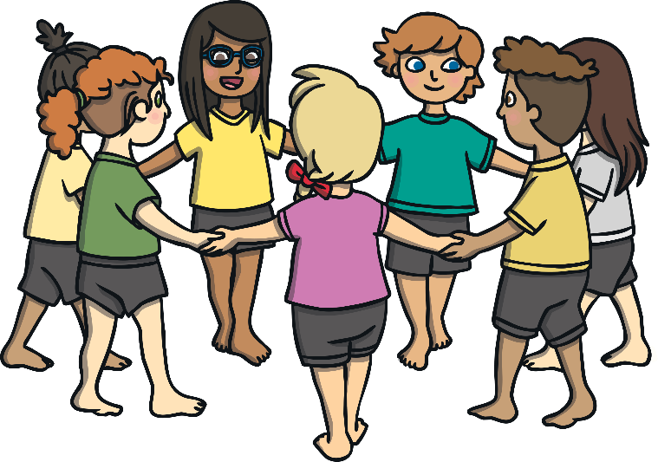
Reconnecting

Slide 7

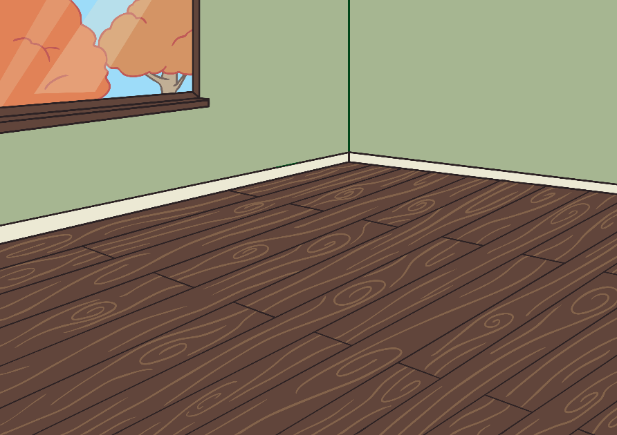
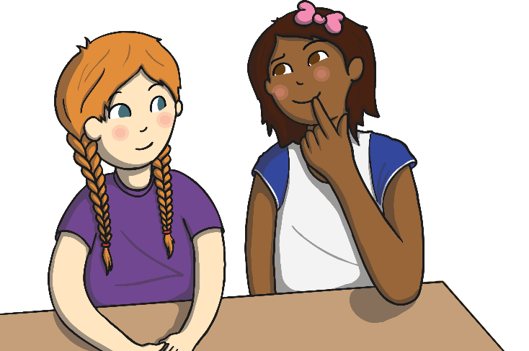
What Type of Behaviour?
Do you know the difference between friendly joking, teasing and bullying?
Friendly Joking
Teasing
Bullying

Slide 8
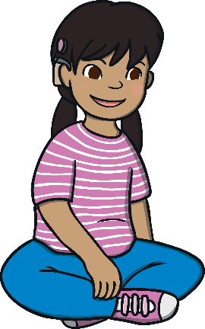
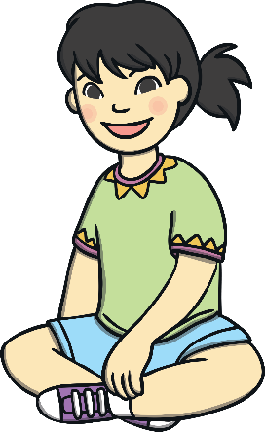
What Type of Behaviour?
What kind of behaviour is friendly joking?
Can you think of an example of friendly joking?
Friendly joking is where someone says something funny or plays a trick on someone to make that person laugh. Joking is between friends and it isn’t meant to be cruel or unkind. Joking doesn’t make anybody feel bad and always stops before anyone gets upset.

Slide 9
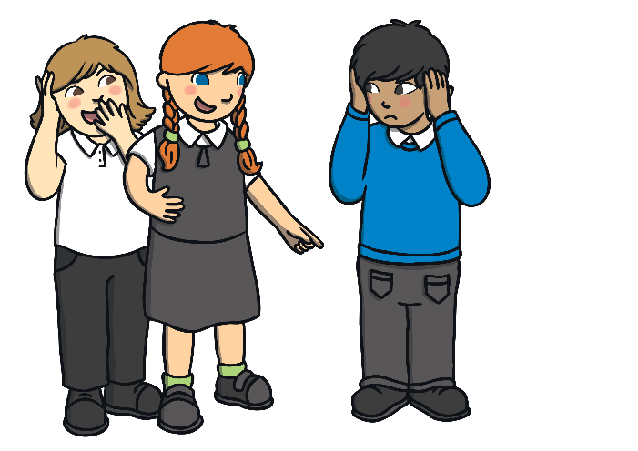
What Type of Behaviour?
What kind of behaviour is teasing?
Can you think of an example of teasing?
Teasing is where a person makes fun of another person, annoys them or says something unkind to them in a playful way. Sometimes teasing is friendly but it can easily hurt people’s feelings. Teasing can become bullying if it carries on when the person being teased is upset. Teasing someone to hurt and upset them is never OK.

Slide 10
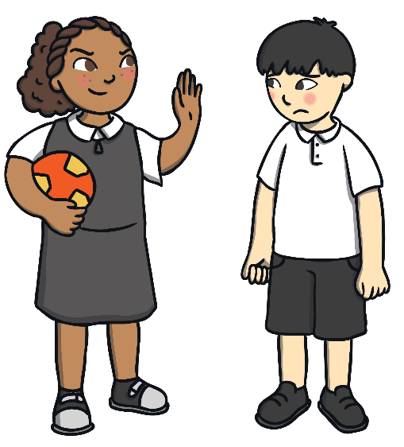
What Type of Behaviour?
What kind of behaviour is bullying?
Can you think of an example of bullying?
Bullying is where a person hurts another person with their body or their words. It can happen more than once and the person who is doing it knows that their actions are hurtful. Bullying can include leaving people out, making people feel silly on purpose, hurting people, calling them names or making them feel bad about themselves. Bullying is never OK.

Slide 11
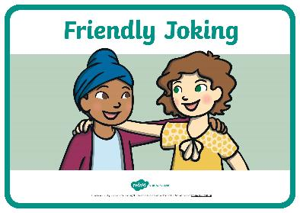
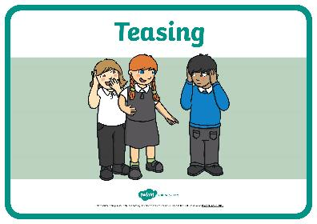
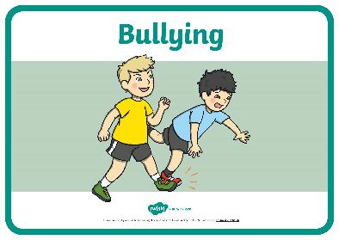
What Type of Behaviour?
We are going to play a game where we look at and sort different behaviours.
Some of the behaviour will be ‘friendly joking’, some will be ‘teasing’ and some will be ‘bullying’.
Around the classroom there are three signs. When you hear one of these types of behaviour, go and stand by the sign that you think best describes what is happening.

Slide 12
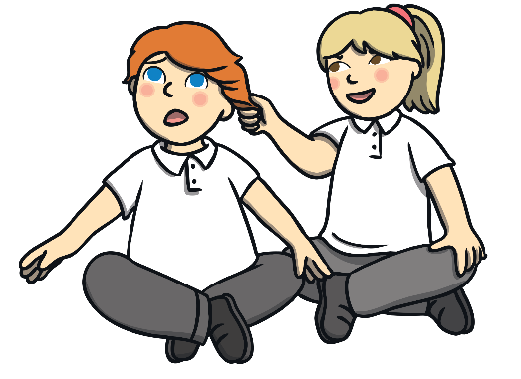

What Type of Behaviour?
Is this friendly joking, teasing or bullying? What do you think?
At carpet time, Susie sits behind Jacob. Each day Susie taps Jacob on the back but when he turns around she just laughs about it. Jacob has asked Susie to stop and said he doesn’t like it but Susie carries on doing it. Jacob doesn’t like sitting on the carpet anymore because he can’t concentrate on what his teacher is saying.
Susie knows that she is being unkind and that Jacob wants her to stop. However, she continues with her behaviour. This is bullying.

Slide 13

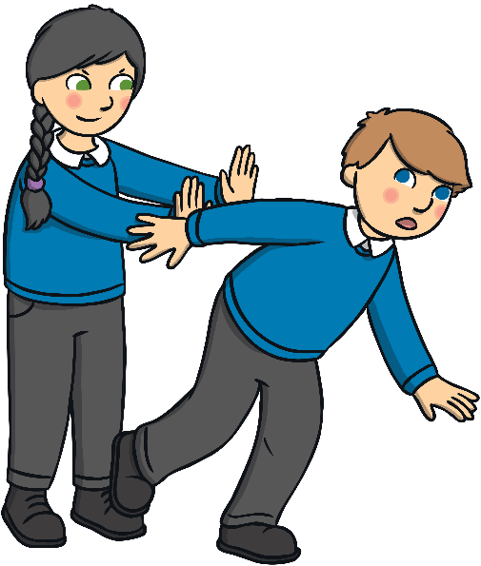
What Type of Behaviour?
Is this friendly joking, teasing or bullying? What do you think?
Every day, Caitlin pushes Edward out of the line so he has to go to the back. This makes Edward cry but Caitlin carries on doing it. Today Caitlin pushes Edward hard and he falls over.
Caitlin knows that she is being unkind but every day she keeps upsetting and hurting Edward on purpose. This is bullying.

Slide 14
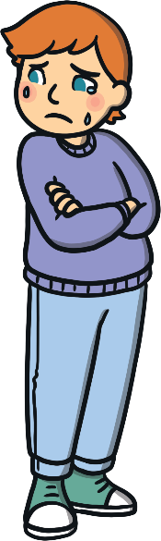


What Type of Behaviour?
Is this friendly joking, teasing or bullying? What do you think?
Savannah tells Bobby that he has to go inside to speak to the teacher. When Bobby goes in, Savannah laughs and says that he didn’t really have to go in. Bobby is cross. Savannah
says sorry.
Savannah played
a trick on Bobby
to annoy him.
It made him cross
but she is sorry.
This is teasing.

Slide 15
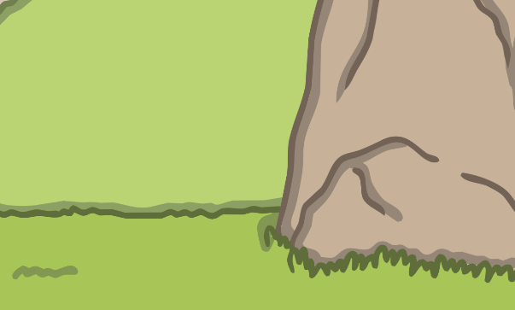
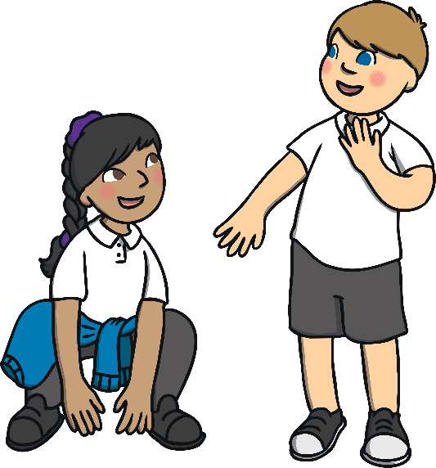
What Type of Behaviour?
Is this friendly joking, teasing or bullying? What do you think?
William says to Farrah that she is so good at jumping that she could be a frog. They both laugh.
William said something funny to make Farrah laugh. This is friendly joking.

Slide 16
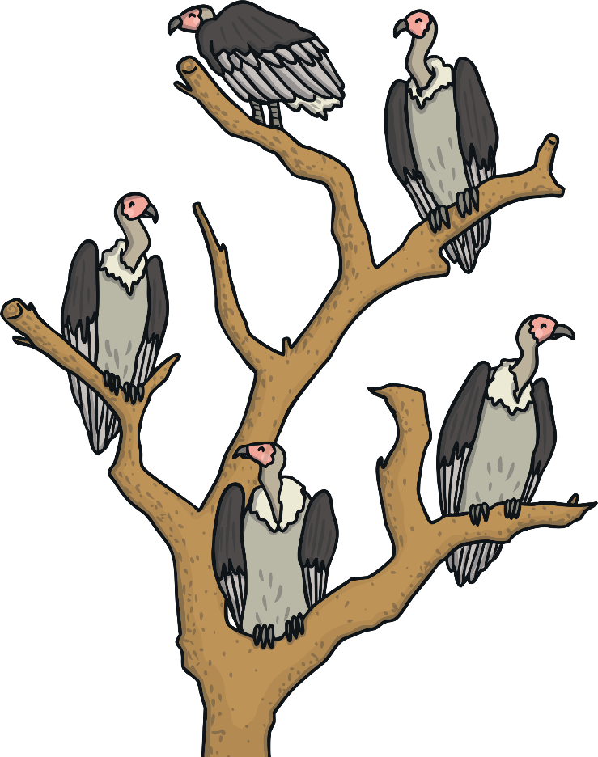
Exploring

Slide 17

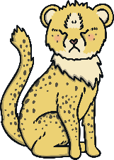

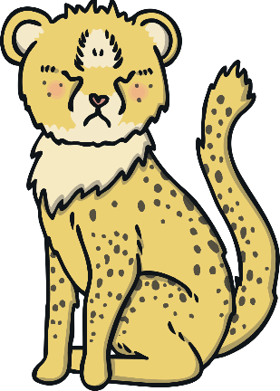
Chase the Cheetah
We are going to hear a story about a Cheetah called Chase.
While we listen to the story, think about this question.
What can we do if we see someone being teased or bullied, or if it happens to us?

Slide 18

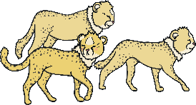
Chase the Cheetah
In Africa, there lived a coalition of cheetahs. Cheetahs have long legs and strong muscles that make them run fantastically fast. What cheetahs love best of all is to run as fast as they can.
One of the cheetah cubs in Cheetah School was called Chase. Chase had shorter legs than all the other cubs in his class so he couldn’t run nearly
as fast.
The other cubs in the class loved to play running races but they didn’t let Chase join in. They said he was too slow.
How do you think this made Chase feel?

Slide 19
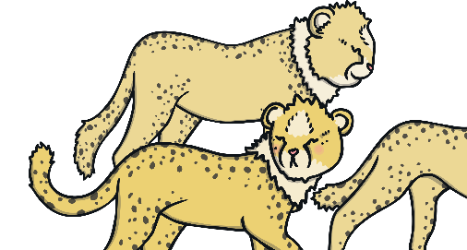
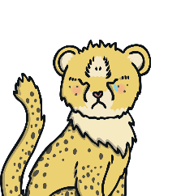
Chase the Cheetah
As the cheetah cubs grew, their legs became longer. They spent their play times running further and faster. Chase couldn't keep up at all and he was often left on his own.
One day, one of the cheetah cubs, Flo, noticed that Chase was looking lonely. She asked the other cubs if they could let Chase join in with their race.
All of the other cheetahs said no. They ran off together and Flo followed.
Do you think that Flo did the right thing?

Slide 20


Chase the Cheetah
Every day, the cheetah cubs raced through the jungle. Every day, Flo asked the other cubs in the class if Chase could join in with their games. The other cheetahs always said no. Sometimes they called Chase
nasty names.
Flo felt bad for Chase but she didn’t know how she could help.
How do you think the cubs’ behaviour makes Chase feel?
What could Flo do
to help?

Slide 21
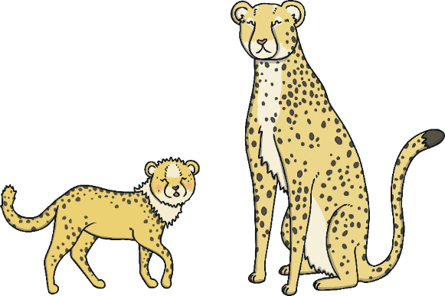
Chase the Cheetah
One day, Flo thought hard about how it must feel for Chase to be left out at play time every day. She knew he must be feeling very sad.
So, Flo did something very brave. She told the other cheetah cubs that they were being very unkind by leaving Chase out of all of their games.
Flo knew that she should also tell a grown-up what she had seen. She raced back to Cheetah School to tell her teacher how the other cubs had been behaving
towards Chase.
What do you think the teacher will do?
What could Flo
do next?
What might happen?

Slide 22
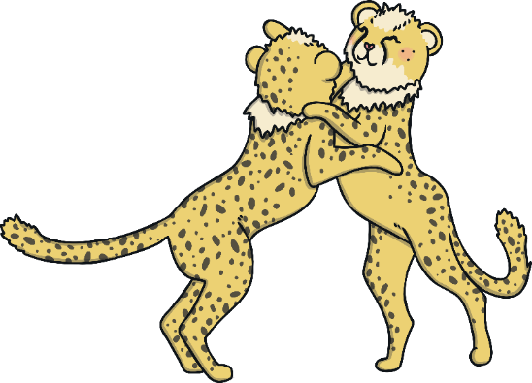
Chase the Cheetah
Flo felt much better when she had told the teacher what had been happening.
That day, Flo played with Chase instead of the other cubs. Flo found that Chase had great ideas for games to play in the jungle and they both had lots of fun.
Flo and Chase became good friends and played together often. After a while, the other cheetahs joined in with their games and they all had fun together.
How do you think Chase feels now?

Slide 23
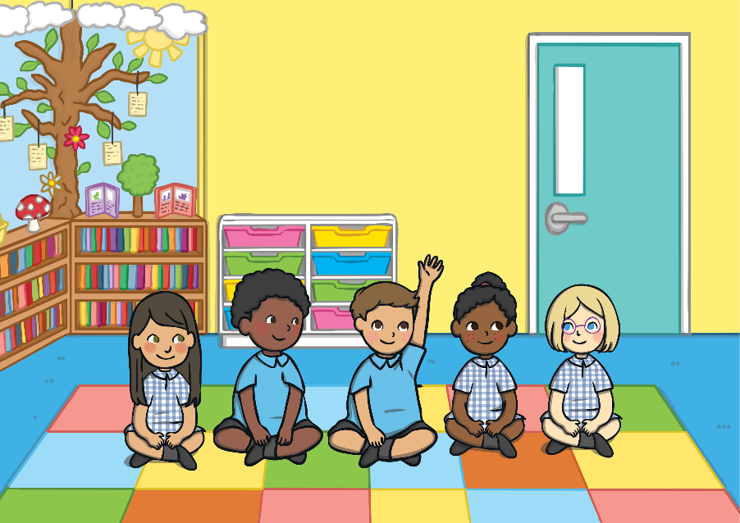
Chase the Cheetah
What can we do if we see someone being teased or bullied, or if it happens to us?
Slide 25
Consolidating
Reflecting

Slide 24


Consolidating

Slide 25


What Can We Do?
Bullying is never OK.
We can make a difference. We can help to stop bullying.
Show your ideas on the activity sheet.

Slide 26

Reflecting

Slide 27
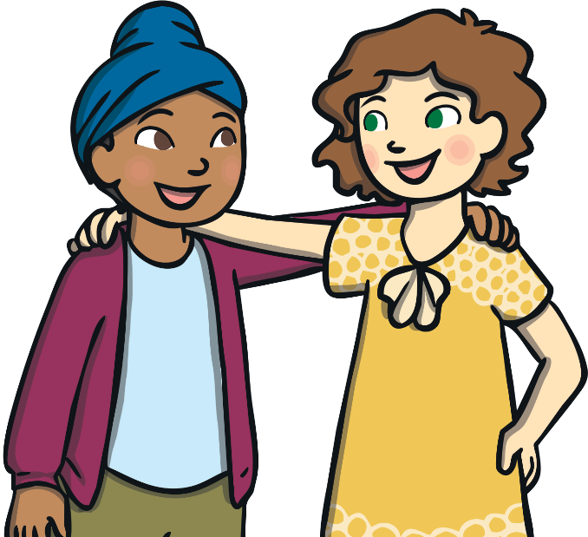
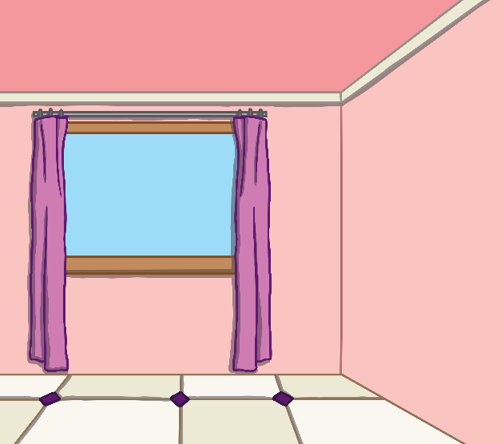
Helping Hands
It’s good to have a joke and a laugh with a friend. This is
how we have fun!
If you are joking around and your friend becomes upset, cross or worried, this means the joke needs to stop.
Everybody accidentally says or does things to upset someone else from time to time – that’s OK! Just say sorry and try
to make the person
feel better.

Slide 28


Helping Hands
It’s never OK to try to make somebody feel bad because of who they are, what they look like, or what they can or can’t do. Everybody is different, everyone is special and we
all deserve to be treated
with kindness.
It’s never OK to try to make someone feel cross, scared, worried or sad on purpose. This is not kind.
If a person often says or does something on purpose to make someone feel bad, this is bullying. This is never OK.

Slide 29

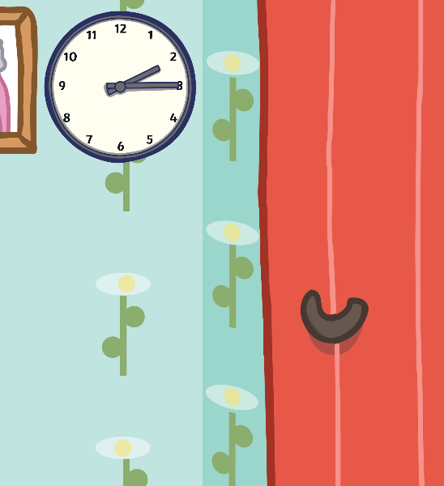
Helping Hands
It is up to all of us to work together to make sure that bullying doesn’t happen, and to help others if we see teasing or bullying behaviour.
We are going to choose volunteers to act out some scenarios.
What could the people in some of the scenarios do differently?
Choose kindness and say no to bullying!
Talk to a trusted adult if you are worried about anything at all.
If you saw one of these scenarios happening, what could you do
to help?

Slide 30

The Big Questions

Slide 31
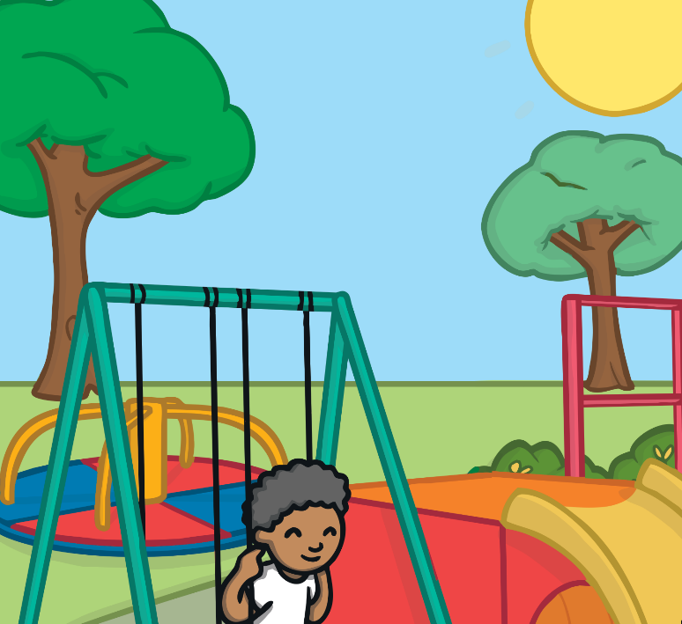

The Big Questions
What do you know now that you didn’t know at the beginning of the lesson?
What can we do if we see someone being teased or bullied, or if it happens to us?
What types of unkind behaviour are there?

Slide 32
Aim
I can talk about unkind behaviour like teasing and bullying.
Success Criteria
I can say if behaviour is joking, teasing or bullying.
I can describe what to do if I see teasing or bulling.

