Slide 1
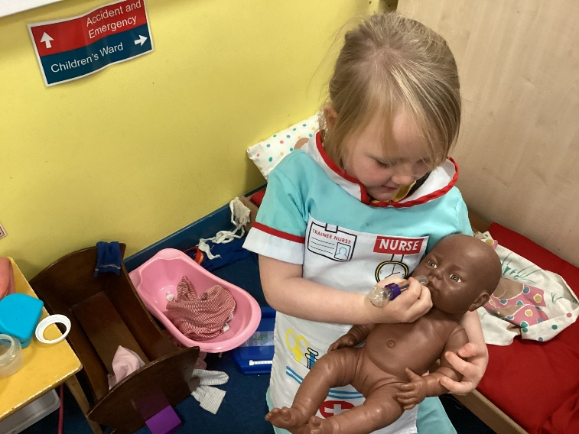
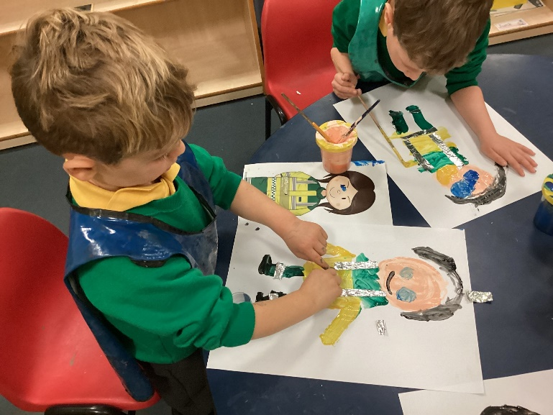
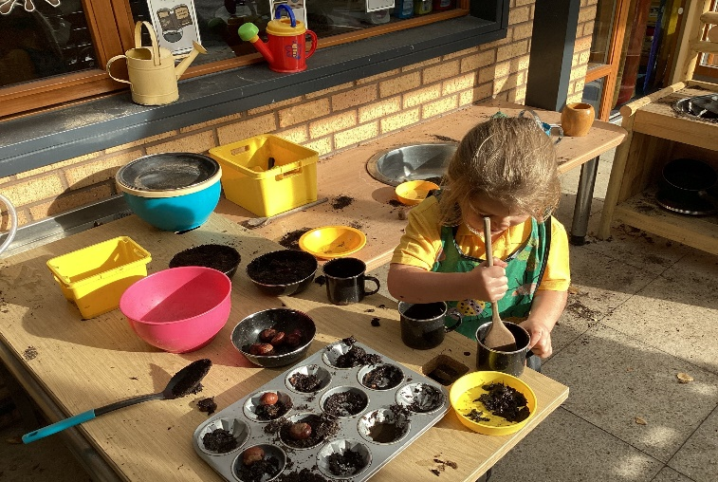
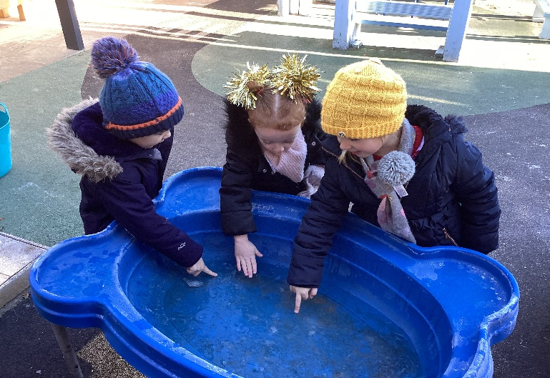
Welcome to Reception
‘This is an outstanding school’
‘The outstanding EYFS provides an excellent start to the children’s education’
‘There is exceptional teamwork with all staff working very closely to meet the needs of the children. This is also apparent in the outstanding level of care that ensures that children are not only safe but feel highly valued’

Slide 2
The Reception Team
Mrs Webb: Headteacher
Miss Berry: EYFS Team Leader/DHT/SENDCo
Mrs Parker: Class RP
Mrs Bell: Class RB
Miss Goldsmith: Nursery Nurse
Mrs Hesmondhalgh: Nursery Nurse
Mrs Jamieson: Class RB & RP

Slide 3
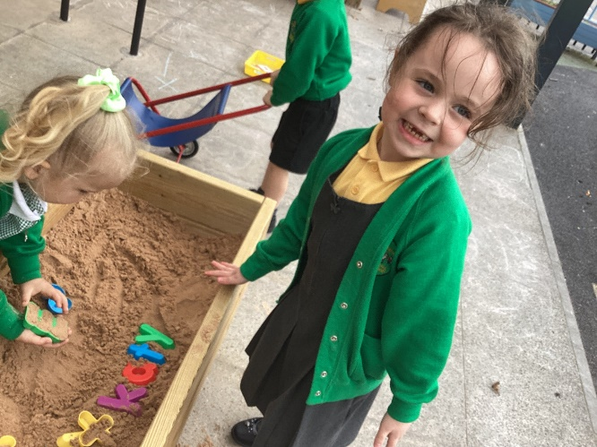
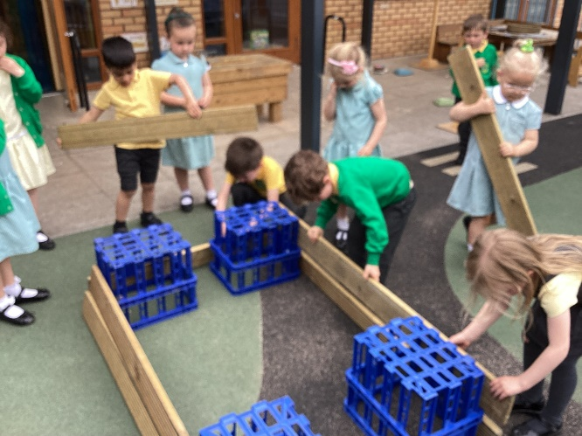
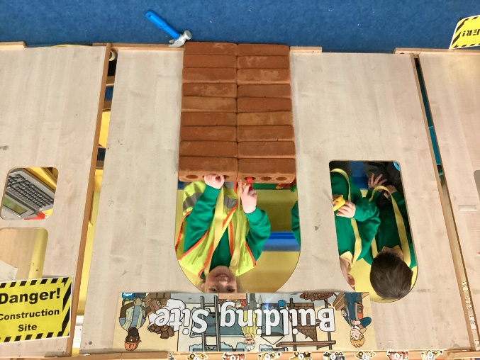
Induction Timetable
Each child is allocated an Induction Group (A, B or C).
Non pre-school children start first, in age order, followed by our pre-school children.

Slide 4
Induction Diary Dates
Reception open day- Wednesday 5th July (see induction pack for time)
Home visits (non pre-school children) - Friday 1st and Monday 4th September
Tuesday 5th September- induction process begins (session until 1:30pm)
Friday 8th September – All children begin full-time sessions
Your child's induction group is in your induction pack.

Slide 5
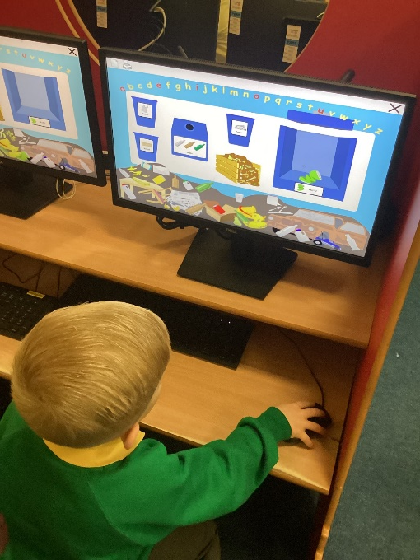
The start and the end of the day
First day arrangements – Reception playground door/gate
will open at 9.30am
Please say your goodbyes on the playground and encourage them into school
End of day – The children exit through the Reception door/gate.
We only hand children over to a named/known adult. If someone different is collecting the child we need permission, unless of emergencies the password can be used.
Waving hands!
Please be on time.

Slide 6
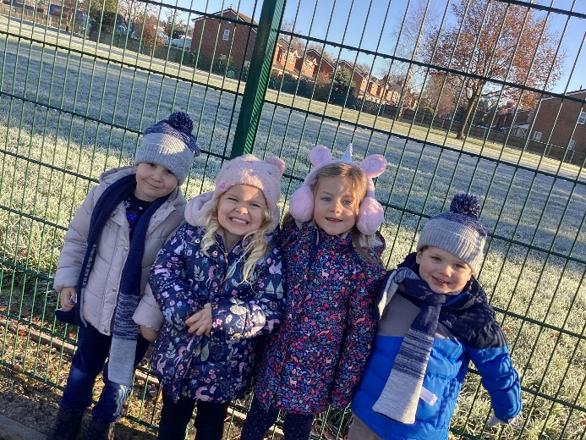
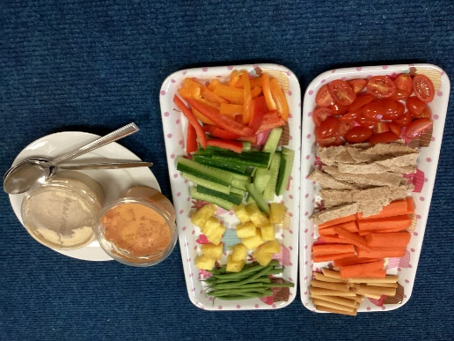
What your child will need to bring to school
A named coat WITH A HOOD that they have practised
putting on and taking off themselves.
An optional healthy snack (fruit/vegetables) for morning break – in a named/ labelled bag/tub.
A bottle of still unflavoured water (not juice) - named with an anti-spill cap.
Reading pack (no backpacks/bags).
A named lunchbox (if not having a school dinner).

Slide 7
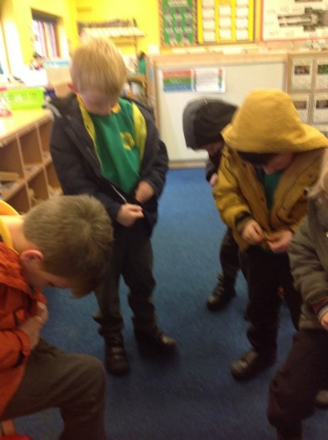

Preparing your child for school
Dressing and undressing themselves
Putting on and taking off their own coat (including fastening)
Velcro shoes - named
Using the toilet independently
Hand washing
Using a hand dryer
Being independent
Sharing and tidying up

Slide 8
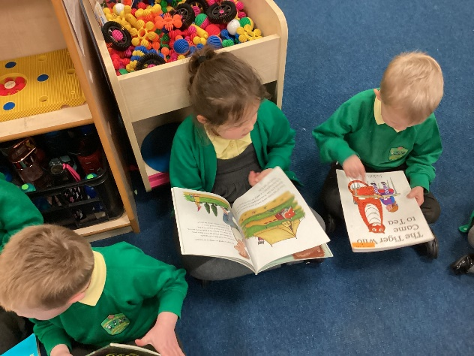
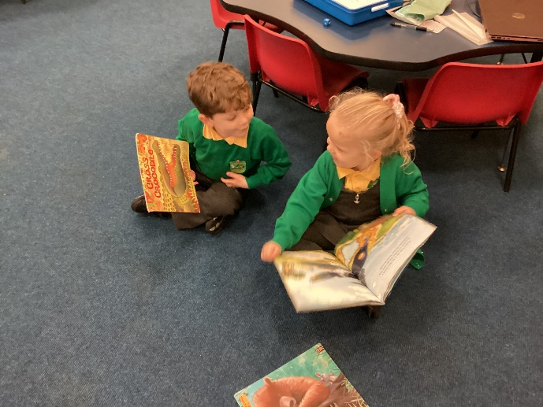
Preparing your child for school - Reading
Reading with your child is so important & can make a huge difference
When children start school, please support
home reading, also listening to your child read
as often as possible (at least 4-5 times a week)

Slide 9
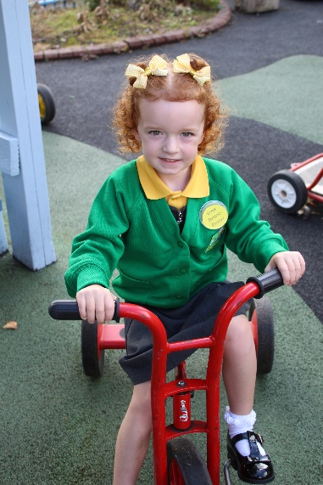
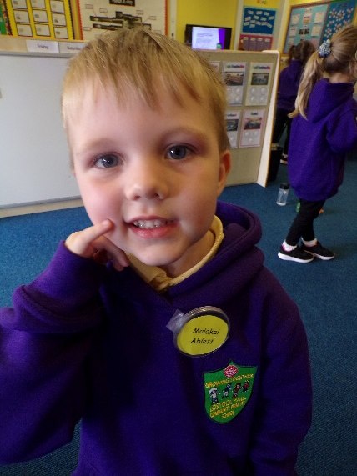
Uniform
All orders need to be submitted online using your online account as soon as possible and at the very latest by Friday 30th June. This information was sent via post. You will be contacted by phone once your order is ready be to collected.
Name ALL uniform and make sure your child knows it belongs to them. Please place name labels in the neck area on jumpers, cardigans, tops and coats.
PE Kit – children will come to school in their PE kit on their PE day (Friday). You will be informed when the PE sessions commence.
Reading packs – will be provided - please check every night. No key rings.

Slide 10
Payments
All payments must be paid online using your online account (uniform, trips etc.)
FREE - We provide healthy snacks each day and provide ingredients for practical, exciting activities, such as baking or special party events.
School dinners are free whilst in EYFS and KS1.
Fundraising events (Comic Relief, etc)- online donation

Slide 11
Free School Meals (FSM) eligibility
Your child may be able to get free school meals if you get any of the following:
Universal Credit with a household income of less than £7,400 a year (after tax and not including any benefits you get)
Income-Based Jobseekers' Allowance
Income-Related Employment and Support Allowance
Child Tax Credit, not entitled to Working Tax Credit and household income less than £16,190
Support under part VI of the Immigration and Asylum Act 1999
Guarantee element of State Pension Credit
Income Support
Working Tax Credit 'run on' – the payment you receive for a further four weeks after you finish work

Slide 12
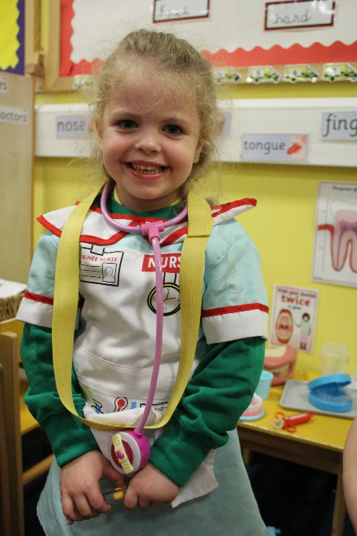
Medical Information
Please ring and leave a message if your child is absent from school.
Sickness and illness: please keep your child off school for 48 hours.
Feeling unwell at school:
- We will air on the side of caution and phone you.
- Contact numbers: ensure they are always up to date.
Inhalers:
- Please complete an asthma form (available on the open day)
- Children need to use their inhaler independently.
Medicine will not be administered.
Headlice: please inform school. An app message will be sent out to the year group.

Slide 13
School Nursing Service
Role:
They support children and young people aged 0-19, carrying out the National Child Measurement Programme and School Health Needs Assessments
Provide advice on health promotion, wellbeing and health issues for children and teenagers.
For further information, please visit the school website – Parents – School Nursing Service
Contact details:
Telephone number: 0300 247 0040
Email: vcl.019.singlepointofaccess2@nhs.net
Website for further info: http://www.lancsyoungpeoplefamilyservice.co.uk/
(This service is open from 9am-5pm, Monday-Friday)

Slide 14
Family Support Worker (FSW)/ Learning Mentor (LM)
Our FSW/ LM: Mrs Jackson
Role:
- Works alongside children and their families to provide support if/ when needed.
- Oversees attendance and punctuality across the school.
Website: Please visit our website (parents> supporting our children & families) for more information: https://www.lostockhallcps.co.uk/supporting-our-children-and-families/

Slide 15
Linden Stay and Play
Times:
Breakfast Club – 7.45am until school begins.
After School Club – end of school day until 5.30pm.
Cost:
Breakfast Club - £4.00
After School Club - £7.50 (£7 for other siblings)
Holiday Club:
Times - 8am until 5pm
Full Day - £18
Half day - £10
Email Mrs Lang for further details/ to book a place: ascc@lostockhallcps.co.uk
Times are based on current data & may be subject to change

Slide 16
PTFA
We have a very friendly, committed and dedicated PTFA (Parents, Teachers and Friends Association).
They organise regular fundraising events to support out school community
For more information about our PTFA or to sign up, please click this link: https://www.lostockhallcps.co.uk/ptfa/

Slide 17
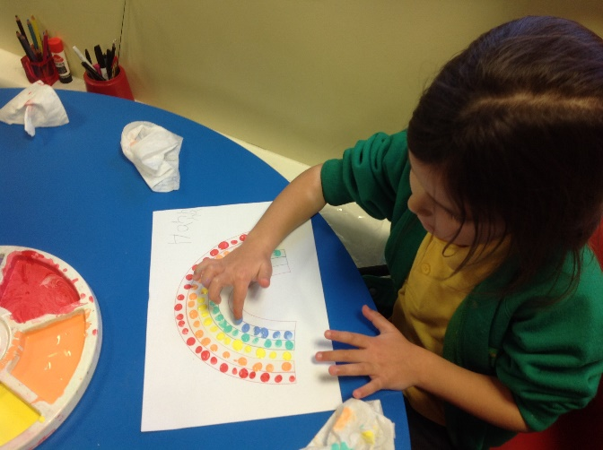
Finally…
We look forward to seeing you and your child at our open day on Wednesday 5th July 2023 at your given appointment time.
We will be holding our ‘EYFS Curriculum meeting’ on Tuesday 12th September 2023 @ 5pm.
Please ensure you download our ‘SchoolApp’: Download the ‘SchoolApp’> type in ‘Lostock Hall Community School Primary School’
Please check the website for relevant information/ photographs and a copy of this PowerPoint: Parents> Reception intake-September 23 (in September this will change to the Reception Blog – please check weekly)

Slide 18
Questions….

